Slide 1
Commercial Determinants of Health: overview
What are the Commercial Determinants of Health?
What are their effects on health & health inequalities?
How do they operate?
Acknowledgements:
Acknowledgements for this slide-set specifically: BiteBack, The Food Foundation, NCD Alliance, Anna Gilmore, Jeff Collin.
Thanks to colleagues who shared ideas, experience and materials: Simone Arratoonian, Greg Fell, Tim Howells, Kylie Murrell, Amanda Pickard
These materials were developed as a set by: Anna Brook with Katherine Körner, May van Schalkwyk & Mark Petticrew
With contributions from our action research partners including: Amy Barnes, Samuel Bostock, Emma Gibson, Susan Hampshaw, Tim Howells, Greg Stenson, Caroline Temperton, Maddy Ardern, Megan Doran, Stefanie Gissing, Matt Greensmith, Jo James, Edward O’Malley, Katie Powell, Emily Reed and Vicky Smyth.
We acknowledge and appreciate the evidence developed by the many dedicated researchers whose work is cited and used throughout, the experience, tools, frameworks and case studies shared by practitioners and advocates, and the helpful feedback from our action research participants which also helped to shape these materials.
This document is part of CDoH Essentials (2024) Brook et al
Notes:
Acknowledgements
These materials were developed as a set by: Anna Brook with Katherine Körner, May van Schalkwyk & Mark Petticrew
With contributions from our action research partners including: Amy Barnes, Samuel Bostock, Emma Gibson, Susan Hampshaw, Tim Howells, Greg Stenson, Caroline Temperton, Maddy Ardern, Megan Doran, Stefanie Gissing, Matt Greensmith, Jo James, Edward O’Malley, Katie Powell, Emily Reed and Vicky Smyth.
We acknowledge and appreciate the evidence developed by the many dedicated researchers whose work is cited and used throughout, the experience, tools, frameworks and case studies shared by practitioners and advocates, and the helpful feedback from our action research participants which also helped to shape these materials.
To colleagues who shared ideas, experience and materials Simone Arratoonian, Greg Fell, Tim Howells, Kylie Murrell, Amanda Pickard
And to the researchers and organisations who have kindly agreed for their evidence to be included, especially for this section of materials: BiteBack, The Food Foundation, NCD Alliance, Anna Gilmore, Jeff Collin but please see acknowledgements on each slide and in the notes.

Slide 2
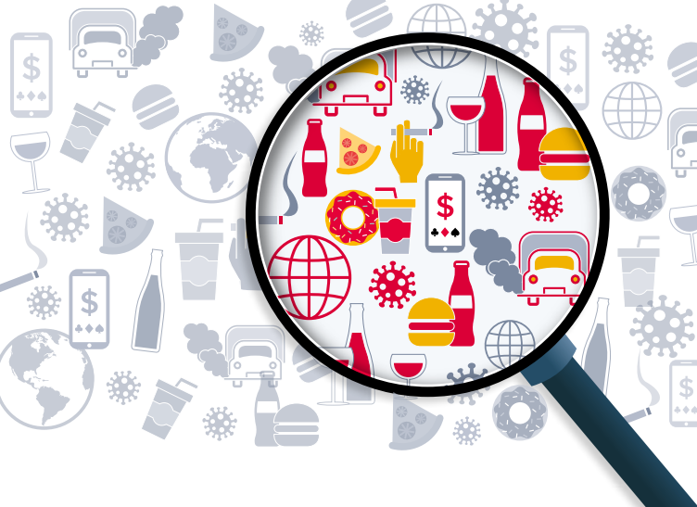
Definitions
‘Commercial determinants of health (CDoH) are the private sector activities impacting public health, either positively or negatively, and the enabling political economic systems and norms.’ (WHO)
The Lancet series proposes ‘a broad definition of the commercial determinants of health as: the systems, practices, and pathways through which commercial actors drive health and equity.’
Image credit: Mar Nieto,
from Collin J; Ralston R; Hill SE, Westerman L (2020) Signalling Virtue, Promoting Harm: Unhealthy commodity industries and COVID-19. NCD Alliance, SPECTRUM
This document is part of CDoH Essentials (2024) Brook et al
Notes:
Many definitions. Both of these recognise 3 key points:
the positive and negative impacts
that there are a range of ways in which these impacts happen and
the fact that organisations & individuals don’t act in isolation, this is also about a wider system that can enable health benefits or health harms.
We will be focusing today on the harms because that’s where there has been a lack of focus and where the effects on health are not being sufficiently addressed, but we do of course recognise that there are benefits to health from business. Important to flag this up front so people understand the focus of the workshop.
References:
WHO website overview of CDoH, May 2023: https://www.who.int/health-topics/commercial-determinants-of-health#tab=tab_1
Lancet, Gilmore et al 2023, Defining and conceptualising the commercial determinants of health: https://www.thelancet.com/journals/lancet/article/PIIS0140-6736(23)00013-2/fulltext
Additional extract from Lancet series:
Although commercial entities can contribute positively to health and society there is growing evidence that the products and practices of some commercial actors—notably the largest transnational corporations—are responsible for escalating rates of avoidable ill health, planetary damage, and social and health inequity; these problems are increasingly referred to as the commercial determinants of health.

Slide 3
Why is this important?
Much of this is preventable
People are dying too young
Early deaths and ill-health
Inequalities
Spending too much of their lives in ill-health
Inequalities are substantial
This document is part of CDoH Essentials (2024) Brook et al
Notes:
Why is this important?:
1. People are dying before their time
Around 1 in 5 (22.8%) deaths in Great Britain were considered avoidable in 2020, that is, preventable or treatable in those aged under 75 (ONS). Although this is statistically significantly higher than previous years (and 1st year that Covid was included), since 2011, this figure has been between 1 in 5 and 1 in 4 (22-24%) for the UK.
2. People are spending many years in ill-health
‘Healthy life expectancy at birth in England in 2015–17 was 63.4 years for males and 63.8 years for females, meaning that more than one-fifth of life will likely be spent in ill health.’
‘Healthy life expectancy at birth in the UK showed no significant change between 2015 to 2017 and 2018 to 2020 and disability-free life expectancy at birth in the UK decreased significantly for both males and females between 2015 to 2017 and 2018 to 2020’
3. Inequalities are substantial
With those living in more deprived areas also living shorter lives, this means that they spend a smaller proportion of their lives in good health. (ONS)
‘In England, there are health inequalities between ethnic minority and white groups, and between different ethnic minority groups. The picture is complex, both between different ethnic groups and across different conditions, and understanding is limited by a lack of good quality data.’ (King’s Fund)
4. We know much of this is preventable: will come on later to talk about causes and solutions. But the key thing is we know we can do something to prevent and reduce harm and inequality in our communities. The most common non-communicable diseases are strongly influenced by unhealthy commodities and their industries and strongly socially patterned – and we know particularly from experience with the Tobacco Industry what works and what is needed to improve health and increase equity. [if possible, add in local success story]
CHOICE about whether to use next 3 slides with data, or adapt to show local data, or just give brief overview with this slide
References
‘In 2020, 22.8% of total deaths in Great Britain were considered avoidable (153,008 deaths out of 672,015) and the avoidable mortality rate was statistically significantly higher than all years since 2010’
https://www.ons.gov.uk/peoplepopulationandcommunity/healthandsocialcare/causesofdeath/bulletins/avoidablemortalityinenglandandwales/2020
‘Healthy life expectancy at birth in England in 2015–17 was 63.4 years for males and 63.8 years for females, meaning that more than one-fifth of life will likely be spent in ill health.’ https://www.health.org.uk/sites/default/files/2020-03/Health%20Equity%20in%20England_The%20Marmot%20Review%2010%20Years%20On_executive%20summary_web.pdf
‘Healthy life expectancy at birth in the UK showed no significant change between 2015 to 2017 and 2018 to 2020 and disability-free life expectancy at birth in the UK decreased significantly for both males and females between 2015 to 2017 and 2018 to 2020’
https://www.ons.gov.uk/peoplepopulationandcommunity/healthandsocialcare/healthandlifeexpectancies/bulletins/healthstatelifeexpectanciesuk/2018to2020
Reference for preventable: as above re avoidable mortality, see slides 8/9/10/11 for causes references.

Slide 4
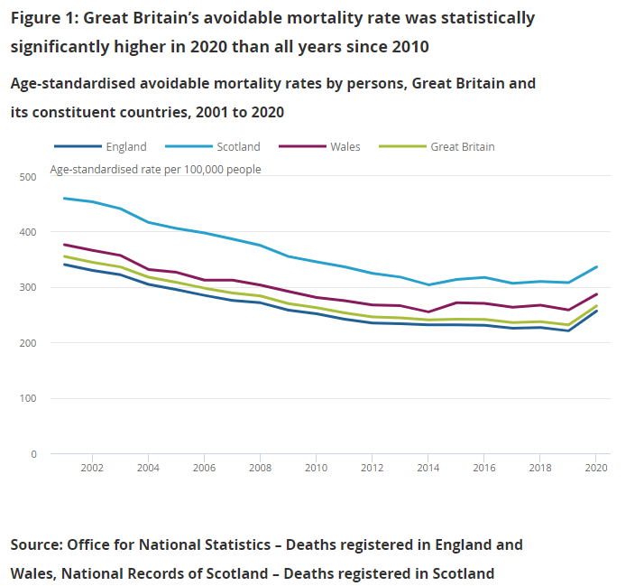
‘In 2020, 22.8% of all deaths in Great Britain were considered avoidable’ (ONS)
This document is part of CDoH Essentials (2024) Brook et al
Notes:
Why is this important?:
People are dying before their time
People are spending many years in ill-health
Inequalities are substantial
‘In 2020, 22.8% of total deaths in Great Britain were considered avoidable (153,008 deaths out of 672,015) and the avoidable mortality rate was statistically significantly higher than all years since 2010’
https://www.ons.gov.uk/peoplepopulationandcommunity/healthandsocialcare/causesofdeath/bulletins/avoidablemortalityinenglandandwales/2020
‘Since 2011 improvements in life expectancy in the UK have stalled, and for certain groups of the population, gone into reverse…a rising number of avoidable deaths among the under 50s
https://www.health.org.uk/publications/reports/mortality-and-life-expectancy-trends-in-the-uk

Slide 5
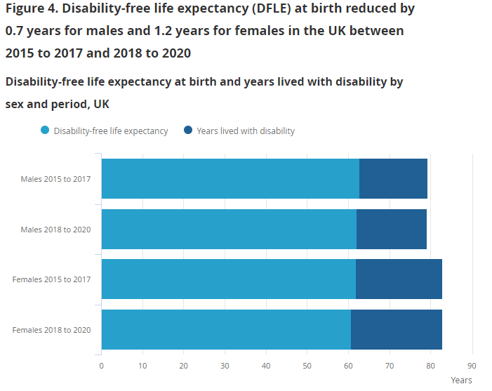
‘Healthy life expectancy at birth in the UK showed no significant change between 2015 to 2017 and 2018 to 2020 and disability-free life expectancy at birth in the UK decreased significantly for both males and females between 2015 to 2017 and 2018 to 2020’ (ONS)
This document is part of CDoH Essentials (2024) Brook et al
Notes:
Why is this important?:
People are dying before their time
People are spending many years in ill-health
Inequalities are substantial
Too many people are struggling with poor health years before they should
‘Healthy life expectancy at birth in England in 2015–17 was 63.4 years for males and 63.8 years for females, meaning that more than one-fifth of life will likely be spent in ill health.’ https://www.health.org.uk/sites/default/files/2020-03/Health%20Equity%20in%20England_The%20Marmot%20Review%2010%20Years%20On_executive%20summary_web.pdf
‘Healthy life expectancy at birth in the UK showed no significant change between 2015 to 2017 and 2018 to 2020 and disability-free life expectancy at birth in the UK decreased significantly for both males and females between 2015 to 2017 and 2018 to 2020’
https://www.ons.gov.uk/peoplepopulationandcommunity/healthandsocialcare/healthandlifeexpectancies/bulletins/healthstatelifeexpectanciesuk/2018to2020
In 2018 to 2020, male healthy life expectancy (HLE) at birth in the most deprived areas was 52.3 years, compared with 70.5 years in the least deprived areas.
Female HLE at birth in the most deprived areas was 51.9 years, almost 20 years fewer than those living in the least deprived areas (70.7 years).
The years lived in poorer states of health were associated with the level of deprivation exposure for males and females. Years spent in poorer health states decreased progressively from the most deprived areas in Decile 1 (21.2 years for males, 26.4 years for females), to the least deprived areas in Decile 10 (12.7 years for males, 15.6 years for females). With those living in more deprived areas also living shorter lives, this means that they spend a smaller proportion of their lives in good health.

Slide 6
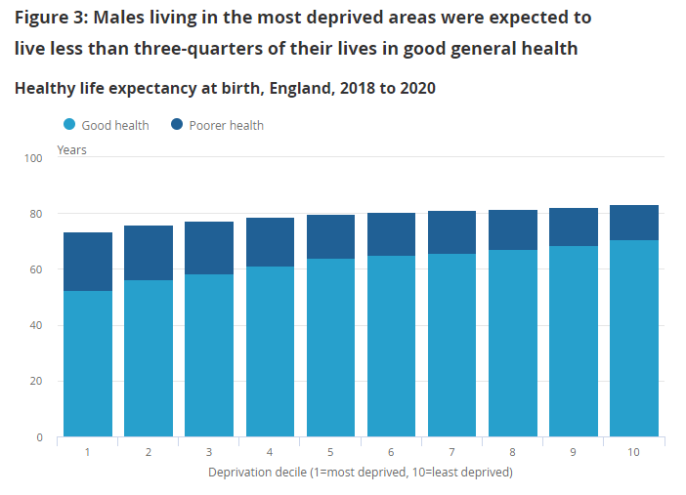
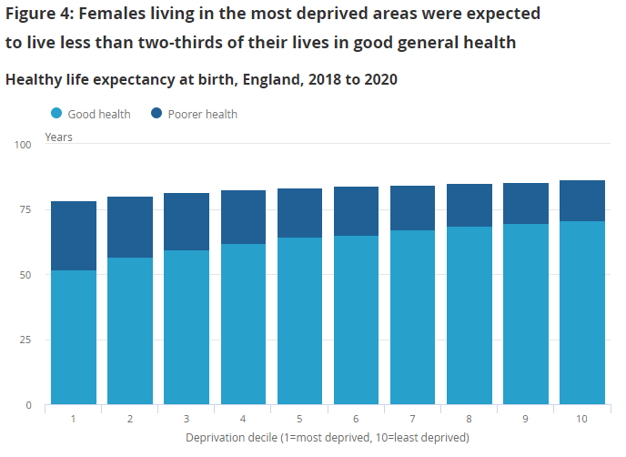
With those living in more deprived areas also living shorter lives, this means that they spend a smaller proportion of their lives in good health. (ONS)
‘In England, there are health inequalities between ethnic minority and white groups, and between different ethnic minority groups. The picture is complex, both between different ethnic groups and across different conditions, and understanding is limited by a lack of good quality data.’ (King’s Fund)
Source: Office for National Statistics – Annual Population Survey, 2011 Census
Notes:
Why is this important?:
People are dying before their time
People are spending many years in ill-health
Inequalities are substantial
‘Someone younger than age 75 in the poorest tenth of the country is around three times more likely to die in the next year than someone of the same age living in the richest tenth.’ https://www.health.org.uk/news-and-comment/charts-and-infographics/deprivation-and-excess-deaths
‘On average, healthy life expectancy at birth differs by 12 years between the most and least deprived local authorities for men and women.’
‘People in more deprived areas spend more of their shorter lives in ill-health than those in less deprived areas.’
https://www.health.org.uk/sites/default/files/2020-03/Health%20Equity%20in%20England_The%20Marmot%20Review%2010%20Years%20On_executive%20summary_web.pdf
‘In England, there are health inequalities between ethnic minority and white groups, and between different ethnic minority groups. The picture is complex, both between different ethnic groups and across different conditions, and understanding is limited by a lack of good quality data.’ For specific facts and figures see: https://www.kingsfund.org.uk/publications/health-people-ethnic-minority-groups-england
In 2018 to 2020, male healthy life expectancy (HLE) at birth in the most deprived areas was 52.3 years, compared with 70.5 years in the least deprived areas.
Female HLE at birth in the most deprived areas was 51.9 years, almost 20 years fewer than those living in the least deprived areas (70.7 years).
The years lived in poorer states of health were associated with the level of deprivation exposure for males and females. Years spent in poorer health states decreased progressively from the most deprived areas in Decile 1 (21.2 years for males, 26.4 years for females), to the least deprived areas in Decile 10 (12.7 years for males, 15.6 years for females). With those living in more deprived areas also living shorter lives, this means that they spend a smaller proportion of their lives in good health.

Slide 7
What is causing this?
Non-communicable diseases = main cause of death and poor health
Estimates suggest commercial determinants contribute substantially to deaths and premature deaths
We know the main building blocks for good health
Early deaths and ill-health
Inequalities
This document is part of CDoH Essentials (2024) Brook et al
Notes:
And key causes:
Non-communicable diseases (mainly cancer, cardiovascular disease, chronic respiratory diseases, and diabetes) are the main cause of death and poor health globally and in the UK
In 2019, 88.8% of deaths in England were attributable to NCDs. They are also a major factor in understanding the inequalities gap in life expectancy.
Estimates suggest commercial determinants contribute substantially to deaths and premature deaths
Exposure to health-harming products (such as tobacco, alcohol, high fat, salt and sugar foods, gambling products, fossil fuels) can cause and contribute to non-communicable diseases, which are shortening people’s lives and causing years of poor-health
Initial estimates suggest commercial determinants contribute to at least one third and probably more than 58% of all deaths and 41% and probably more than 78% of deaths from NCDs (non-communicable disease) globally.
We know the main building blocks for good health
We already think about the wider determinants of health in our work, things like good jobs, housing and food are well understood as important building blocks for good health (over half of health socially determined)
Many of these have commercial determinants aspects to them – for example, when we are surrounded with fast-food outlets and advertising for unhealthy foods and healthy options are limited and expensive, it is much harder to eat well. People are not protected from exposure to these harms where they live, and work, and online. We need to address this to help us improve and protect the health of our residents.
AGAIN, CHOICE about whether to use next 3 slides with data, or adapt to estimate with local data, or just give brief overview with this slide
References
NCDs are a significant cause of death, playing a large role in the burden of mortality across the population. In 2019, 88.8% of deaths in England were attributable to NCDs
https://www.gov.uk/government/publications/nhs-health-check-programme-review/annex-c-data-on-the-distribution-determinants-and-burden-of-non-communicable-diseases-in-england
‘NCDs (noncommunicable diseases) are the number 1 cause of death and disability worldwide, accounting for 74% of all deaths and more than three out of four years lived with a disability.’
https://ncdalliance.org/why-ncds/NCDs
‘Each year, more than 15 million people die from a NCD between the ages of 30 and 69 years; 85% of these "premature" deaths occur in low- and middle-income countries. Cardiovascular diseases account for most NCD deaths, or 17.9 million people annually, followed by cancers (9.3 million), respiratory diseases (4.1 million), and diabetes (1.5 million). These four groups of diseases account for over 80% of all premature NCD deaths.’
https://www.who.int/data/gho/data/themes/topics/topic-details/GHO/ncd-mortality
Initial estimates suggest commercial determinants contribute to at least one third and probably more than 58% of all deaths and 41% and probably more than 78% of deaths from NCDs (non-communicable disease) globally
https://www.thelancet.com/journals/lancet/article/PIIS0140-6736(23)00013-2/fulltext
Studies suggest that the social determinants of health account for between 30-55% of health outcomes (https://www.who.int/health-topics/social-determinants-of-health#tab=tab_1). Several studies attempt to estimate how the broader determinants of health impact on our health. All put it higher than healthcare
https://www.kingsfund.org.uk/projects/time-think-differently/trends-broader-determinants-health

Slide 8
Image from the NCD Alliance https://ncdalliance.org/why-ncds
This document is part of CDoH Essentials (2024) Brook et al
Notes:
And key causes:
Non-communicable diseases (mainly cancer, cardiovascular disease, chronic respiratory diseases, and diabetes) are the main cause of death and poor health globally and in the UK
Between 30-55% of health outcomes from social determinants
Initial estimates suggest commercial determinants contribute to at least a third and probably more than 58% of all deaths and at least 41% and probably more than 78% of deaths from non-communicable disease globally
The factors behind these non-communicable diseases, which are shortening people’s lives and causing years of poor-health, include tobacco, alcohol, unhealthy foods
NCDs are a significant cause of death, playing a large role in the burden of mortality across the population. In 2019, 88.8% of deaths in England were attributable to NCDs
https://www.gov.uk/government/publications/nhs-health-check-programme-review/annex-c-data-on-the-distribution-determinants-and-burden-of-non-communicable-diseases-in-england See figure 1 for a break down of the conditions shortening people’s lives. Figure 1 illustrates the contribution to the difference in life expectancy between the most deprived (decile 1) and least deprived (decile 10) by the cause of death in England between 2014-16.
‘NCDs (noncommunicable diseases) are the number 1 cause of death and disability worldwide, accounting for 74% of all deaths and more than three out of four years lived with a disability.’
https://ncdalliance.org/why-ncds/NCDs
‘Noncommunicable diseases (NCDs) kill 41 million people each year, equivalent to 71% of all deaths globally...Each year, more than 15 million people die from a NCD between the ages of 30 and 69 years; 85% of these "premature" deaths occur in low- and middle-income countries. Cardiovascular diseases account for most NCD deaths, or 17.9 million people annually, followed by cancers (9.3 million), respiratory diseases (4.1 million), and diabetes (1.5 million). These four groups of diseases account for over 80% of all premature NCD deaths.’
https://www.who.int/data/gho/data/themes/topics/topic-details/GHO/ncd-mortality

Slide 9
Estimated contribution of commercial determinants globally
At least one third and probably more than 58% of all deaths globally
At least 41% and probably more than 78% of deaths
from non-communicable disease
Reference for data: Lancet Commission Gilmore et al 2023
This document is part of CDoH Essentials (2024) Brook et al
Notes:
And key causes:
Non-communicable diseases (mainly cancer, cardiovascular disease, chronic respiratory diseases, and diabetes) are the main cause of death and poor health globally and in the UK
We know the main building blocks for good health
Initial estimates suggest commercial determinants contribute to at least one third and probably more than 58% of all deaths and 41% and probably more than 78% of deaths from non-communicable disease globally
The 2019 Global Burden of Disease study estimates that just four commercial products (tobacco, alcohol, ultra-processed food, and fossil fuels) make up 34% of all deaths or 41% deaths from non-communicable diseases.
They also provide a very conservative estimate that commercial practices bringing the totals to 36% of total or 45% of deaths from non-communicable diseases.
These are likely to be underestimates, the Lancet series suggests for example deaths from unhealthy diets as a whole (rather than just ultra-processed foods) reach an estimated 11 million deaths, air pollution from fossil fuels over 10 million, and alcohol 3 million, added to the estimated 9 million deaths from tobacco, the total reaches 58% of all deaths and 78% of deaths from non-communicable disease
Panel 2: Estimates of the harm from commercial products and practices (extract from Lancet, Gilmore et al 2023)
It is challenging to estimate the exact effect commercial sector products and practices have on health due to the scarcity of comprehensive data and specific studies on this topic. The 2019 Global Burden of Disease (GBD) study (appendix pp 2, 4) estimates that just four commercial products (tobacco, alcohol, ultra-processed food, and fossil fuels) account for 19 million global deaths annually (34% of the 56 million total deaths or 41% of the 42 million NCD deaths). They also provide a very conservative estimate that commercial practices cause over 1·2 million deaths globally, bringing the total annual deaths to 20·3 million (36% of total or 45% of deaths from non-communicable diseases). These numbers are likely to be significant underestimates as they take no account of numerous other products (eg, lead or prescribed opioids) or practices (eg, dumping of toxic substances in water courses). Moreover, other data, including specific GBD studies, suggest a higher toll from some products (appendix pp 2, 3). For example, deaths from unhealthy diets as a whole (rather than just ultra-processed foods) reach an estimated 11 million deaths, air pollution from fossil fuels over 10 million, and alcohol 3 million. If we add these to the GBD estimate of 9 million deaths from tobacco, the total reaches 33 million annual deaths (58% of all deaths and 78% of deaths from non-communicable disease globally; appendix pp 2–4).
https://www.thelancet.com/journals/lancet/article/PIIS0140-6736(23)00013-2/fulltext

Slide 10
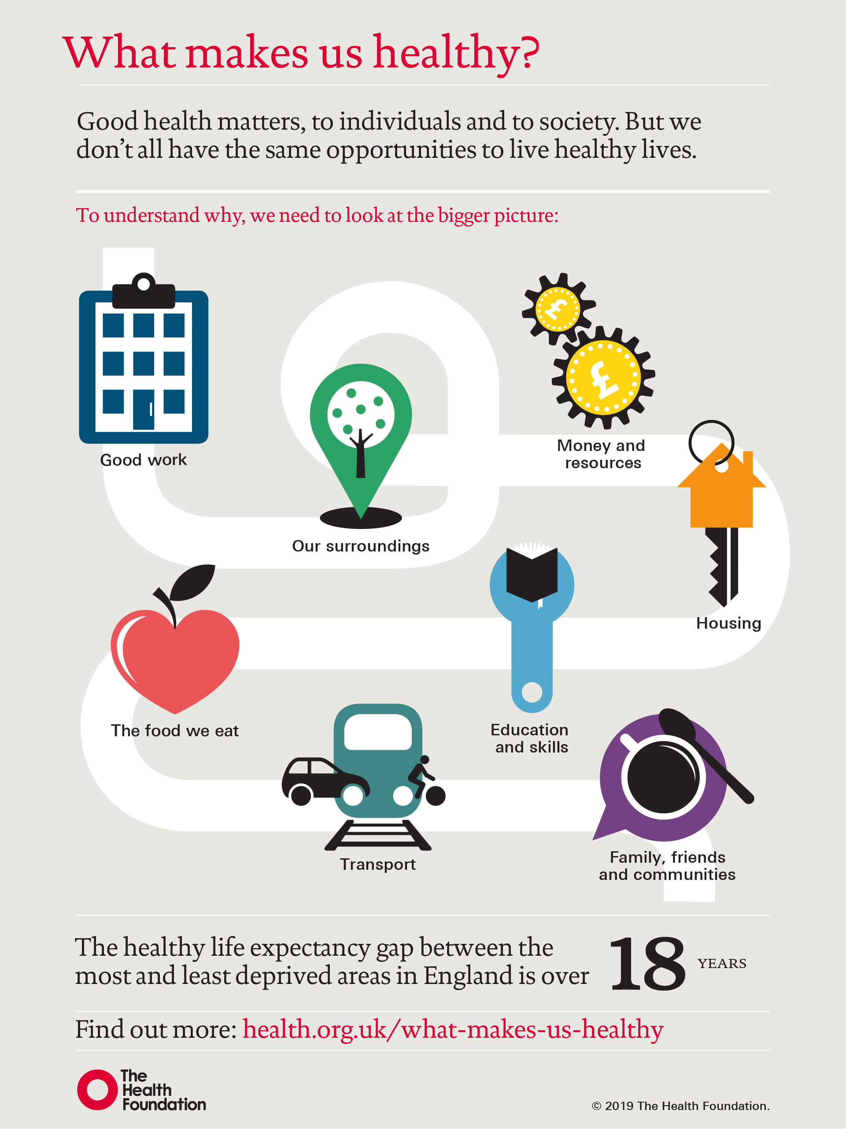
We know the main building blocks for good health
https://www.health.org.uk/infographic-what-makes-us-healthy
Notes:
And key causes:
Non-communicable diseases (mainly cancer, cardiovascular disease, chronic respiratory diseases, and diabetes) are the main cause of death and poor health globally and in the UK
We know the main building blocks for good health
Initial estimates suggest commercial determinants contribute to at least a third and probably more than 58% of all deaths and at least 41% and probably more than 78% of deaths from non-communicable disease globally
Determinants of health
We already think about the wider determinants of health in our work, things like good jobs, housing and air quality are well understood as important building blocks for good health
Many of these have commercial determinants aspects to them – for example, when we are surrounded with fast-food outlets and advertising for unhealthy foods and healthy options are limited and expensive, it is much harder to eat well. People are not protected from exposure to these harms where they live, and work, and online.
Studies suggest that the social determinants of health account for between 30-55% of health outcomes (https://www.who.int/health-topics/social-determinants-of-health#tab=tab_1).
Several studies attempt to estimate how the broader determinants of health impact on our health. All put it higher than healthcare
https://www.kingsfund.org.uk/projects/time-think-differently/trends-broader-determinants-health

Slide 11
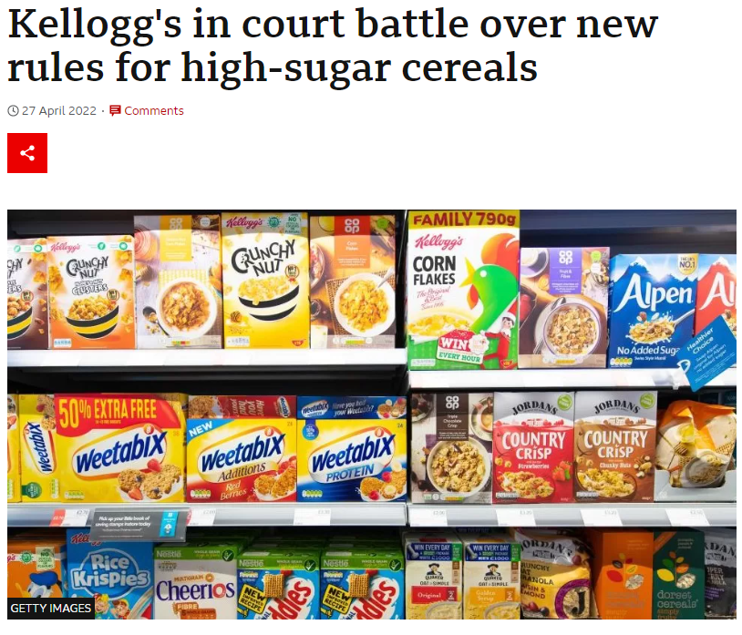
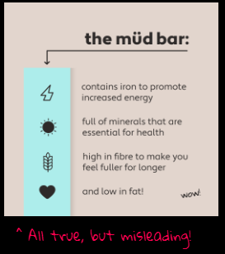
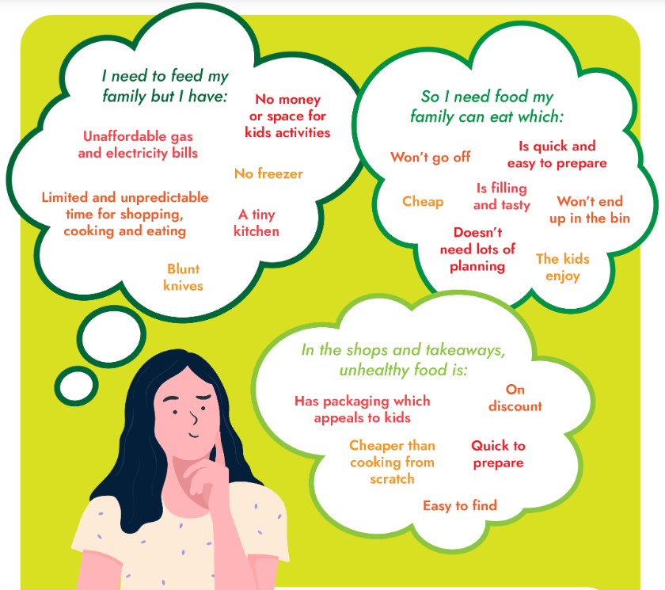
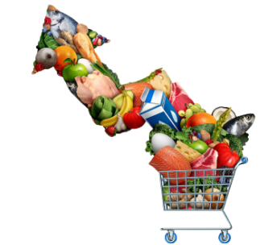
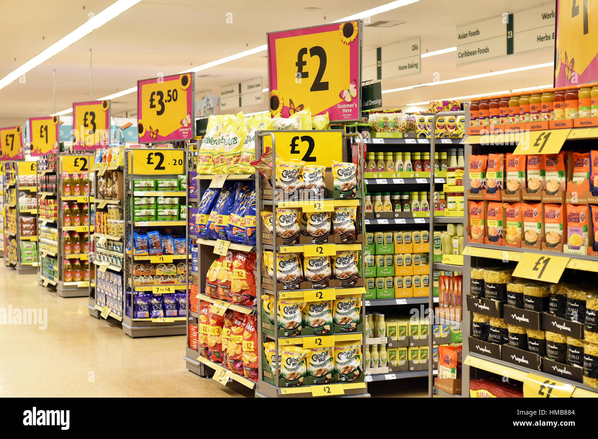
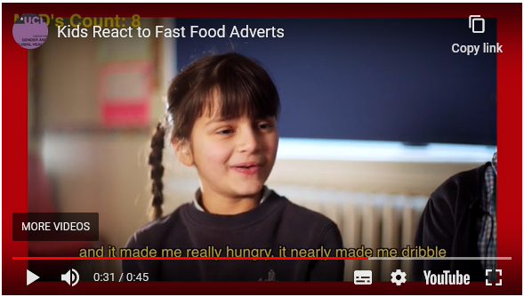
How do Commercial Determinants affect health? – an example
Power & money
What is in food
Regulation & legislation
Advertising
Information about food
What people on social media, tv, films etc eat
Fresh food 1hr+
Trade policies
Special offers & promotions
Pay & conditions for people growing and making food
ideas about ‘normal’ and ‘healthy’ body sizes
How much time and capacity our family has
Taxes on foods
Nearby food options
Definitions of problems – and therefore potential solutions
What our friends and family eat
How much money we have
What we choose to eat affects our health
Image credits: The Food Foundation, Bite Back 2030, Healthy Societies 2030
This document is part of CDoH Essentials (2024) Brook et al
Notes:
DRAFTING notes
The aim of this slide is to situate Commercial Determinants of Health as part of social / wider determinants, addressing the individual vs structural point (and how choices are shaped) with a single example of food environment (could be adapted to choose one that particularly resonates locally) and making the upstream / causes of the causes point, it deliberately starts with a simplistic statement that is gradually covered up by the real picture of what affects our choices
This slide is animated so the images cover each other to demonstrate the bigger set of issues that really affect what we eat and our health rather than the first simple ‘our choice’ statement
Speaking notes / notes for facilitator
In this next couple of slides we’ll try to give more concrete examples of how commercial determinants operate, starting with one example focused on food
We know that food affects our health, but what affects the choices we have about what to eat?
(Click through the animated slide which brings up different structural issues with examples – speaking notes for each section below)
Money
Latest data on national food insecurity levels from The Food Foundation’s Food Insecurity Tracker show that food insecurity has doubled in the last year, with 9.3 million adults (17.7% of households) experiencing food insecurity in January 2023 and one in four households with children (4 million children) experiencing food insecurity in the same month.
Cost of food increasing
Refs: https://foodfoundation.org.uk/initiatives/tackling-cost-food-crisis
Time & capacity
Added to the cost of food, there is also the time & cost of shopping around and preparing food. This image is from the Food Foundation Cost of Living Briefing From purse to plate: implications of the cost of living crisis on health (2023) and reflects ongoing research being undertaken by the Centre for Food Policy (City, University of London) as part of the National Institute for Health and Care Research funded Obesity Policy Research Unit. This research investigates the lived experience of families on low incomes and aims to understand the social, economic and environmental factors that underpin dietary decisions https://foodfoundation.org.uk/sites/default/files/2023-03/TFF_Cost%20of%20living%20briefing.pdf
Nearby food options – what can people get to easily?
Especially in places where healthy affordable food options are not accessible or available (‘food deserts’)
And/or places where unhealthy food options are surrounding us (‘food swamps’)
[potential to add local data indicating % of places to buy food that are fast food in most and least deprived quintiles for eg]
Special offers & promotions
Promotions lead on average to higher consumption (rather than people buying the same and benefitting from the reduced price) especially on things like chocolate
(National Food Strategy quotes PHE data: If you ran a ‘buy one get one free’ on chocolate so someone bought twice the amount of chocolate they normally would, they’ll consume 93% more than normal, and come back to buy chocolate in roughly the same amount of time as they would have normally. If you do the same with sauces, they’ll consume 49% more, and so end up coming back about 1.5x slower than normal.’ https://www.nationalfoodstrategy.org/wp-content/uploads/2021/08/NFS_Evidence-Pack.pdf)
Information about food can be misleading
This is an example of a campaign by youth activist movement Bite Back as part of their ‘Don’t Hide What’s Inside’ campaign they made up an ‘all natural’ product ‘mud’ marketed with true but misleading statements such as ‘full of minerals that are essential to health’ this is part of their campaign to overhaul standards on food labelling
See for the campaign report: https://biteback.contentfiles.net/media/documents/Dont_Hide_Whats_Inside.pdf
See for the campaign
https://www.youtube.com/watch?v=KLHdUIWLKU0
Regulation & legislation
For example affecting what is in food – the national food strategy showed ‘some changes will require legislation to ensure a level playing field. If food companies are to start making their products healthier, they must be confident that the competition won’t simply move in and undercut them.’ https://www.nationalfoodstrategy.org/wp-content/uploads/2021/10/25585_1669_NFS_The_Plan_July21_S12_New-1.pdf
Political environment & unequal power
Although the Kellogg’s argument was overruled, it takes time, energy & money to address these cases and some egs closer to home where legal challenges by industry are overturning local policy (eg a local authority planning policy to restrict hot food takeaways close to schools, was challenged and policy overruled by external Planning Inspector) – again this distracts from other work and risks making other councils cautious about implementing such policies
Advertising
High Fat Salt & Sugar foods are advertised more, National Food Strategy showed just a quarter of advertising in 2019 was for foods not likely to be HFSS. In addition, in 2019, analysis by Nielsen on behalf of Cancer Research UK found almost half (47.58%) of all food ads shown during September 2019 on ITV1, Channel 4, Channel 5 and Sky1 were advertising HFSS products. This proportion rose to nearly 60% of ads in the 6-9pm slot on those channels, up from 49% in May 2018.
Advertising affects us in all sorts of ways, this image is from a film made by children about their own responses to the food they see around them including advertised food, in this clip this young child describes how seeing a fast food advert made her hungry and made her dribble
Definitions of problems and therefore potential solutions
Defining issues mainly as the responsibility of individuals – eg ‘what we choose to eat affects our health’ (the original wording in the green circle)
Rather than a combination of individuals, communities, organisations and the structures we work within (the combination of what we can now see on the screen)
Means the solutions tend also to be focused at the individual scale (providing advice and information about food to people)
Rather than the solutions also covering the environments that affect which choices are available to us or the things that shape the choices we might make
Option to show 2 very short film clips to demonstrate the effects on children
https://www.healthysocieties2030.org/films-archive
AND
https://www.biteback2030.com/news/watch-video-fast-food-industry-dont-want-you-see

Slide 12
How do Commercial Determinants affect health?
Political
Maximising use of harmful products
Financial
Scientific
Affecting underlying drivers and determinants of health
Reputation management
Early deaths and ill-health
Inequalities
Labour & employment
Marketing
Supply chain & waste
Profit prioritised over health and society
Simplified version of image from Gilmore et al 2023: https://www.thelancet.com/journals/lancet/article/PIIS0140-6736(23)00013-2/fulltext
This document is part of CDoH Essentials (2024) Brook et al
Notes:
Main reference: Gilmore et al, Lancet, 2023 https://www.thelancet.com/journals/lancet/article/PIIS0140-6736(23)00013-2/fulltext
We’ll now introduce a framework for how the commercial determinants operate which is a simplified version of one that appeared in a recent Lancet series focused on the CDoH and written by expert academics from across the world. This is to help us understand how these different commercial practices lead to people dying too young and living too much of their lives in poor health.
Commercial Determinants of Health include political, scientific, and marketing practices which mainly cause health harm by maximising the use of potentially harmful products, either directly or by enabling corporations to block, delay, or weaken policy and deter litigation. The use of products is not only personal consumption as in food and alcohol, but also plastic and other fossil fuel based products.
They also include Labour, supply chain, and financial practices which mainly harm health when a narrow focus on profit at any cost fails to consider societal effects. Slave labour working conditions in fashion industry sweatshops, illegal discharges of hazardous substances, and deforestation leading to climate change, biodiversity loss, and infectious diseases are examples of transnational corporations acting against the public interest.
As well as Reputation management which is about efforts to shape legitimacy and credibility, reduce risk, and enhance corporate brand image – these help create systems, norms and values and an environment in which the other practices are enables. Corporations want to present themselves as social responsible and part of the solution not the driver of the problem, thereby arguing that governments do not need to regulate them.
To help think this through, it can be useful to think about corporate strategies as multifaceted and aimed at maximising the interests of the individual corporation or commercial sector often at the expense of public health and the environment.
These practices can be more overt – for example, using sophisticated marketing strategies to influence the environments where we live, work and play and the decisions we make or for example calling for specific policy measures at times of policy debates or changes of government.
But other practices are about creating and maintaining regulatory, social and political environments that are favourable to their commercial interests and involve less obvious and more longer-term strategies that are directed at influencing what research gets done by whom, how and what evidence is used by government for decision-making, building relationships with decisionmakers and reputable partners like charities and research institutions, shaping people’s norms and values (including what children are taught in schools) and influencing public debate through shaping what is reported in the media and undermining independent researchers and other professionals and advocacy groups.
For example, if we think about Tobacco Control
Political (click)
Taxation & price are recognised as a WHO ‘best buy’ in terms of tobacco control
Internal industry documents demonstrate that tobacco companies knew these were an effective way to decrease consumption
Industry groups have lobbied against price increases
(ref: https://tobaccotactics.org/article/price-and-tax/)
It can be harder to spot when industry works through other organisations, for example the WHO report ‘Tobacco Industry Interference with Tobacco Control,’ concluded: “The industry has a long history of using seemingly independent ’front groups’ to advance its case”. Adding that “smokers’ rights associations, … frequently supported by the tobacco industry, have served as front groups in opposition to indoor smoking bans”.
Example of how we can address: take care in how we approach consultation and engagement and put in place policy and processes to manage conflicting interests.
Scientific (click)
By selectively funding research, withholding findings and generating doubt about evidence ‘doubt is our product’ the industry has affected what is accepted as knowledge on which to make policy decisions and also the public support for regulation and other action
(for example ref: Angulo, A. J.. Miseducation .2016. Johns Hopkins University Press.)
For example, tens of thousands of internal industry documents, released through litigation, reveal that the industry knew for decades that its products caused cancer and were highly addictive and yet it refused to acknowledge this publicly
(https://tobaccotactics.org/article/influencing-science/)
Example of how we can address: practice critical thinking and consider carefully how we use evidence – focus on conflicting interests.
Marketing (click)
Advertising but also sponsorship and product placement (eg in tv films, sports)
Examples from Gilmore et al include: the normalisation of youth smoking was facilitated by childfriendly advertising, with Camel cigarettes’ Joe Camel having approximately the same recognition as Mickey Mouse among children.
(ref Proctor R. Golden holocaust: origins of the cigarette catastrophe and the case for abolition. Berkeley, CA: University of California Press, 2011)
There is also evidence that marketing can be targeted at vulnerable groups such as tobacco industry targeting of homeless people via building relationships with homelessness services organisations
(Ref https://tobaccocontrol.bmj.com/content/14/6/409)
Example of how we can address: local advertising & sponsorship policies.
Supply chain and waste (click)
For example using supply chain to externalise responsibility for harms caused during production or costs of dealing with waste - often meaning the public pays for the costs both in terms of lives harmed and also in money paid out to clean up waste
The production of tobacco causes pollution, soil degradation and deforestation, contributing to adverse climate change and biodiversity losses
(ref: WHO Tobacco and its environmental impact: an overview 2017 http://apps.who.int/iris/bitstream/handle/10665/255574/9789241512497-eng.pdf?sequence=1)
British American Tobacco (BAT) acknowledged in their 2019 sustainability report that: “our supply chain (scope 3) emissions represent 90% of our total carbon footprint”. However these supply chain emissions are not included in company targets to reduce emissions.
(ref: https://tobaccotactics.org/article/tobacco-and-the-environment/ reviewing British American Tobacco, Sustainability Strategy Report 2019, BAT website, March 2020, accessed April 2020)
Example of how we can address: policies for required minimums in procurement and improving data for transparency and accountability.
Labour & employment
This includes outsourcing responsibility for costliest aspects of production leading to harmful practices such as modern slavery and informal or zero-hour contracts that offer no stability or security of income.
Child labour has historically been a substantial issue in tobacco growing. Following pressure from the UN’s International Labour Market Organisation, transnational tobacco companies (TTCs) have invested in corporate social responsibility (CSR) initiatives that focus on child labour in tobacco growing. However there are concerns that this is not effective.
For example according to Dr Athena Ramos, from the University of Nebraska Medical Centre, CSR programmes that propose to address child labour “represent more of a public relations strategy that any real meaningful change in practice” and disincentivise external monitoring efforts, especially in low and middle income countries (LMICs).
Refs: https://tobaccotactics.org/article/csr-child-labour/
A legal case is underway brought by human rights lawyers on behalf of hundreds of tenant farmers and their children in Malawi, contends that the company is guilty of “unjust enrichment.” Martyn Day, a senior partner at Leigh Day, the firm bringing the case, told The Guardian that the tenant farmers cultivating tobacco for one of BAT’s main suppliers are paid so little and the work involved is so labour intensive that they are forced to rely on help from their children. BAT attempted to get the High Court to throw out the claim but the High Court has agreed it can be heard. Mr Justice Martin Spencer commented that tobacco companies’ applications to strike out had been “misconceived”.
Ref: https://web.archive.org/web/20200707160830/https:/www.hrw.org/news/2019/12/04/case-against-tobacco-giant-could-protect-children
https://www.leighday.co.uk/news/cases-and-testimonials/cases/british-american-tobacco-and-imperial-brands/
https://www.leighday.co.uk/news/news/2021-news/court-allows-malawian-child-farmer-claims-against-british-american-tobacco-and-imperial-to-proceed/
Example of how we can address: business rates relief for living wage / support for unionisation.
Financial (click)
Example from Gilmore et al: British American Tobacco and Imperial Brands, which over 10 years paid almost no corporation tax in the UK, where they are headquartered, having engaged extensively in all forms of tax avoidance alongside other transnational tobacco companies.
(ref Vermeulen S, Dillen M, Branston JR. Big tobacco, big avoidance. https://www.bath.ac.uk/publications/big-tobacco-big-avoidance/attachments/Big_Tobacco_Big_Avoidance.pdf (accessed Feb 17, 2023).
Example of how we can address: this is mainly support for national policy but for eg Bristol advertising policy excludes companies who avoid paying legal tax – this is partly norm setting.
Reputation management (click)
For example funding youth programmes as a tactic to influence favourably government perspectives of the tobacco industry with the aim of preventing or delaying regulation of the industry
(ref: Landman, A., Ling, P. M., & Glantz, S. A. (2002). Tobacco industry youth smoking prevention programs: Protecting the industry and hurting tobacco control. American Journal of Public Health, 92(6), 917–930 https://ajph.aphapublications.org/doi/full/10.2105/AJPH.92.6.917)
Example of how we can address: locally we can take care re partnerships and consider reputation management as part of risk assessment processes for managing interactions and potentially conflicting interests
All of these operate collectively to affect the underlying drivers (such as power and social norms) and determinants of health (such as political & economic system, regulatory & upstream approaches, public policy such as housing, transport etc, environment, community etc)
For example, by using power to focus more on individual responsibility and less effective ‘downstream’ measures and moving the conversation away from regulation & legislation
Again this can be harder to spot when industry works through other organisations – what is known as ‘Astroturfing’ is the faking of a grassroots movement, when in reality the agenda and strategy is controlled by a hidden company or organisation.
For example In 2010, Alliance of Australian Retailers (AAR) launched a media campaign against Australia’s proposed plain packs law. The AAR claimed to represent “the owners of your local corner stores, milk bars, newsagents and service stations” and wanted to “make the voices of small retailers heard, and to oppose plain packaging until it is overturned”. However, leaked documents revealed that this was not a genuine grassroots campaign – on the contrary, it received millions of dollars of funding from Imperial, BAT and Philip Morris and Philip Morris staff had regular input into its running.
https://tobaccotactics.org/article/astroturfing/
If needed – explanation of primary & secondary prevention plus upstream health creation (from submission to Health & Care Select Committee – Korner & Brook)
Supporting people to quit smoking (known as secondary prevention) is like putting out fires after they have begun to burn – smoking will have already harmed the health of the smoker and their children. Stopping people from starting smoking (“primary prevention”) through actions such as the Khan review’s proposal to increase the legal age of smoking each year is like stopping harmful fires before they can start to burn – it is a cheaper, more effective way to prevent damage before it can even begin. And health creation is like building fire-proof homes -- enabling people to live lives free from the chronic stress and social pressures that drive smoking in the first place.
In this analogy, a prevention agenda that doesn’t include these commercial ‘causes of the causes’ of ill-health may do its best put out the fires or stop them from starting, but neglects to ask who is selling the kindling and who profits from a lack of fire safety regulations.

Slide 13
Cycle of actions favouring commercial profits
1
Use of wealth and power to shape regulations and policies in own interests.
2
Favourable policies lead to increased sales (and consumption) of harmful products
4
Excess profits fuel a growing power imbalance between commercial actors and governments who should hold them to account
3
Externalising the costs of harm caused by production, consumption, and disposal of products
4
Externalised costs largely met by states and populations affected, reducing resources
https://www.thelancet.com/infographics-do/commercial-determinants-health-2023
This document is part of CDoH Essentials (2024) Brook et al
Notes:
Rebalancing global power asymmetries to substantially improve human and planetary health – this is a slightly simplified version of the infographic from the Lancet series on the CDoH
A cycle of behaviour by commercial actors and policy makers has insidiously tipped the balance of power increasingly in favour of commercial profits over several decades, which has perpetuated poor health outcomes and inequities.
Use of wealth and power to shape regulations and policies in own interests.
2. Favourable policies stimulate increased sales — and thus consumption — of harmful commercial products, which compounds the harm and cost burden they cause.
3. Favourable policies also enable commercial entities to externalise the costs of harm caused by the production, consumption, and disposal of their product
4. Externalised costs (eg, paying to treat non-communicable diseases caused by commercial products) are largely met by the states and individuals affected. These costs reduce the resources available to states and individuals to pay for medicines, health care, food, and housing, leaving health systems increasingly unable to cope.
5. Meanwhile, commercial entities enjoy excess profits, fuelling a growing power imbalance between commercial actors and governments who should hold them to account

Slide 14
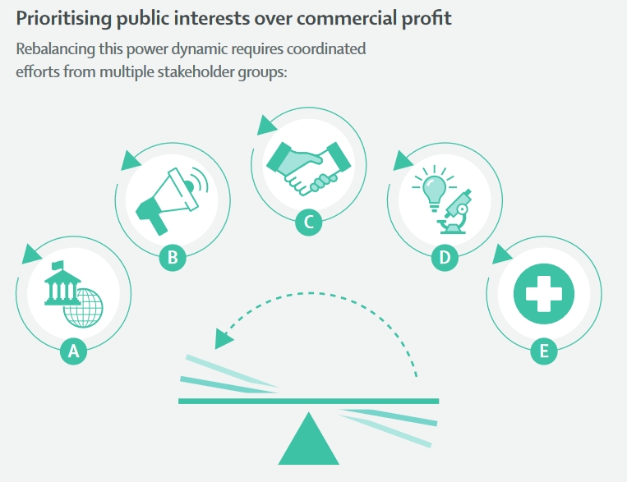
Prioritising public interest over commercial profits
We must tip the scales in favour of the public if we are to succeed in improving health and reducing inequalities
https://www.thelancet.com/infographics-do/commercial-determinants-health-2023
This document is part of CDoH Essentials (2024) Brook et al
Notes:
We will come back to what can be done globally, nationally, locally and at an individual level later in the session, but just to indicate there are ways to protect our residents from harm
We can’t achieve our goals to improve population health without reducing the consumption of harmful products like tobacco, alcohol and highly processed foods high in fat, salt, or sugar.
People are not currently protected from these harms where they live, work, socialise, and online (eg Health Foundation assessment of how we’re doing on addressing key risk factors: https://www.health.org.uk/publications/reports/addressing-the-leading-risk-factors-for-ill-health)
We need to shift and re-balance the system so that the scales are tipped in favour of people & public interest
governments regulate in the public interest (rather than shape in the corporate interest) such that
commercial actors then operate more in the public interest
the underlying drivers are rebalanced
commercial sector practices are directed towards ethical/legal rather than unethical/illegal practices
The determinants of health subsystem is consequently rebalanced in the public interest with more favourable outcomes
(From Lancet Gilmore et al, 2023)
We also need to be aware of the concept of false balance – the calling for ‘balance’ by industry. We need to consider what really matters in our communities and prioritise that – question whose benefit the ‘balance’ is in.
NOTE: there is public support for many of these measures
ASH found support for more government action on tobacco, alcohol, gambling & obesity (majority wanted government to take ‘more action’ compared with ‘about right’ ‘don’t know’ or they’re already doing ‘too much’) https://www.yhphnetwork.co.uk/media/102566/hc-5-public-opinion-risk-factors.pdf

Slide 15
Commercial Determinants of Health: overview
Many thanks:
For their work which is included in this slide-set specifically: BiteBack, The Food Foundation, NCD Alliance, Anna Gilmore, Jeff Collin.
To colleagues who shared ideas, experience and materials: Simone Arratoonian, Greg Fell, Tim Howells, Kylie Murrell, Amanda Pickard
These materials were developed as a set by: Anna Brook with Katherine Körner, May van Schalkwyk & Mark Petticrew
With contributions from our action research partners including: Amy Barnes, Samuel Bostock, Emma Gibson, Susan Hampshaw, Tim Howells, Greg Stenson, Caroline Temperton, Maddy Ardern, Megan Doran, Stefanie Gissing, Matt Greensmith, Jo James, Edward O’Malley, Katie Powell, Emily Reed and Vicky Smyth.
We acknowledge and appreciate the evidence developed by the many dedicated researchers whose work is cited and used throughout, the experience, tools, frameworks and case studies shared by practitioners and advocates, and the helpful feedback from our action research participants which also helped to shape these materials.
This document is part of CDoH Essentials (2024) Brook et al
Notes:
Acknowledgements
These materials were developed as a set by: Anna Brook with Katherine Körner, May van Schalkwyk & Mark Petticrew
With contributions from our action research partners including: Amy Barnes, Samuel Bostock, Emma Gibson, Susan Hampshaw, Tim Howells, Greg Stenson, Caroline Temperton, Maddy Ardern, Megan Doran, Stefanie Gissing, Matt Greensmith, Jo James, Edward O’Malley, Katie Powell, Emily Reed and Vicky Smyth.
We acknowledge and appreciate the evidence developed by the many dedicated researchers whose work is cited and used throughout, the experience, tools, frameworks and case studies shared by practitioners and advocates, and the helpful feedback from our action research participants which also helped to shape these materials.
To colleagues who shared ideas, experience and materials Simone Arratoonian, Greg Fell, Tim Howells, Kylie Murrell, Amanda Pickard
And to the researchers and organisations who have kindly agreed for their evidence to be included, especially for this section of materials: BiteBack, The Food Foundation, NCD Alliance, Anna Gilmore, Jeff Collin but please see acknowledgements on each slide and in the notes.

