Slide 1
Annual Associate Workshop 2023
05 October 2023
#ADPHAssociateWorkshop23

Slide 2
ADPH Associate Member Workshop Thursday 05 October 2023, 10:00 – 13:00 View your virtual delegate pack by clicking the link in chat
10:00 | Welcome | Claire Beynon and Dr Mary Orhewere
10:05 | The role of ICSs in tackling health inequalities Q&A and discussion | Prof. Bola Owolabi, Director of Health Inequalities, NHS England
10:30 | Managing public health against the background of increasing inequality Speaker Presentations Q&A and discussion | Panellists: Dr Tim Allison, DPH, NHS Highland Vicky Hobart, Group DPH and Deputy Statutory Health Adviser, Greater London Authority Julia Weldon, DPH and Deputy Chief Executive, Hull City Council
11:25 | Break
11:35 | Why be a DPH Speaker Presentations Q&A and discussion | Prof. Jim McManus, ADPH President and DPH Hertfordshire Lynn Donkin, DPH Bolton Metropolitan Borough Council
12:10 | Leadership Speaker Presentations Q&A and discussion | Greg Fell, ADPH Vice President and DPH Sheffield Alice Wiseman, ADPH Treasurer and DPH Gateshead Metropolitan Borough Council
12:40 | ADPH update: WeDPH | Alastair Stewart Technical Support Manager, ADPH
12:50 | Interactive session | Mary Orhewere
12:55 | Summary and closing remarks
#ADPHAssociateWorkshop23

Slide 3
Professor Bola Owolabi
Director of Health Inequalities at NHS England
The role of ICSs in tackling health inequalities
#ADPHAssociateWorkshop23

Slide 4
Managing public health against the background of increasing inequality
#ADPHAssociateWorkshop23

Slide 5
Dr Tim Allison
Director of Public Health and Policy, NHS Highland
Public Health on the Edge
#ADPHAssociateWorkshop23

Slide 6
Public Health on the Edge
Tim Allison

Slide 7
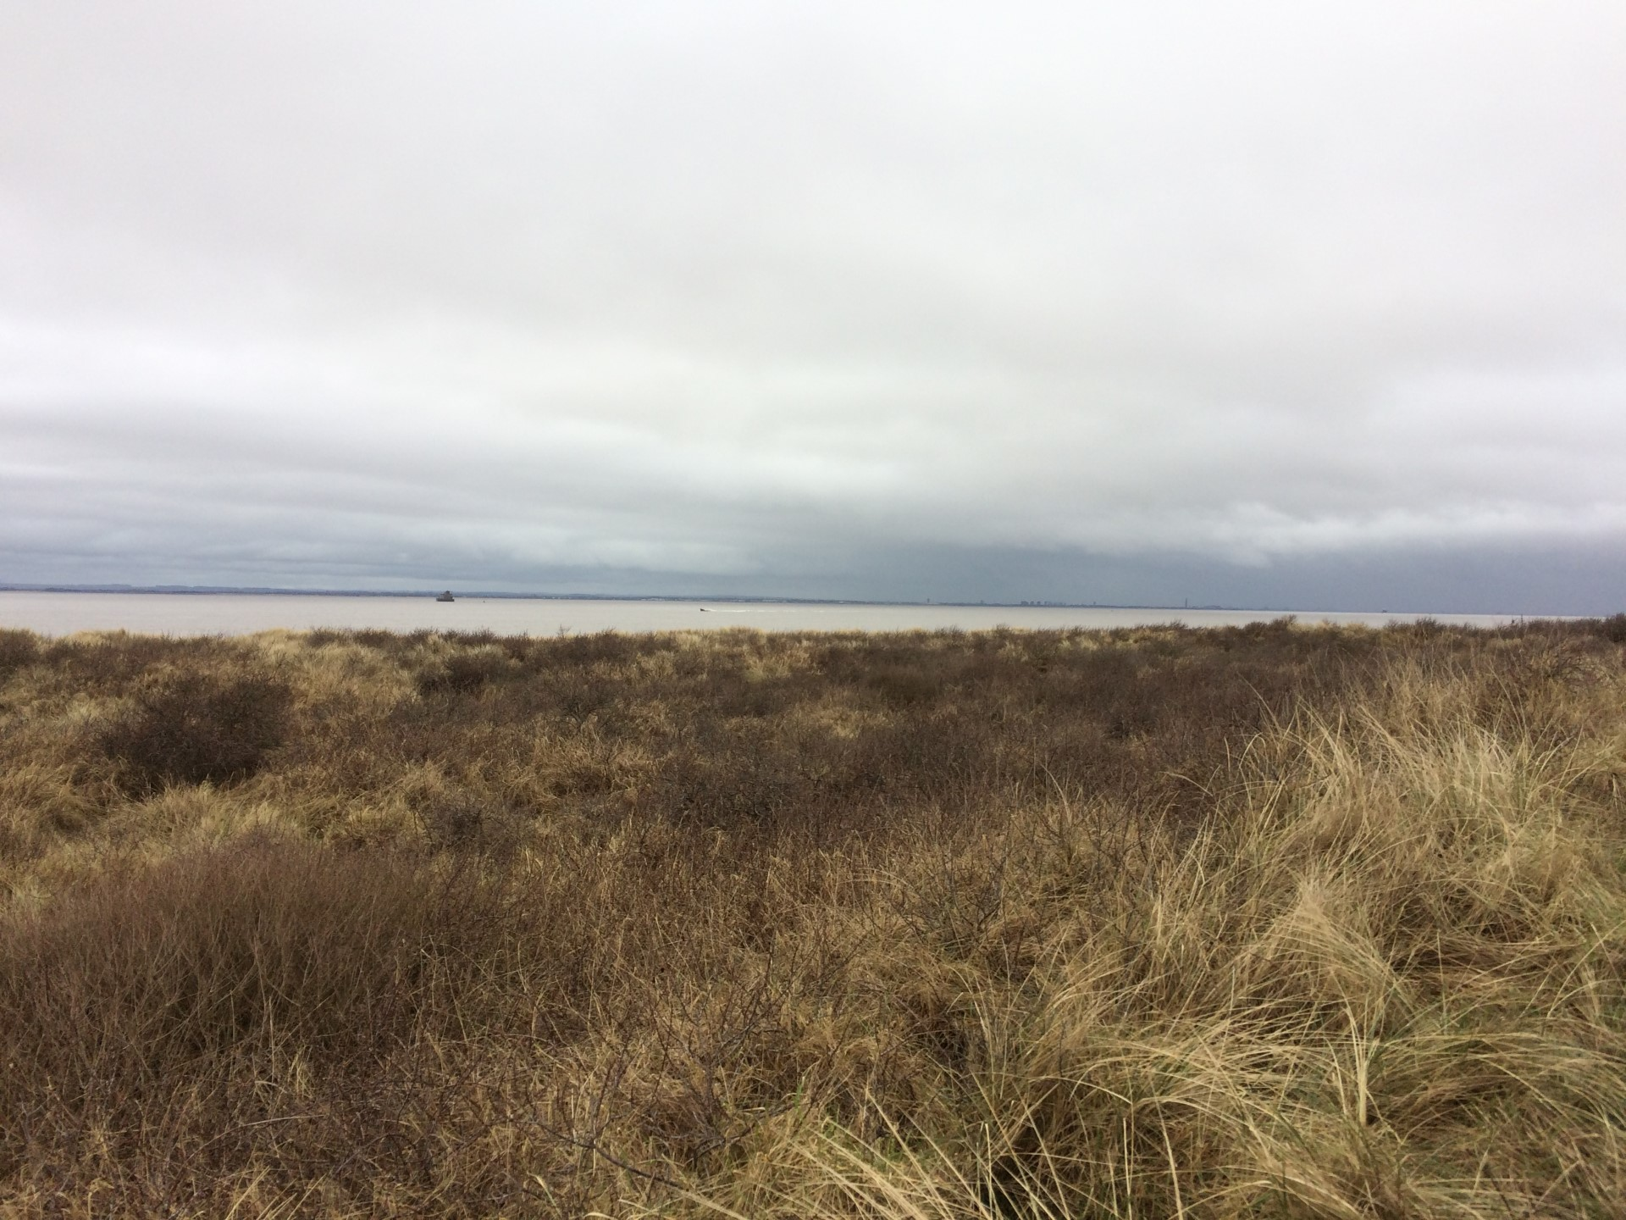

Slide 8
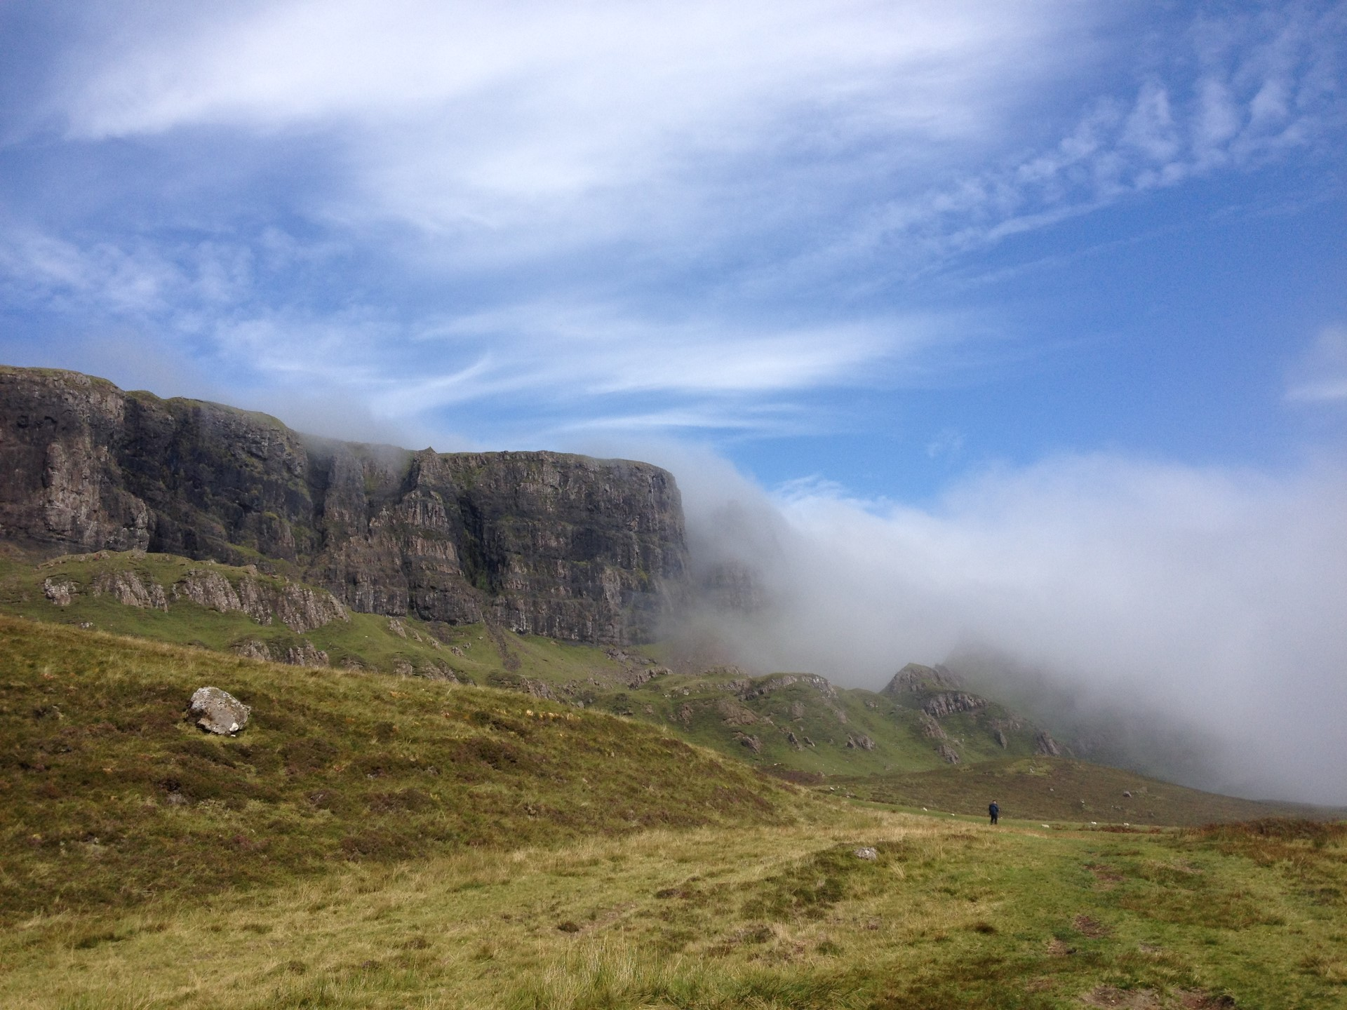

Slide 9
The Edge
The boundary between people or places
Where people end up
The sharp and edgy place
Opportunity for change
Opportunity to be ignored
Avoid the long grass

Slide 10
Where is Public Health?
At the centre or on the edge?
What happened during the pandemic?
What if anything has changed?
So what?

Slide 11
Health Inequalities
Individual v Population
Different types of inequality
Income
Geography
Sections of society
Generating support
Getting results

Slide 12
Understand Health Inequalities
Did you hear about the person who went to their GP complaining of health inequality?
If a poor sick person moves to a richer area does their health inequality increase or decrease?
Will their health get better or worse?

Slide 13
Who was affected the worst?
Significant effects among the poor
Oslo
Paris
Military camps and malnourished badly affected
Half a million German troops taken from the front line
High mortality in Sub-Saharan Africa
More than 13 million deaths in India
Catastrophe for many Inuit communities
Notes:
Yet that is not the whole story and in fact it was the poor who really suffered most from the pandemic. Recent research from Norway indicates that there is some protective effect of wealth and in Paris the relatively large number of cases of influenza in rich neighbourhoods was due to illness among servants living in rich households. Army recruits crammed together in barracks were susceptible and the British naval blockade of Germany which resulted in significant food shortages will have exacerbated vulnerability to influenza especially in the poor. Other international comparisons really emphasise the effects of wealth and poverty with poorer countries and communities badly affected. Up to 10% of Tanzanian population died from influenza and associated famine while the biggest number of deaths was in India. Impact on communities was highest among the Inuit. For example, SS Harmony arrived at Hebron in Labrador on 27 October 1918 carrying people infected with influenza. By 19 November 86 of Hebron’s 100 residents were dead. It arrived at Okak and by the end of December 204 of its 263 residents were dead. All adult men in Okak died.

Slide 14
Numbers killed in the Great War show a different health inequalities pattern
Ordinary Soldiers: 12% died
Officers: 17% died
Old Etonians: 20% died
Notes:
It is interesting to see that the pattern of deaths in conflict in the Great War is not the same. It shows an inverse social class gradient with people from more advantaged backgrounds more likely to be killed. This is different from the pattern of influenza deaths and is a relatively uncommon feature in epidemiology. Along with the larger number of deaths from conflict than from influenza in Europe it is perhaps a contributory factor in the low profile given to the pandemic.

Slide 15
Remote and Island Communities
Services are limited and highly valued
Transport is crucial
No ferry means empty shelves
Few people, so few staff
How do we identify the people in most need?

Slide 16
Support and Results
Make links across partners
Use community assets
Keep it simple and straightforward
Keep it real and grounded
Move inequalities from the edge to the centre
Develop existing systems for delivery

Slide 17
Building a Better Boat: The Event

Slide 18
Social mitigation
The process:
Gather local information from services and communities
Review local and national data
Collate information to inform development of the NHS Highland social mitigation plan
Share with partners and NHS H to support actions going forward

Slide 19
Lessons for this type of work
Value public health staff
Use the evidence
Look after the basics
Understand the inequalities
Person, place and time

Slide 20
What is Important?
Systems leadership
Partnership
Relationships
Balancing being on the edge and being in the centre
The edge can be good but don’t fall off!

Slide 21
Vicky Hobart
Group Director of Public Health and Deputy Statutory Health Adviser, Greater London Authority
Mind the widening gap – reflections on efforts to improve public health in London against a backdrop of increasing inequality
#ADPHAssociateWorkshop23

Slide 22
Leading self - What is my role? How can I make a difference? What support do I need?

Slide 23
Leading team - Creating the GLA Group Public Health Unit

Slide 24
Public health contributions
LONDON: Healthiest global city
1. Health Protection: threats to health
2. Health Improvement: keeping well
3. Health and care system: maximising contribution
4. Data, insight & intelligence: health needs and equity
5. Wider determinants of health: HiaP
6. Leadership, advocacy and networks: systems

Slide 25
What is a public health approach?
Recognising that the conditions in which we live impact our health. Health is not determined by hospitals and healthcare, and instead social, economic, and environmental conditions play the biggest role.
The key principles of a public health approach include the following:
A focus on equity (or fairness) rather than equality through taking a needs-based approach. This includes identifying and taking action to reduce inequalities and advocating for vulnerable populations.
Taking preventative action - tackling ‘upstream’ risk factors, it aims to lessen ‘downstream’ consequences
Using evidence and data to inform the work that we do
Working with a wide range of partners – taking a system approach
Ensuring projects / programmes / interventions are evaluated
Taking a health in all policies approach is key to maximising the impact of these principles.

Slide 26
Health in all GLA Group Policies
“access to health care only accounts for around 10% of a population’s health,
with the rest being shaped by socio-economic factors -
the conditions in which people are born, grow, live, work and age”
The GLA HiaP approach
Identifies opportunities for health and wellbeing co-benefits across GLA Group policies and programmes
Makes use of existing levers to improve social, economic & environmental conditions in which people live
Improves health and wellbeing
Reduces health inequalities
Keeping people safe (including resilience)
Preventing Poor Health
Levelling up the health gap

Slide 27
Organising the work: Five Consultant – led portfolios
Economy, culture and children (Alice Walker)
Community safety and young people (Farrah Hart)
Housing and vulnerable adults (Emma DeZoete)
Planning, environment and resilience (Emer O’Connell)
Transport and air quality (Katie Hunter)

Slide 28
Leading organisations - Resources The GLA Group

Slide 29
Why should we collaborate on public health now?
The strategic purpose of the collaboration is clear:
Restore confidence, minimise the impact on communities, and build back better (London’s recovery mission)
Make London the world’s healthiest global city, and the best global city in which to access care (London’s Health and Care Vision)
Ensure London is a city where no one's health suffers because of who they are, or where they live (London’s Health Inequalities Strategy)
Ensure London is resilient and prepared for future health challenges.
As we came out of the pandemic, there was a window of opportunity to secure progress;
The COVID pandemic shone a light on existing and widening health inequalities
Many sectors are reviewing their strategic and operational priorities to ensure they meet current needs
The public health system continues to evolve
Other cities, regions and countries want to collaborate
The whole GLA Group can play an innovative and impactful role in the new system.

Slide 30
‘The Mayor wants to put health at the heart of policy design and decision making across the GLA Group’
Planning – e.g. 400m healthy zones around schools
Economic development- e.g. good work standard, london living wage, anchors network
Health in all policies
Transport – e.g. Active travel
Culture – e.g. Social prescribing or dementia friendly venues
Violence reduction with a focus on young people
Housing – e.g. Everyone in or specialist and supported housing needs
High fat and sugar advertising restrictions
Environment & air quality – e.g. low emission zones
Tackling violence against women and girls with the NHS
Gambling advertising harm reduction

Slide 31
NEW GLA GROUP PUBLIC HEALTH UNIT – April 2022
Serving The GLA Group:
The Mayor
The London Assembly
The Greater London Authority
Transport For London
Mayor’s Office For Policing And Crime
Violence Reduction Unit
London Fire Commissioner
Old Oak And Park Royal Development Corporation

Slide 32
Leading systems - Working regionally? Collaborating locally, nationally and internationally?

Slide 33
London health inequalities snapshot
Snapshot of Health Inequalities in London – London Datastore

Slide 34
Visualisation
Inequality in life expectancy as measured across stops in London Elizabeth line,
using MSOA data, 2015-19
Life expectancy in London changes as you travel along the Elizabeth line in London
Between both from Hanwell to Acton, and Liverpool Street to Custom House, you can see a gradient of inequality in life expectancy
Note: The Liverpool Street (City of London) life expectancy has limitations as some individuals may list this as their place of residence, but may not live there
Source:
Source: (1) ONS

Slide 35
Reasons to be cheerful?

Slide 36
Links
Introducing the GLA Group Public Health Unit | London City Hall
Supporting London's journey to becoming the healthiest global city | London City Hall
Health inequalities strategy webpages
HIS annual report 2022
Cities Health Inequalities Project
Snapshot of Health Inequalities in London – London Datastore
The Rising Cost of Living: Interventions to Reduce Impacts on Health Inequalities in London - IHE
Evidence Review: Housing and Health Inequalities in London - IHE (instituteofhealthequity.org)

Slide 37
Julia Weldon
Director of Public Health and Deputy Chief Executive, Hull City Council
Leadership for public health against the background of increasing inequalities
#ADPHAssociateWorkshop23

Slide 38
Leadership for public health against the background of increasing inequalities
DPH & Deputy Chief Executive
Hull City Council
October 2023

Slide 39
Widening inequalities in Hull
 | Hull | England
LSOAs in most deprived fifth nationally | 54%
Gross disposable income | £15,329 | £21,962
Economic Inactivity | 26% | 21%
Children in Poverty | 30% | 15%
Smoking prevalence | 17% | 12%
Notes:
is one way to measure the health of a population or particular group. Since 2010, improvements in life expectancy have stalled for the population as a whole, and for the poorest 10 per cent of women they have declined. Before the pandemic, the gap in life expectancy between the most and least deprived areas in England had grown to 10.3 years for men and 8.3 years for women. Narrowing this gap demands a more preventive approach to health and a focus on the broader determinants of health.The case for tackling health inequalities is clear and overwhelming, and yet attempts to do so in recent decades have had mixed success. Crucially, none of these efforts have translated into the enduring focus on addressing health inequalities that is needed.

Slide 40
A complex and changing operating landscape
Politics and political ideology
National Policy
Financial challenges for people and public services
New NHS landscape
Industrial action and unrest
Widening social and health inequalities
Notes:
Politics and ideology
Devolution
Policy and ideology
Financial challenges
ICS
Covid recovery
Industrial action and social unrest
Cost of Living

Slide 41
Building Blocks – the essential components of a healthy life that give us an opportunity to thrive
“Health inequalities are not caused by one single issue, but a complex mix of environmental and social factors which play out in a local area, or place - this means that local areas have an important role to play in reducing health inequalities” PHE 2021

Slide 42
Our Health Inequalities Framework 2023
Civic interventions have the greatest reach of any intervention and therefore are an extremely powerful component of place-based action to reduce inequalities
Service interventions are able to achieve significant outcomes due to their direct impact with individuals - they must, however, be delivered with system, scale and in a sustainable way, and calibrated to deliver further and faster to the most disadvantaged communities
Community-centred interventions hold unique potential in reducing health inequalities particularly building on the assets, skills, knowledge and social connections
Notes:
Bringing together the Place based approach to reducing inequalities to create a strong foundation for the building blocks of health
Underpinned by our Collective Place Based Leadership
A clear vision and strategy
Develop knowledge, skills and capability through our inequalities innovation hub
Effective system leadership and accountability to elevate Hulls voice
Using data and evidence systematically
Sustained and targeted investment in reducing inequalities
Comprehensive engagement- amplifying citizen and community voice

Slide 43
The art and science of modern public health leadership
Notes:
Getting a strong plan developed in collaboration and sticking to it now what the prevailing political/financial/ challenges are

Slide 44
Examples of community, civic and service interventions already underway in Hull
A New Community Plan for Hull
Building Forward Together
Poverty Truth Commission
Centre of Excellence for Tobacco Control
Family Hubs

Slide 45
Hull Poverty Truth Commission
“What we have definitely picked up already from the Poverty Truth Commission is that often services are there but accessing and navigating systems and services does appear to be the main barrier. They do exist, but they’re not always joined up and they are not always trauma informed. “
Pippa Robson – Deputy Chief Officer, Forum.
Notes:
Nothing about us, without us, is for us, is the starting point for Poverty Truth Commissions. It identifies that lasting social change only happens when those who experience the struggle participate in generating that change.

Slide 46
Building Forward Together- A new relationship with the Voluntary and Community sector
An equal and reciprocal arrangement with
kkkk

Slide 47
Family Hubs Launch
Circa £3.9m for Family Hubs in our most disadvantaged communities
Built on foundations of 10 years PH funding to maintain our children’s centre’s
Notes:
Your total maximum allocation for the Family Hubs and Start for Life programme is £3,675,700 over the three financial years of 2022-23, 2023-24 and 2024-25. As set out in section 2 below, your actual payment for 2022-23 may have differed to the maximum allocation, for that year, for the reasons explained. As you are a trailblazer, you received an additional £133,000, making your overall maximum allocation for the programme £3,808,700.

Slide 48
HNY Centre of Excellence for reducing tobacco harm
In 2022 a long-standing ambition to develop a Centre of excellence was achieved with £2m investment from HNY. Based on Fresh North East this will be a gamechanger for Hull

Slide 49
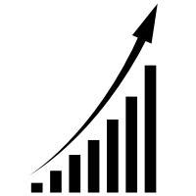
A New Community Plan for Hull
Safe, attractive neighbourhoods
A Healthier & Fairer Hull
Reaching our potential
Economic growth that works for all
Responding to the climate emergency
Our Heritage, our City, our Future
Notes:
Behind the aspiration to deliver a Community Plan is our aspiration to develop a fairer city. A city in which people have opportunity to work, live and thrive in Hull. Where people feel safe, have good health and wellbeing, where inequalities are less prevalent and where we invest in our generations of tomorrow who will help deliver our aspirations of the future.
Additionally, there are three commitments:
Engagement of all residents and communities.
Strong, united leadership committed to improving outcomes.
A focus on Inclusion.

Slide 50
Managing public health against the background of increasing inequality
Q&A Discussion
#ADPHAssociateWorkshop23

Slide 51
Break
The session will resume at 11.35
#ADPHAssociateWorkshop23

Slide 52
The DPH role
#ADPHAssociateWorkshop23

Slide 53
Professor Jim McManus
ADPH President and DPH Hertfordshire
Why be a DPH
#ADPHAssociateWorkshop23

Slide 54
Why be a DPH?
ADPH Associate Workshop
5th October 2023
Prof Jim McManus, D.Sc CPsychol, FBPsS,FFPH
Executive Director of Public Health, Hertfordshire
President, UK Association of Directors of Public Health

Slide 55
The Must Dos
Culture
Building Blocks
Build a positive psych-social environment
Create an environment where people feel they can bring their entire selves to work, especially on bad days
Build in all the things needed before and beyond formal employee assistance programmes
Leadership – emotional intelligence
Behaviours
Configuration of the working day and environment
Policies and support packages

Slide 56
Why be a DPH?
Values
Sandro Galea and Love as a Determinant of Health
Impact seen and unseen
Salt and Light
Science in Public Service
Influence the system
Because people need the public health mindset
Complexity, Transdisciplinarity, Long Term view - the area under the curve
6. Ability to make a difference
7. Fits with your talents and abilities
8. The opportunity to practice a model of leadership which empowers others to practice their leadership
High drive and low emotional intelligence is toxic
9. Opportunities

Slide 57
Four Domains of Leadership © AshridgeHult Business School
Personal
Interpersonal
Technical
Contextual

Slide 58
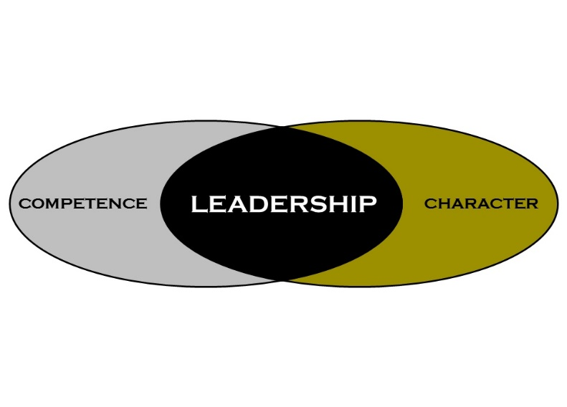
Leadership comprising
Competence
Culture
Emotional Intelligence
A focus on Justice
Fostering other Leaders
Virtues : excellence in ordinary practices–
Personally and interpersonally aware, contextually and technically effective
Character

Slide 59
Diverse approaches: problems and solutions
Challenges
Ways Forward
Historically leadership models have been based on white western men
One set of cultural worldviews have dominated
Top-down assumption rather than leader
Leadership is not about the Leader as Ruler but leader as enabler of others
Leadership as multiple sets of managing social processes
Good leadership is interpersonal. It requires self-awareness and self-reflection
Encourage people to start from their cultures and dialogue with the evidence base and contribute to the debate
Leadership is always under review
Recent psychology on character and wisdom and decision-making

Slide 60
Leadership through virtues (character)
Modules
Psychology meets our tradition on the nature of the leader
The service of leadership in the contemporary world
justice in interpersonal relationships
Integrity and the Emotionally Intelligent Leader
Teamwork through Commitment to Shared Goals
Empowering Team Members to Flourish
Methods: Seminars, Workshops, Personal Mentoring, self reflection, psychometrics, group work, learning set, project report

Slide 61
The best of tradition meets the best of modern psychology
Traditional language | Recast them in light of what they had and what psychology can tell us
Justice | Genuinely wanting the organisation, team and person to succeed (1) Fairness, Equality, enabling everyone to be their best Create the conditions for success
Charity | Genuinely wanting the organisation, team and person to succeed (2) Positive psychosocial environment Also creating the conditions for success
Fortitude | Resilience, self-knowledge, self-care, self-compassion
Temperance | Ensure good use of time Carey Nieuwhof’s – at your best understanding how to schedule your day to get the best Cal Newport’s Deep Work and weaning yourself from “always on” The psychology of email
Prudence | Good judgement – ensuring you make good decisions and make them well (psychology of decision-making) The psychology of wisdom

Slide 62
Thank you!
www.hertfordshire.gov.uk/healthinherts
www.adph.org.uk
Jim.mcmanus@hertfordshire.gov.uk
President@adph.org.uk

Slide 63
Lynn Donkin
DPH Bolton Metropolitan Borough Council
Perspective from a new DPH
#ADPHAssociateWorkshop23

Slide 64
Why be a DPH?
Perspective from new DPH..
Lynn Donkin, Director of Public Health, Bolton Council
@lynn_donkin

Slide 65
From CPH to DPH…
Reflecting on the first 12 months
All change
Contemplating goals

Slide 66
One year on …
Deputy - interim - substantive
A different seat
Dynamics and uncertainty
Breadth v depth
Wellbeing and balance
Who’s round your personal board table?
Coach, mentor, peers/action learning, appraisal

Slide 67
The DPH role
Q&A Discussion
#ADPHAssociateWorkshop23

Slide 68
Greg Fell
ADPH Vice President, DPH Sheffield
Leadership
#ADPHAssociateWorkshop23

Slide 69
Leadership as a DPH
What they all said
FOBFO
Authenticity
Know your ground, know your role
Trust
Risks.
With not to. Co produce answers
Compassionate
How will I know I have made a difference
You are not alone. The team matters.

Slide 70
Alice Wiseman
ADPH Treasurer, DPH Gateshead Metropolitan Borough Council
10 Lessons from the Wizard of Oz
#ADPHAssociateWorkshop23

Slide 71
10 Lessons from the Wizard of Oz
Alice Wiseman
DPH Gateshead
ADPH Board member (trustee) and addiction lead

Slide 72
Vision
“It’s always best to start at the beginning. And all you do is follow the Yellow Brick Road.” Glinda the Good Witch of Oz
Courage
Dorothy: Weren’t you frightened?
Wizard of Oz: Frightened? Child, you’re talking to a man who’s laughed in the face of death, sneered at doom, and chuckled at catastrophe… I was petrified.
Relationships
“A heart is not judged by how much you love, but by how much you are loved by others.” – The Wonderful Wizard of Oz

Slide 73
Uncertainty and change
“Toto, I’ve a feeling we’re not in Kansas anymore.” – Dorothy.
Experience and wisdom
“A baby has brains, but it doesn’t know much. Experience is the only thing that brings knowledge, and the longer you are on earth the more experience you are sure to get.” – The Wonderful Wizard of Oz
Communication
Dorothy: How can you talk if you haven’t got a brain?
The Scarecrow: I don’t know. But some people without brains do an awful lot of talking, don’t they?

Slide 74
Heart
“I shall take the heart. For brains do not make one happy, and happiness is the best thing in the world”. – Tin Man
Diversity
“It’s not where you go, its who you meet along the way” – Wizard of Oz
Leadership VS Power
“I am Oz, the Great and Terrible,” said the little man, in a trembling voice, “but don’t strike me—please don’t!—and I’ll do anything you want me to.” – The Wonderful Wizard of Oz

Slide 75
Self-Care
There is no place like home!

Slide 76
Leadership
Q&A Discussion
#ADPHAssociateWorkshop23

Slide 77
Introduction to WeDPH
Alastair Stewart, ADPH Technical Support Manager
#ADPHAssociateWorkshop23

Slide 78
Summary and closing remarks
End of workshop
#ADPHAssociateWorkshop23

