Slide 1
Champions programs and Children & Young People
11.01.2024

Slide 2
Community Champions Programmes
Community Champions programmes were an important part of the response to COVID-19 in London.
People from all across London got information from their local public health teams about COVID – and they shared this information with friends and family.
In some places there were – and still are – young champions programmes
Champions programmes are still going in many parts of London
We are designing how these could work with and for children and young people in two ways
  With children and young people: what would a champions progamme look like for children and young people now that COVID-19 has ended
  For children and young people: how can we make sure that information about children and young people’s health is part of the adult champions programmes

Slide 3
The Community Champions Development Programme (CCDP)
The CCDP is a London-wide programme run by Newham Council that brings together people who are working on Champions programmes across the city
It supports learning and sharing good practice between people who are working on two-way dialogue in their local places
It is trying to imbed champions models in ICS, ISBs, and LAs by creating a champions business case showcasing that champions are a powerful and unique tool to support London Healthcare System to overcome health challenges London facing these days.
We are also connecting Community Champions with other personalised health roles, gathering case studies of excellent practice between public sector organisations and communities and looking at how small grants can be used most effectively
1) who from yout loca syste, ICS andlocality leverl we should invite (should invite should come from us or we should sent the invite
2) please share any design questions or thought that we can incompritae in the process
3if you have any network with young people, or voluntary organisations with young people, please share with us
Ask Kath to pass information into Jane and find out if she is able to join us.

Slide 4
Write to sandy and say we would like to do the staring group for the compendium, 3 times 1.5h each to select case studies, to review insides and final report
Ideally one from ICS and doesn’t have to be a member from the collaborative
Late May

Slide 5
Champions and children & young people
One of the CCDP workstreams is about children and young people – making sure their health issues and priorities are part of existing programmes and developing a children and young person’s champion model that local areas can use in the way that works for their context.
Some definitions
Children and young people: anyone from 0 – 24 years old. For the champions model specifically we are focusing on 12-24 year olds first.
Champions: people in communities who are having two way conversations with their local health system – sharing information with their communities and bringing messages from their communities to the local authority and local NHS

Slide 6
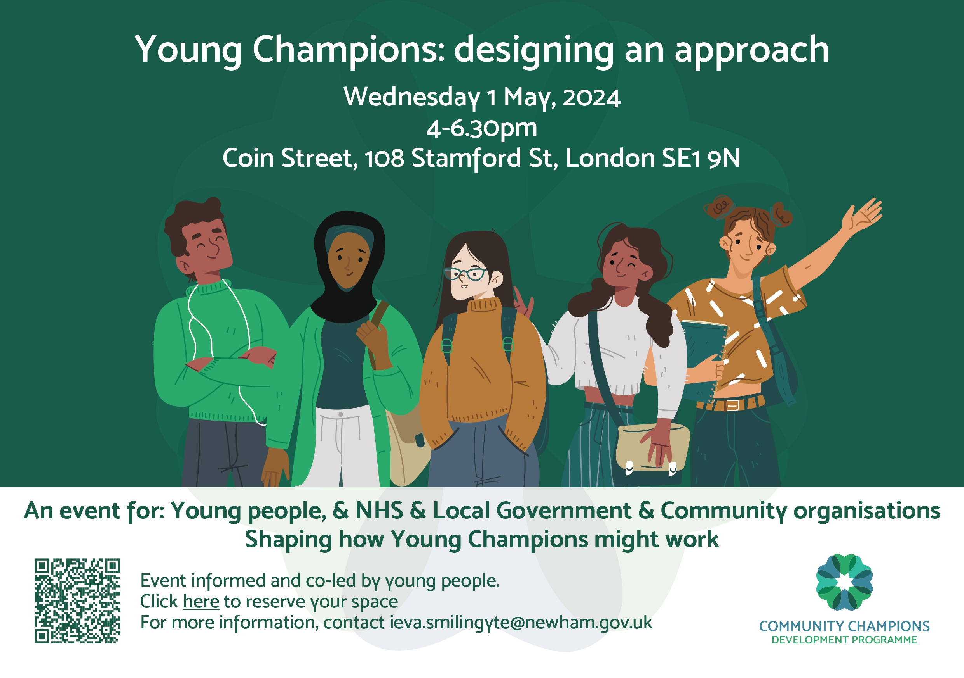
Workshop
We are holding a workshop to design the Young Person’s Champions Model and to agree the priority health issues to share with adult champions.
We are working with children and young people to design the workshop so that all voices are heard and are equal. This includes: London Peer Supporters, LinkedUp Crew and others
We are also talking to people in the NHS and local government to make sure the workshop is right for them
The workshop will start from what we’ve already heard from young people – we will do what we can to not ask the same questions they’ve been asked before

