Slide 1
London Tobacco Alliance and Stop Smoking London
ADPHL Public Health Communications Meeting
Emma Barry
Programme Manager

Slide 2
Programme Overview
Objectives
London Tobacco Alliance – To make London a Smokefree City by 2030 by bringing together partners and stakeholders across London to combine and accelerate efforts to eliminate smoking and giving us the greatest opportunity to reduce health inequalities.
Stop Smoking London – To provide information and support to London smokers and to generate marketing materials for boroughs that can be used to signpost smokers to support either locally, or via the SSL Helpline or SMS service.
Target Audiences
LTA – Stakeholders across LAs / NHS / GLA / London Councils / Academia / Voluntary or Charity organisations across London as well as large employers such as TfL, London Fire Brigade and Metropolitan police.
SSL – Smokers across London with a focus on high priority groups such as routine and manual workers, pregnant smokers and ethnic communities with high smoking prevalences.
Funding
Both programmes are funded through the Local Authority DsPH via ADPHL.

Slide 3
Activity Programme 24/25 – London Tobacco Alliance
Supporting networks and governance across London
LTA Board
LTA Steering group
Smokefree Councillor Network
London Tobacco Control Network
Academics Network (to be formed)
Development of educational resources and webinars for stakeholders, eg Behavioural Science PH Network webinar series supporting LAs to maximise the impact of new smoking cessation funding
Working with Partnership for Young London on young peoples perspective on Smokefree Generation and youth vaping
Developing partnerships with charities such as Cleanslate and Groundswell supporting priority smokers in hard to reach communities

Slide 4
Activity Programme 24/25 – Stop Smoking London
Launch of the Digital pilot offer for London
Proposed development of bespoke multi-cultural campaigns aligned to smokers in high prevalence communities across London
Supporting London boroughs to increase footfall through local services to help achieve new targets
Developing case studies of Smoker Success Stories across London
Amplification of national smoker campaigns throughout the year with London focus and materials

Slide 5
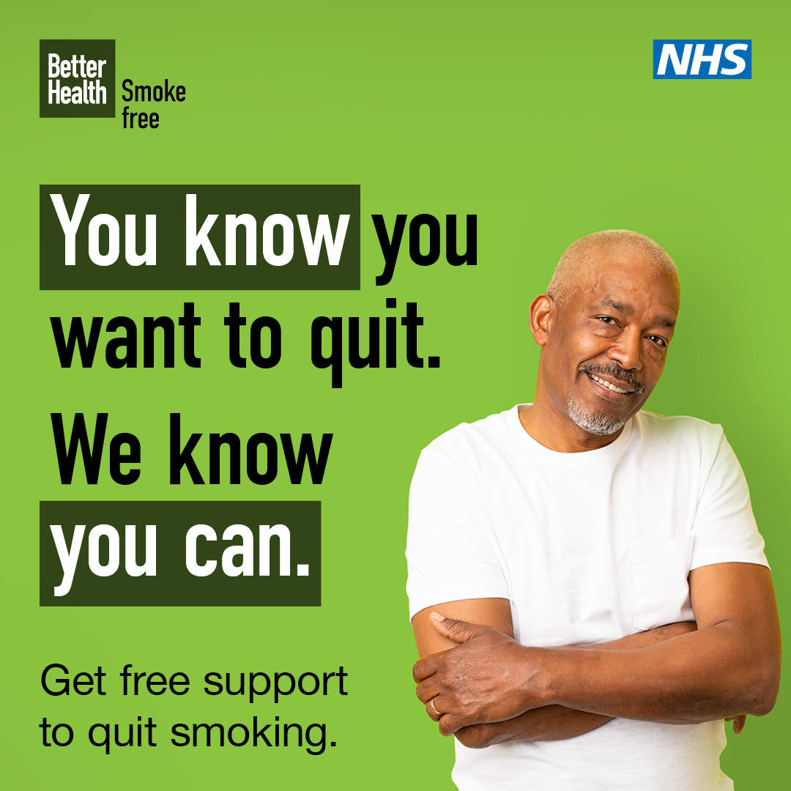
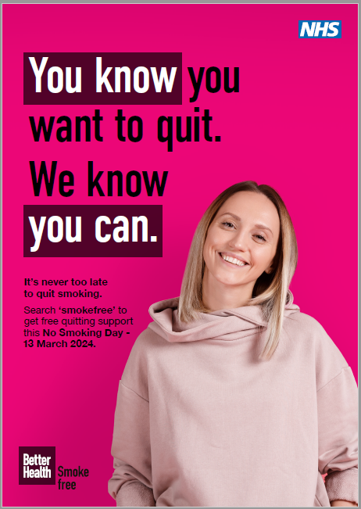
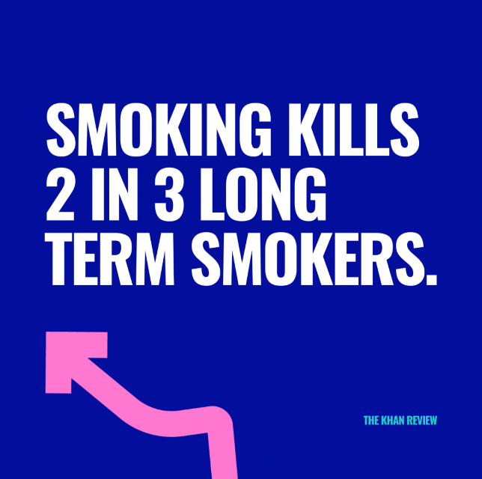
NO SMOKING DAY
Wednesday 13th March
National campaign theme will be Health Harms
Resources on Campaign Resources Centre
Stop Smoking London will amplify and complement this messaging
London campaign – Make Today Your No Smoking Day
To give the campaign longevity past NSD
Paid Social Media Campaign
Smoker Stories videos
HCP Advice videos

Slide 6
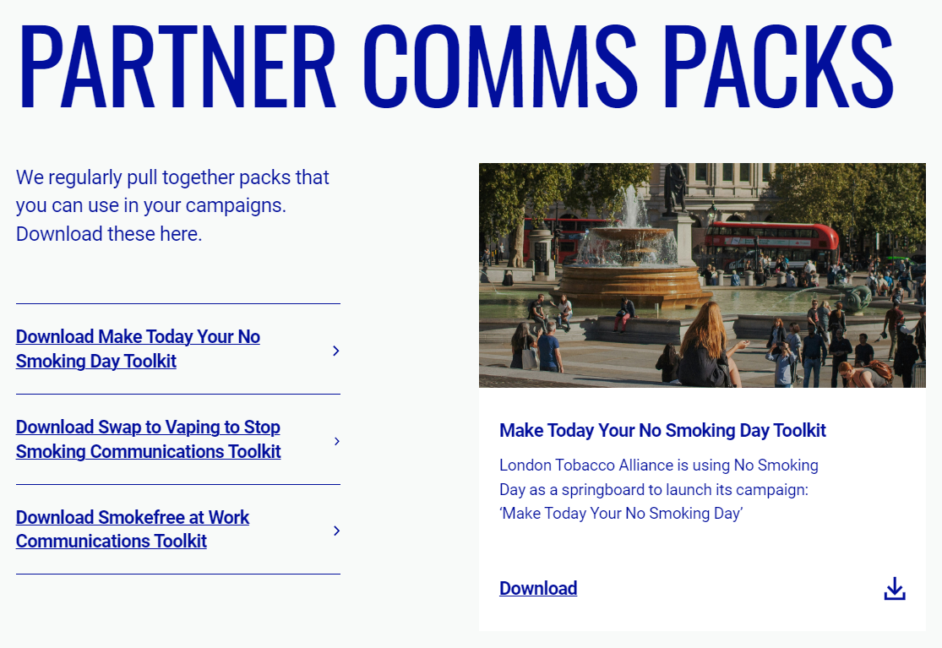
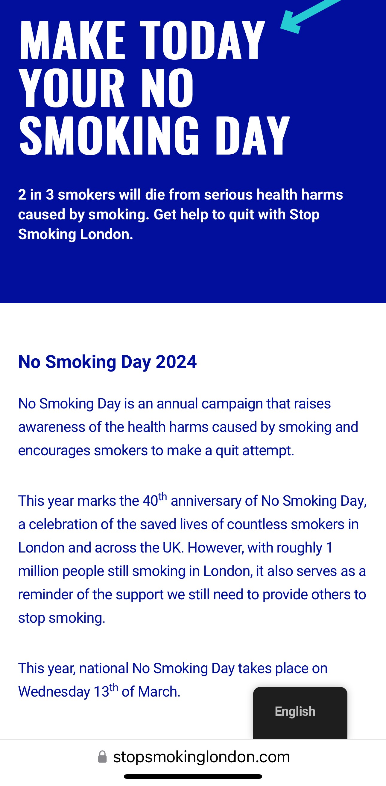
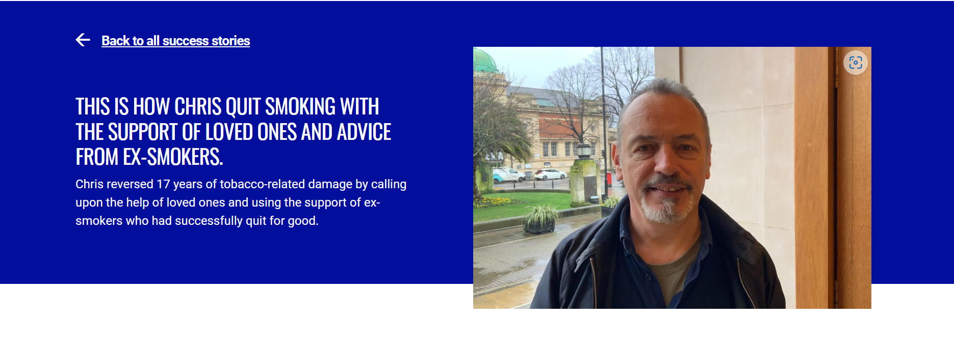
No Smoking Day
Partners Communications Toolkit – Now available
London Tobacco Alliance - Resources, Smoking Insights & More
Adaptable poster – amend for local use
Case study videos – share on websites, intranets etc
Social short reels, graphics and posts – share on social platforms
Stop Smoking London landing page
Make today your no smoking day (stopsmokinglondon.com)
Smoker Story – Cllr Chis Kennedy
Giving up smoking for a loved one (stopsmokinglondon.com)
ASK FOR PARTNERS:
To share and amplify locally

Slide 7
Future Comms Activities
All comms Campaigns will also include Pan-London marketing and paid social media (Twitter / Facebook and Google Search) as well as an “Always On” campaigns
April – Comms focus on Signposting to local support
ASK FOR PARTNERS – Check borough pages on Stop Smoking London – inform us asap of changes to information, particularly contact info
Launch of Digital pilot offer for London – Exact timing TBC
ASK FOR PARTNERS – Local Comms to locally determined priority groups and communities. Partner Comms toolkit for download nearer the time
Mid September – Stoptober launch
ASK FOR PARTNERS – Share and amplify locally. Partner Comms toolkit for download nearer the time
December – New Year Quitters Campaign
ASK FOR PARTNERS – Share and amplify locally. Partner Comms toolkit for download nearer the time

Slide 8
ASK FOR PARTNERS:
Local Comms:
Share your plans for local Stop Smoking activities and LTA / SSL social media can mention/share/include
Tag @StopSmokingLDN and @LTA_London when sharing local news
Or
Send in any details to londontobaccoalliance@towerhamlets.gov.uk we can include details on the London Tobacco Alliance and Stop Smoking London websites and social channels
Smoker Success Stories
Ask successful quitters if they would like to share their success with other smokers across London

Slide 9
Digital Offer for London
Unique opportunity to provide complementary smoking cessation support at scale
To date 31/33 boroughs have confirmed funding year 1
Digital smoking cessation support app/web offer with NRT/Vape provision for 12 weeks
Ability to provide borough level data for quarterly reporting to NHS Digital
Evaluation of at scale digital intervention across a population - Public Health Interventions Responsive Studies Team (PHIRST) EOI submitted Feb 2024
Swap to Stop bid submitted agreed in principle for vape provision
Digital support survey of smokers completed - highlighted strong appetite to use app
Notes:
Digital Support survey:
Over two thirds want to stop smoking
8 in 10 are currently trying to quit or cut down their smoking.
Two thirds would be interested in using an app designed to help smokers in London quit.
Older smokers are more likely to use a local service
Free NRT or vapes; and health improvement and money saving features were seen as the most appealing
The convenience, accessibility and privacy of an app are what appeals to many respondents

Slide 10
Next Steps
Steering group and drafting of Service specification
Evaluation specification/PHIRST - awaiting outcome of EOI
Procurement
Finalise timelines
Design of promotional materials and launch
Linkage with partners re promotion– LAs/NHS primary care/social prescribing
Pilot will have limited number of licences so we are still working on Priority groups for access.
Ongoing monitoring and reporting

Slide 11
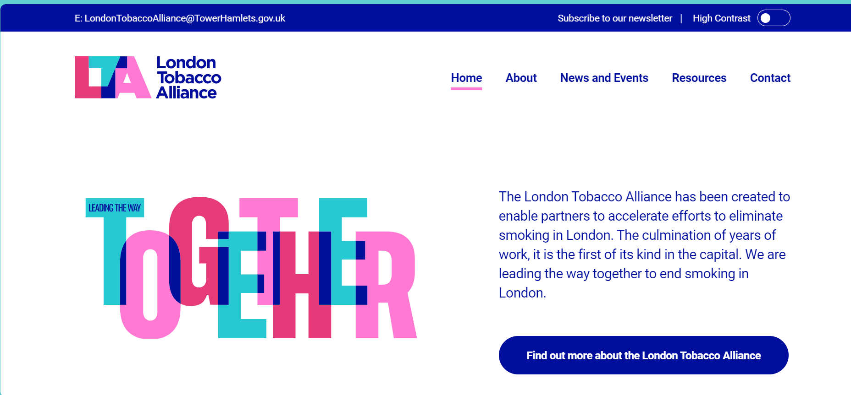
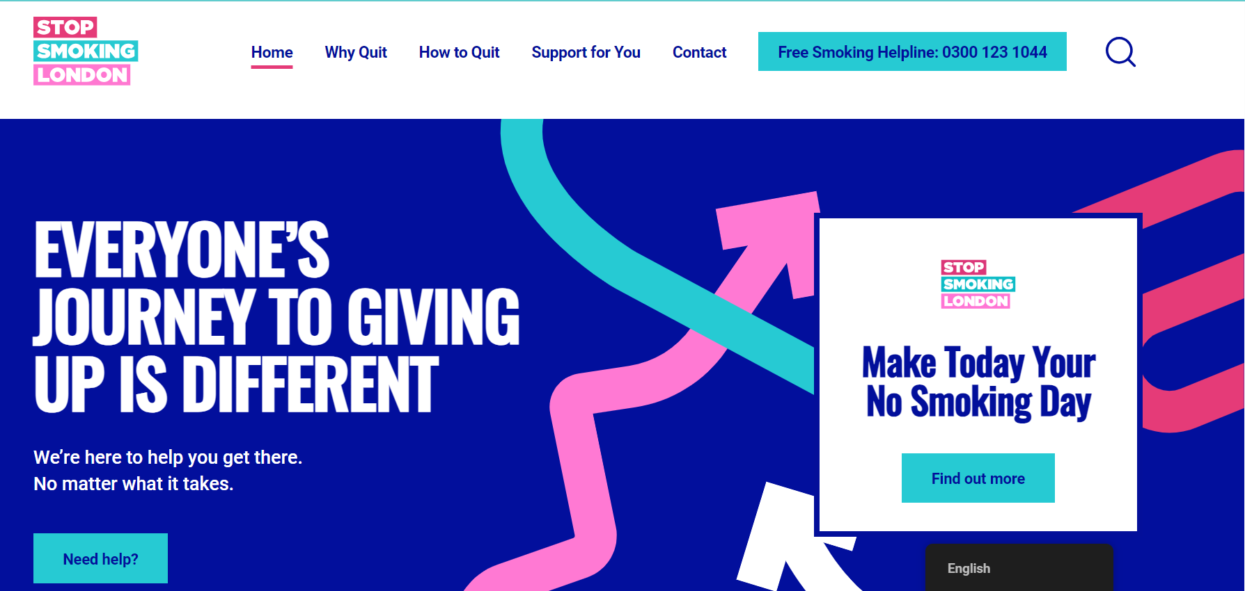
Website Landing Pages
London Tobacco Alliance
London Tobacco Alliance - Homepage
Stop Smoking London
Stop Smoking London - We're Here to Help You Quit Smoking

