Slide 1
OHID London: Communications update Public Health Communications Network
Carly Tutty-Johnson
Head of Business Operations and Stakeholder Engagement
13.03.2024

Slide 2
DG groups organogram from 1 February 2024
CMO
PS1
PS2
Chief Scientific Adviser
Lucy Chappell
Chief Analyst (incl. Chief Economist and Public Health Analysis)
Chris Mullin
Chief Data Officer
Recruiting
DCMO, Health Protection (Director)
Professor Thomas Waite
Finance
Andy Brittain
Global and Public Health
Clara Swinson
Elective Care and Cancer
Oliver Clarke*
Adult Social Care
Michelle Dyson
Digital Policy Unit (Director)
Felix Greaves
New Hospital Programme SRO
(Director)
Natalie Forrest
Group Operations (2PS)
Primary Care and Prevention
Jonathan Marron
Primary and Community Health Care
Ed Scully
Mental Health, Disabilities, Women’s Health and Maternity
Fiona Walshe
Secondary Prevention
Cathy Morgan
Early Years, Children, and Families
Liz Ketch
Work and Health Unit (joint w/ DWP)
Lorraine Jackson (Head of Site in Leeds)
Science, Research and Evidence
Gail Marzetti
Office for Life Sciences (joint w/ DSIT)***
Ros Campion
DCMO, Health Improvement (Director)
Dr Jeanelle de Gruchy
Emergency Preparedness and Health Protection
Emma Reed
Health Protection, and Public Health systems
David Lamberti
Health Improvement
Natasha Burgon
EU and Trade and the Union
Ed Moses
International
Anna Wechsberg
Urgent and Emergency Care
Paul Macnaught
NHS Workforce Gavin Larner
System Oversight and Integration
Jason Yiannikkou
Medicines
Gila Sacks
Quality, Safety and Investigation
William Vineall
ASC Workforce and Policy
Tom Surrey
ASC Delivery
Claire Armstrong
ASC Strategy and Reform
Tabitha Jay
Better Care Fund and Hospital Discharge Ben Dyson
NHP Strategic Engagement, Policy and funding
Charlotte Taylor
NHP Delivery, Performance and Assurance
Paul Mustow
Ministers, Accountability and Strategy
Hugh Harris
Workspace, Information, Security and Technology
Ian Stone
HR
Zoe Bishop*
Communications
Lynda Scott*
Chief Commercial Officer
Michael Carey*
Revenue Directorate
Tim Andrews
Capital Directorate
Patrick Carey
Digital Policy and Programmes
Hulya Mustafa
National Cyber Information Security
Phil Huggins
Secondary Care and Integration
Matthew Style
Supply Resilience David Simmons
Inquiry Response Unit
Anna Sanders
Public Health Regions (incl LKIS); Regional Directors:
Aliko Ahmed; Kevin Fenton; Mike Wade; Peter Kelly; Andrew Furber; Alison Barnett; Debbie Stark
Chief Public Health Nurse**
Vacant
Med Tech and Innovation
David Lawson
Addictions Adviser Rosanna O’Connor
Chief Nurse Adult Social Care**
Deb Sturdy
Chief Social Care Worker**
Lyn Romeo
OHID lead
Office for Health Improvement and Disparities
Commercial Director 2
Vacant
Industrial Relations
Miranda Worthington*
(Temporary Role)
Key
*Interim post holder
**Professional Leadership position
***Role sits within DSIT

Slide 3
OHID London priorities for FY24/25
Creating a Smoke free Generation
System leadership for tackling health inequalities in London
Supporting the effective delivery of the drug strategy in London
Assurance of Public Health Grant & DPH appointments
Tackling CVD prevention as a major driver of morbidity and mortality
Identify and respond to significant public health challenges and risks
Giving every child the best start in life
Supporting a dynamic, thriving and diverse public health workforce
Maximising opportunities to find good work and remain in employment​
Strengthen London health intelligence

Slide 4
The London vision A shared ambition to make London the world’s healthiest global city, and the best global city in which to receive health and care services.
London-Vision-short-summary-1.pdf (transformationpartnersinhealthandcare.nhs.uk)

Slide 5
Examples of OHID London achievements, working with our excellent system partners…

Slide 6
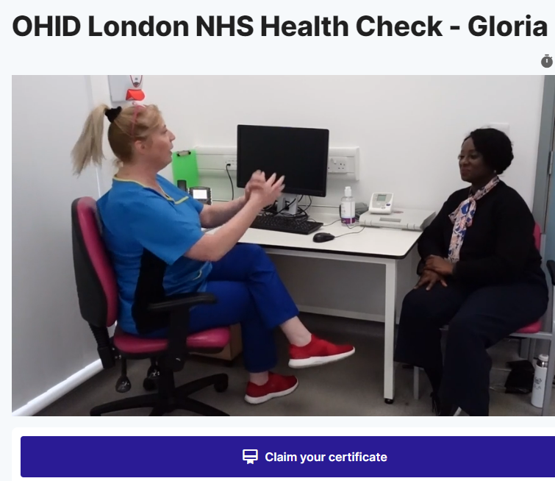
Launch of NHS Health Check training resources
Launched in November 2023, a resource pack to support training of healthcare practitioners in delivering the NHS Health check in London:
Gloria NHS Health Check
Sanjeev NHS Health Check
It includes 2 videos to give an insight into what a good practice health check assessment looks like, a recording of our launch webinar (panel discussion starts at approx. 1hr 10 mins in) and a very helpful Q&A doc NHS Health Check London Training Resource Pack | ADPH London
To access the videos you will have to register on the Medall platform, this is to ensure that they can only be accessed by people involved in health care. This doesn’t take long, and you will only need to do it once. Follow this link
https://app.medall.org/sign-up
The resources have been actively shared with the London network, National and

Slide 7
Evaluation and next steps
The videos received 53 views at the launch event in Nov
In 2024/25 OHID London will be investing in a new video, incorporating evaluation feedback points
What is your profession? | Which borough do you work in? | Confidence in delivering NHS HC before watching the film | Confidence in delivering NHS HC after watching the film | How likely are you to use what you have learned to make a difference? | Have you ever attended NHS Heath Check training?
 | AVERAGE | 3.8 | 4.6 | 4.8
From the evaluation survey there were some suggestions to develop more videos on:
Scenario when an active and healthy person has a high QRisk
Alcohol - how to work out the units if someone is an occasional drinker
More advice regarding diet in relation to blood results
People expressed an increase in confidence after watching the videos
Smart solution training sessions planned
(MedAll | Healthcare training for everyone | MedAll):
City & Hackney - 24 April 9.30am
Hounslow – 8 May 9am
Bromley – 21 May 1pm

Slide 8
Damp and Mould in the home – a public health concern
Issue rose to prominence following the death of 2-yr-old Awaab Ishak (Dec 2020) following chronic exposure to damp and mould.
Sept 2023 – Government published guidance in response to Coroner’s report – Understanding and addressing the health risks of damp and mould in the home (Gov.UK)
London multi-agency group of local government and health system partners – including the ADPH London, GLA, NHS England (London region), UKHSA and OHID – came together to develop a new tool for use by frontline health and social care professionals when visiting residential properties.

Slide 9
Damp and Mould in the home – a public health concern
The Checklist provides evidence and resources to help health and care professionals:
understand and recognise damp and mould concerns and issues,
identify those individuals and households most vulnerable to the health risks of damp and mould exposure,
provide appropriate advice and take action.
Toolkit available on MECC Link London - online directory of health and wellbeing services localised to all 32 London boroughs and the City of London, as well as information on healthy lifestyle topics.
The London Damp and Mould Toolkit has now been adopted by DHSC and DLUHC as a resource to be used nationally to help address the issue in households.

Slide 10
Damp and Mould in the home – a public health concern
Comms ‘Ask’
Please promote the Damp and Mould toolkit and MECC Link London to public facing health and social care workers in your borough, also Public Health and Housing colleagues.
Inclusion on training platforms and internal comms channels…
Promote the upcoming national webinar – Thursday 21 March, 3pm-4.30pm
For more information see: Damp and Mould | ADPH London

Slide 11
Start for Life ‘If they could tell you campaign’
Launched 4th March. Promoting importance and benefits of strong parent and infant relationships. The campaign will highlight how use of body language, facial expressions, noises and cries can help parents find the best way to meet the needs of their infant, and also cover breastfeeding and introducing solid foods
Resources are available on the Start for Life website.
Partners can support this campaign from 18 March with a range of resources on the Campaign Resource Centre, including:
Campaign communications toolkit
Social media toolkit
Posters
Digital screens
Web banners
please make sure you’re subscribed to the Campaign Resource Centre to receive regular updates about this campaign and our other Start for Life campaigns and programmes. If you have any questions, please email partnerships@dhsc.gov.uk.

Slide 12
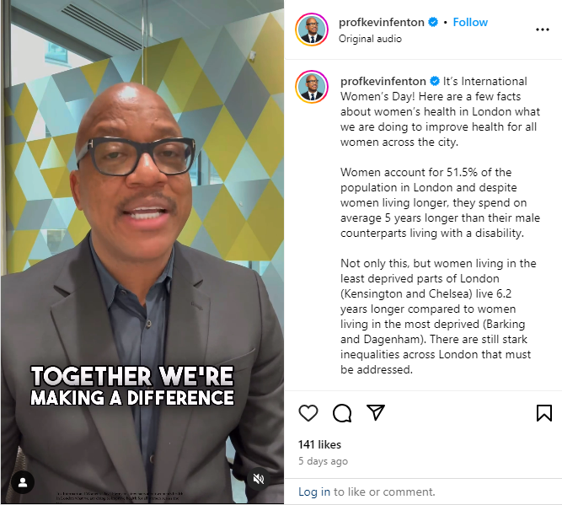
International Women’s Day - 8 March
Kevin Fenton shared a video last week to mark International Women’s day:
https://www.instagram.com/reel/C4P1rkyIm7J/?utm_source=ig_web_copy_link
This celebrated that all London ICBs now have a dedicated Women’s health Champion and that work is underway to establish a Women’s health hub in each ICB.
It promoted breast screening and cervical screening, emphasising the opportunity to eliminate cervical screening by 2040
He highlighted that stark inequalities still exist, as women living in the least deprived parts of London (Kensington and Chelsea) live 6.2 years longer compared to women living in the most deprived (Barking and Dagenham).

Slide 13
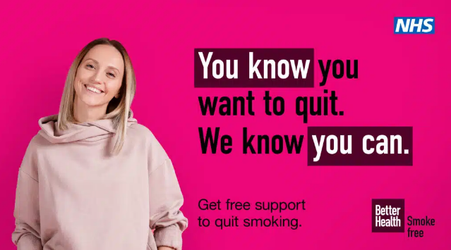
Today is no smoking day!
Here is the link to the resources Better Health Quit Smoking | Campaigns | Campaign Resource Centre (dhsc.gov.uk).
There was a press release this morning: Urgent call to smokes to make a quit attempt for No Smoking Day - GOV.UK (www.gov.uk)
For any challenges relating to the duality of promoting vapes as an adult quit aid vs the vape bill to reduce access to young people – this myth buster is great Vaping myths and the facts - Better Health - NHS (www.nhs.uk)

Slide 14
In the pipeline…
A Major new heart health initiative focusing on CVD, working with GLA and other system partners

