Slide 2
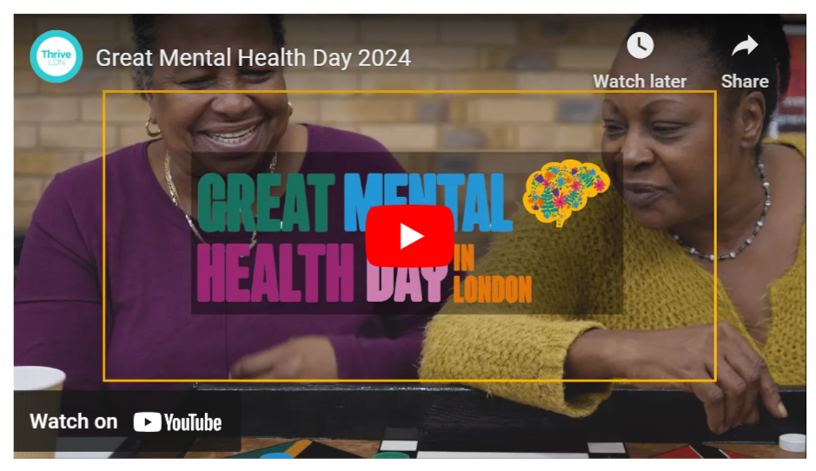
What is Great Mental Health Day?
Great Mental Health Day returns on Friday, 26 January 2024.
Great Mental Health Day is a London region awareness day to supports Londoners to talk about mental health, create a platform to highlight the great support available, and, crucially, take the stigma out of asking for help when needed.
Building on previous years, it will see 1,000s of Londoners come together across 100s of free events taking place across the city, sharing stories, experiences and exploring ways to support individual and community wellbeing.
For 2024, GMHD the theme for the day will explore the importance of ‘meaningful connections’.
Click to watch promotional GMHD 2024 video

Slide 3
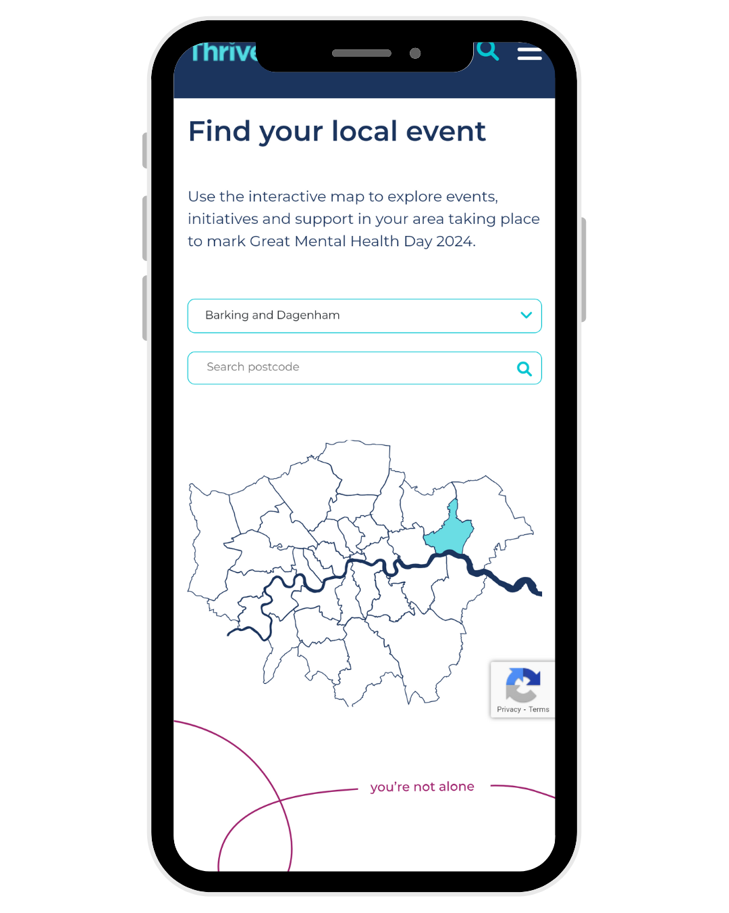
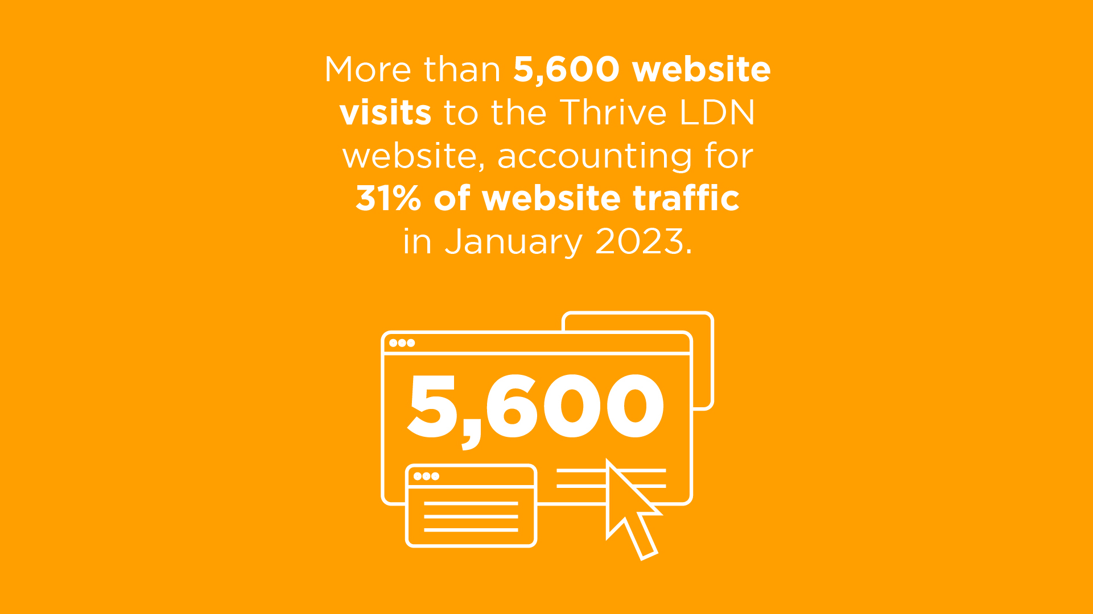
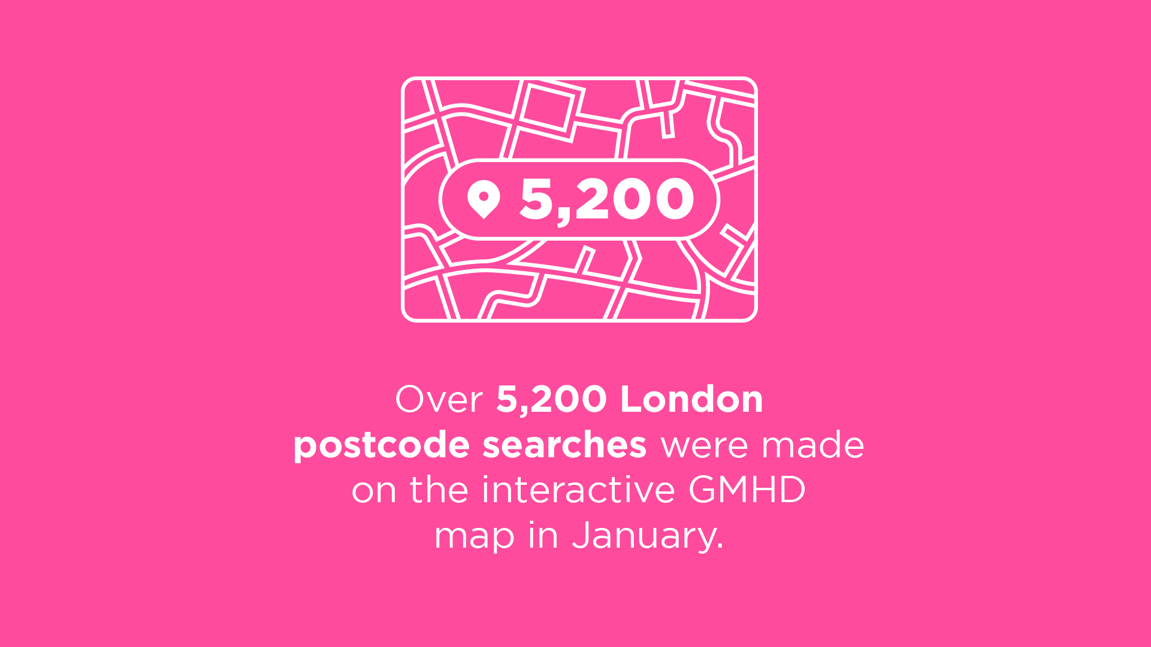
Localising Great Mental Health Day
Events for Great Mental Health Day 2024 will take place all over London.
Thrive LDN will once again host an interactive map of London allowing people to explore events, initiatives and support in their area. If you or anyone in your local area in London is planning an event or initiative for Great Mental Health Day 2024, please tell us about it.
Additionally, this will be supported by an Online Events listing page for anything less locally defined and open to anyone across London (and beyond) to join.
Now available, an updated Supporter’s Pack and communications toolkit. Resources are being updated in the run up to Great Mental Health Day 2024.

Slide 4
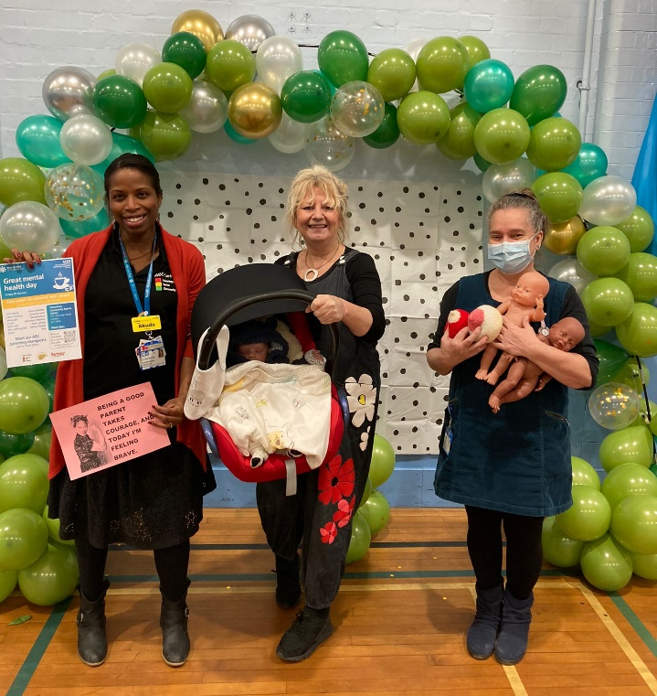
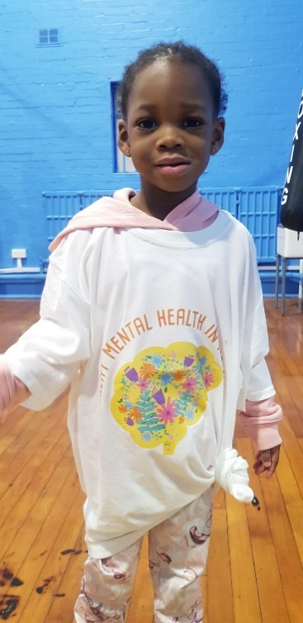
Haringey activities 2024
ABC Parents Fair
Haringey Flagship Event.
Friday 26th January.
Tottenham Sports Centre.

Slide 5
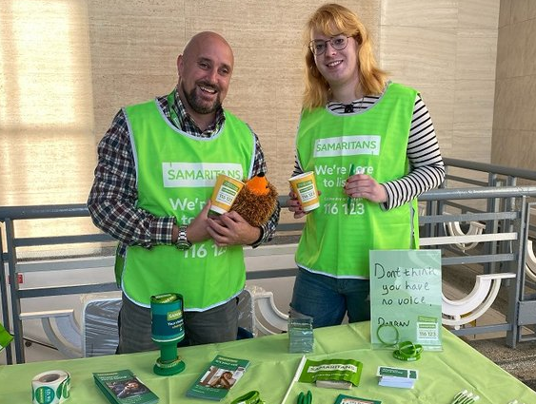
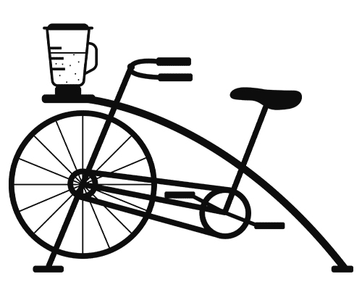
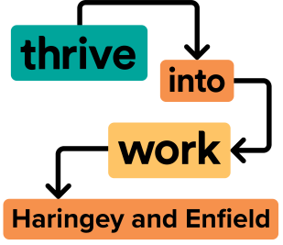
2024 Activities
Subject to change. More events TBC.
IAPT Training
Poetry workshop
Delivering mental health assemblies in schools.
Film screening:
‘Mental health, my father and me’
Samaritans Roadshow
Active travel Team: smoothie bike and cycle to work programme
Gambling Harms Training
Meet our MHFA’ers
₊
CV Building workshop
₌
North London Mental Health Partnership event
Notes:
a

Slide 6
“An amazing opportunity to hear about and learn how to access services we hadn't heard of before”.
“It opened up the conversation of mental health and showed there are many, many aspects to it”.
“It was very informative, good mix of stalls, and activities, very busy and lively, fun, with opportunities to meet others and positively engage in the local community. Shame its only once a year. Would like more community events like this!”

Slide 7
Further questions and contact
Got a burning question?
Then explore our FAQs in case it may be covered in there.
Or speak to the Thrive LDN team.
You can contact us (info@thriveldn.co.uk) to have a chat through your plans and ideas.

