Slide 1
#ChampionMentalHealth
Campaign launch
May 2023

Slide 2
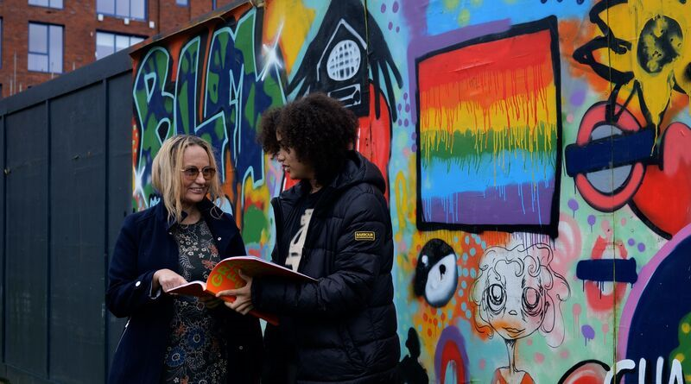
The Mayor’s call to #ChampionMentalHealth and wellbeing in London
Everyday Londoners are doing what they can to support themselves and others with good mental health - whether checking in with a mate at the school gates, inviting a neighbour over for a cup of tea and a chat, or bonding with a customer at the barber shop. After all, looking out for one another is what we in London do best.
But we know that conversations around mental health are difficult. That’s why to mark Mental Health Awareness Week, the Mayor of London launched a campaign in support of Londoners who #ChampionMentalHealth – in their families, places of work or their communities.
Get involved 👉 https://www.london.gov.uk/mental-health-wellbeing

Slide 3
The Mayor’s call to #ChampionMentalHealth and wellbeing in London
When you sign up, you’ll receive tools and resources to best support yourself and others right to your inbox, including:
Training to boost skills & confidence - We will regularly send you opportunities that will give you the chance to broaden your knowledge, gain skills and confidence, and complete free, certified training modules. Everything from #ZeroSuicideLDN to the conversation starter tool.
Support for you – We know that doing your bit to support others who are struggling can bring its own challenges, and nothing is more important than doing what you can to look after your own mental health. Whether that’s browsing Good Thinking’s offers to help with sleep, anxiety, low mood or stress, or reaching out for more urgent support. Remember you are not alone.
An opportunity to connect – You are part of a network of people who are taking action to promote and protect wellbeing. You can continue the conversation and connect by joining Talk London’s mental health discussion. We’ll also be sharing examples of activities these Londoners are doing to help inspire you.
Notes:
What’s in it for Londoners? Access to regular, free opportunities and offers, such as:
Training to boost skills and confidence with difficult conversations
Support to help them get through challenging times
An opportunity to connect with others who are championing good mental health
The best part is people can join and take up opportunities at their own pace and in their own time. And there will be something for everyone.

Slide 4
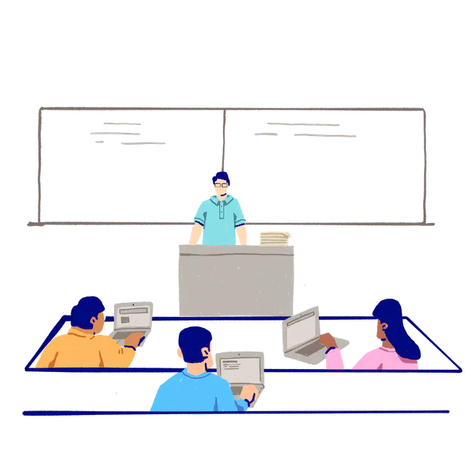
Children and young Londoners - Resources & training
Good Thinking for young people - https://www.good-thinking.uk/youngpeople
Good Thinking for students - https://www.good-thinking.uk/students
Youth Mental Health First Aid topic-focused ‘top-up webinars’ for education and youth sector staff (Thrive LDN & MHFAE) - https://www.youtube.com/playlist?list=PL8ojnZ7ivZYHEf8hlYPWqO-WIDWqQuPJ7
Nurturing Future Minds, support for early years, parents & carers - https://nurturingfutureminds.org.uk/
Urgent & crisis support - https://www.nhs.uk/service-search/mental-health/find-an-urgent-mental-health-helpline

