Slide 1
Polio vaccine booster campaign: London Briefing pack for UKHSA stakeholders
March 2023

Slide 2
Background:
In June 22 the UKHSA announced that, working with the MHRA, it had identified poliovirus type 2 (PV2) in sewage samples collected from the London Beckton Sewage Treatment Works between February and June.
The virus had evolved to a ‘vaccine-derived’ poliovirus type 2 (VDPV2), which on rare occasions can cause serious illness, such as paralysis, in people who are not fully vaccinated.
Continued surveillance of sewage in London has found no further vaccine-derived poliovirus type 2 (VDPV2) isolates have been detected since early November, which suggests transmission in London has significantly reduced.
The World Health Organization requires evidence of 12 months of zero detections before the UK is no longer considered to be a polio ‘infected’ country.
NHS in London will soon be delivering a catch-up campaign, offering polio jabs and other routine childhood vaccines such as measles, mumps and rubella (MMR) to unvaccinated or partially vaccinated children aged 1 to 11 years, during the summer term.

Slide 3
Useful Links:
Original Campaign Launch Press Release (August 2022):
All children aged 1 to 9 in London to be offered a dose of polio vaccine - GOV.UK (www.gov.uk)
Catch-up Campaign Press Release (March 2023):
Polio vaccine catch-up campaign for London as sewage surveillance findings suggest reduced transmission - GOV.UK (www.gov.uk)
NHS Polio booster vaccination data in London
UKHSA Quarterly vaccine coverage data (July-September 2022)
An alert to clinicians was reissued to reinforce the importance of ensuring reporting of acute flaccid paralysis (AFP) and acute flaccid myelitis (AFM)
Polio is considered a Public Health Emergency of International Concern (PHEIC). Advice to travellers to ensure they are up to date with their vaccinations prior to travel has been published.
* The additional sites where the sampling has been rolled out are Sewage Treatment Works covering parts of Birmingham, Blackburn with Darwen, Bradford, Brighton and Hove, City of Bristol, Bury, Castle Point, Leeds, Leicester, Liverpool, Luton, Manchester, North Tyneside, Newcastle upon Tyne, Gateshead, Nottingham, Preston, Salford, Sheffield and Watford. London sites will continue to be tested bi-weekly, and the rest of the country is on a monthly sample collection and testing cycle.
More information available here: Expansion of polio sewage surveillance to areas outside London - GOV.UK (www.gov.uk)

Slide 4
Lines to Take:
Dr Vanessa Saliba, Consultant Epidemiologist at the UKHSA said:
“While there are early signs of reduced spread of the poliovirus in London, we need to continue to improve uptake of childhood vaccines in all communities. Until we reach every last child, we cannot be sure that we will not see a case of paralysis. Even a single case of paralysis from polio would be a tragedy as it is completely preventable.
“Only by improving vaccination coverage across all communities can we ensure resilience against future disease threats”

Slide 5
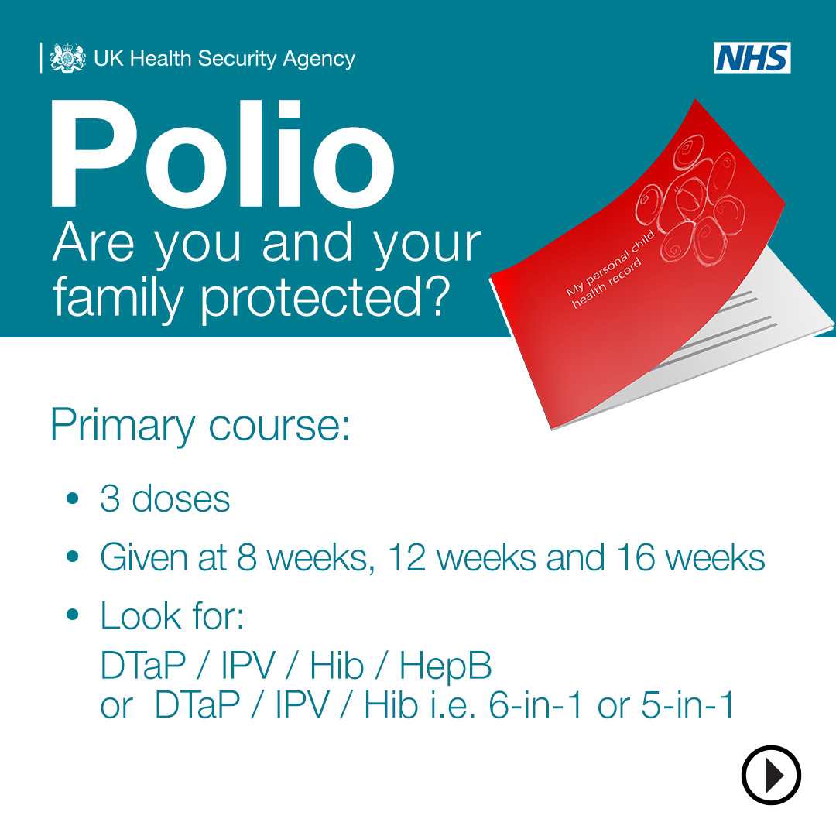
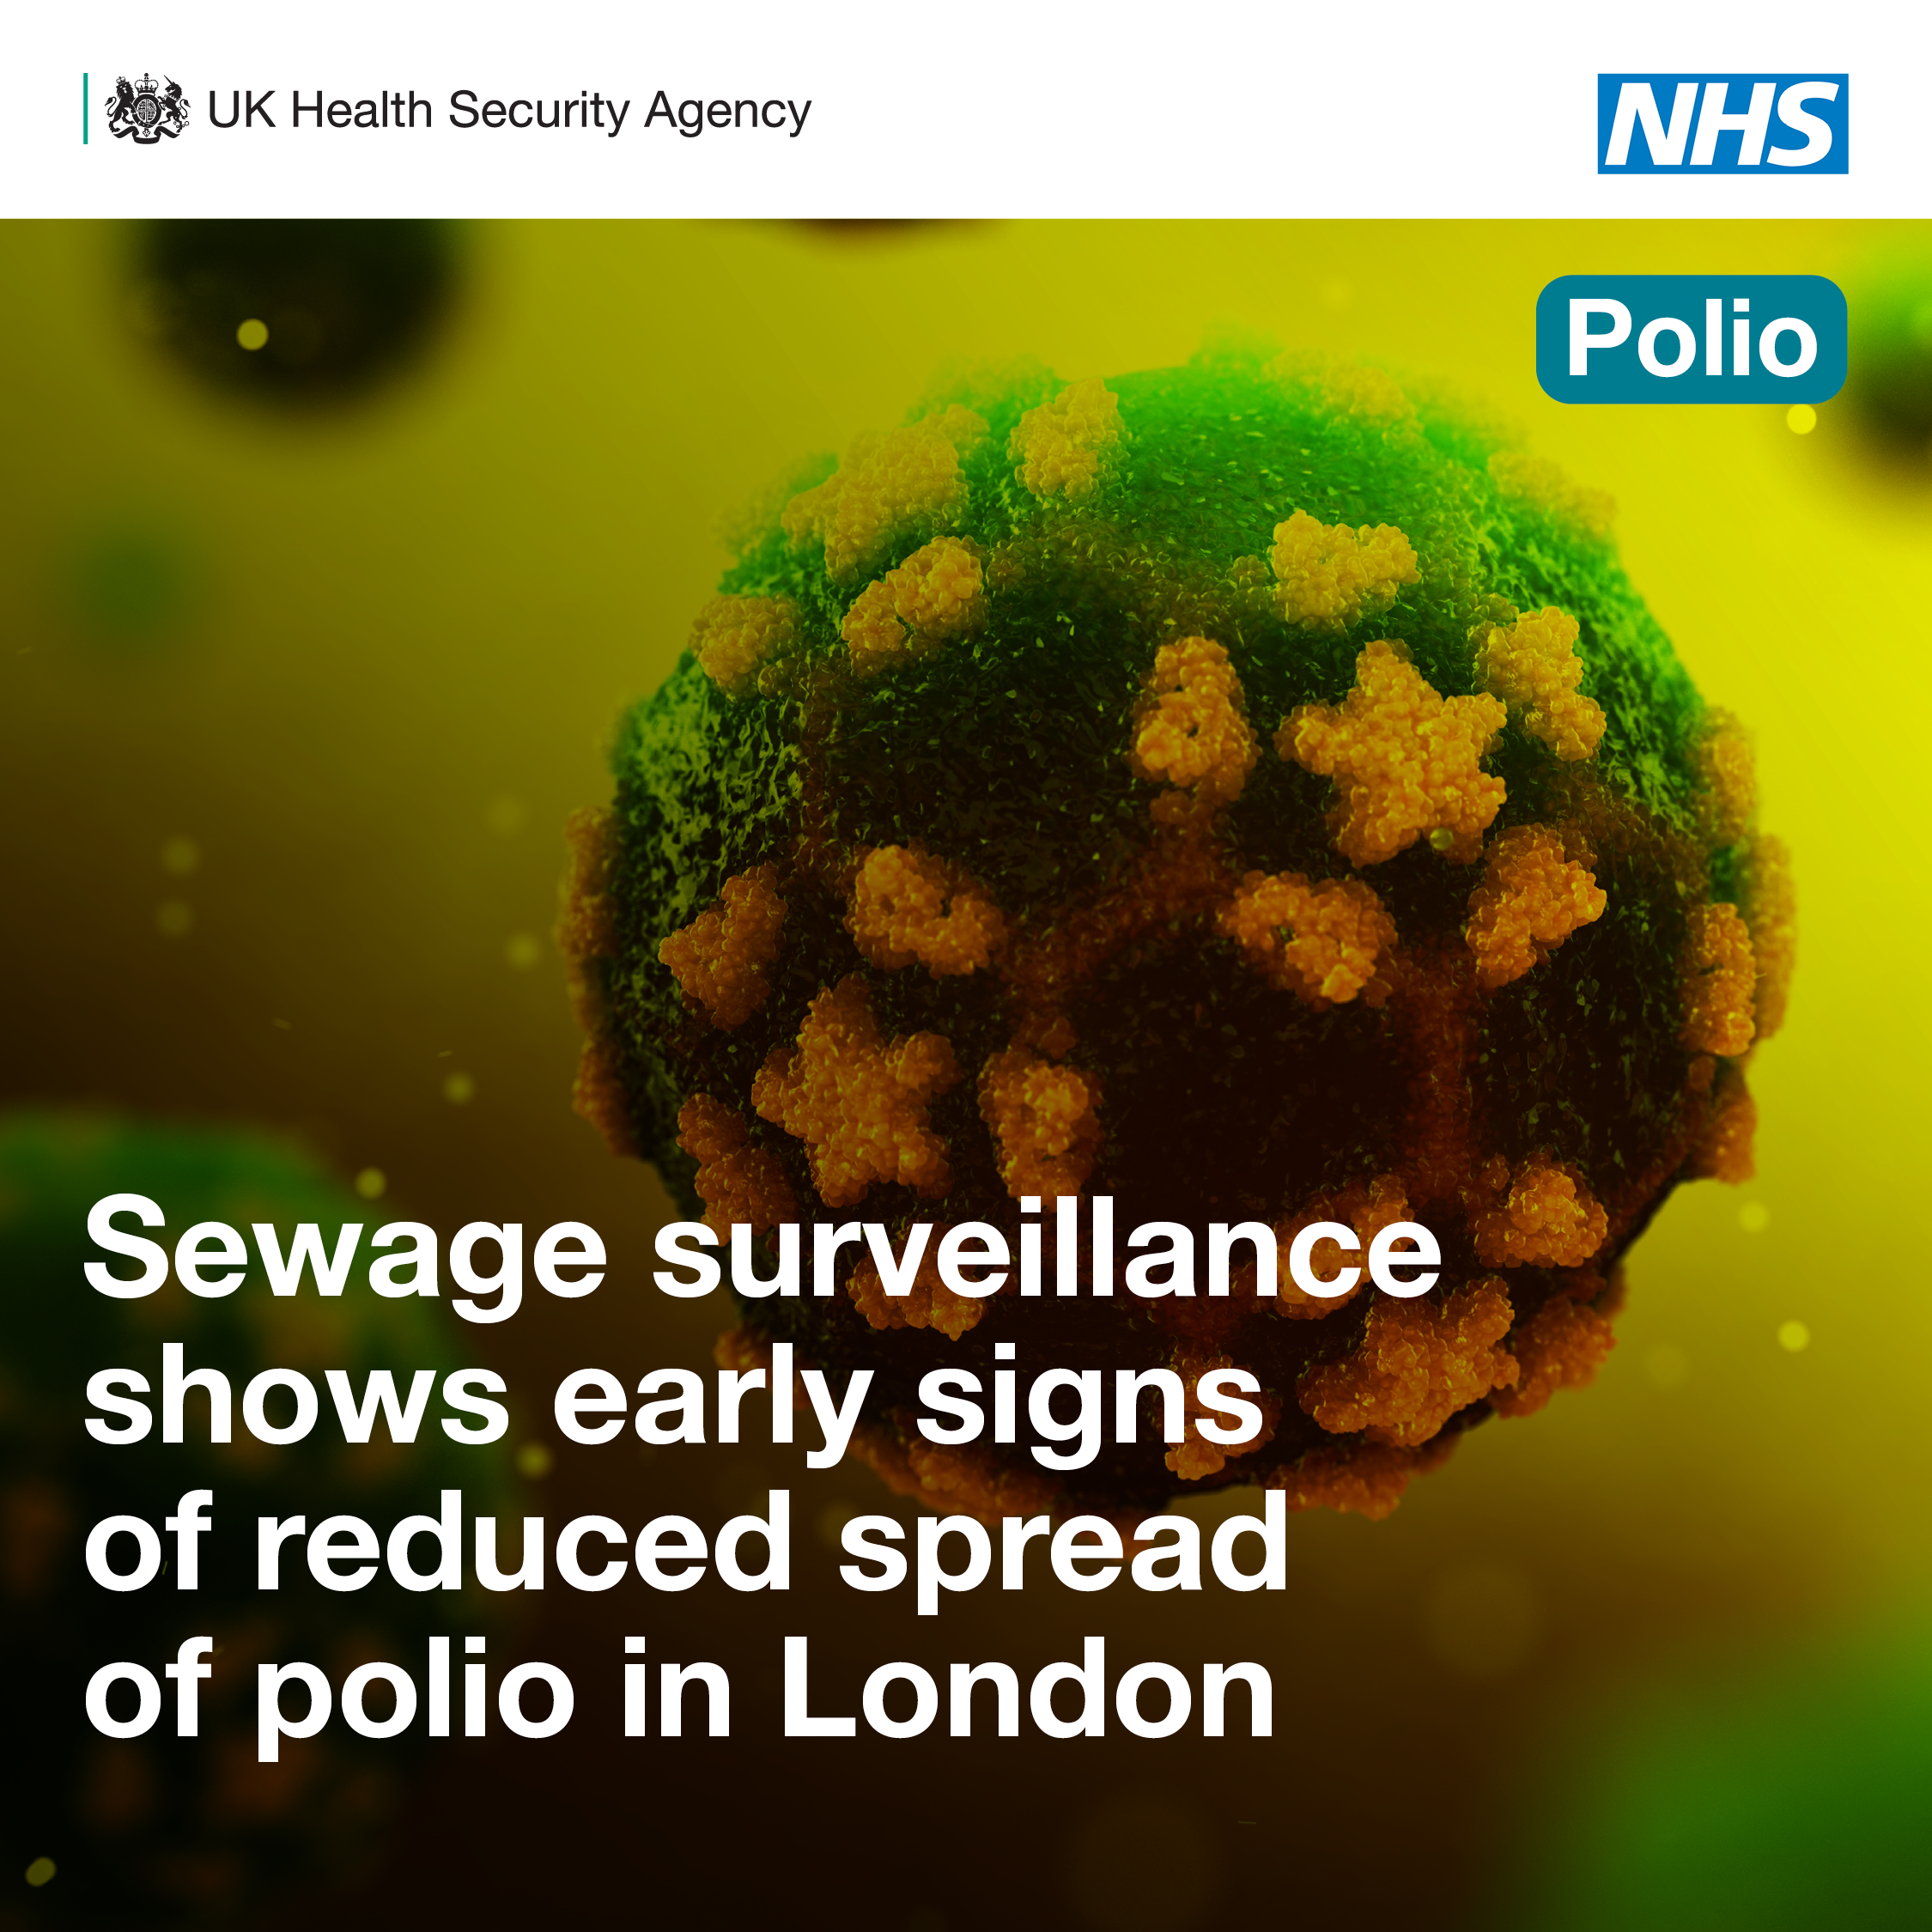
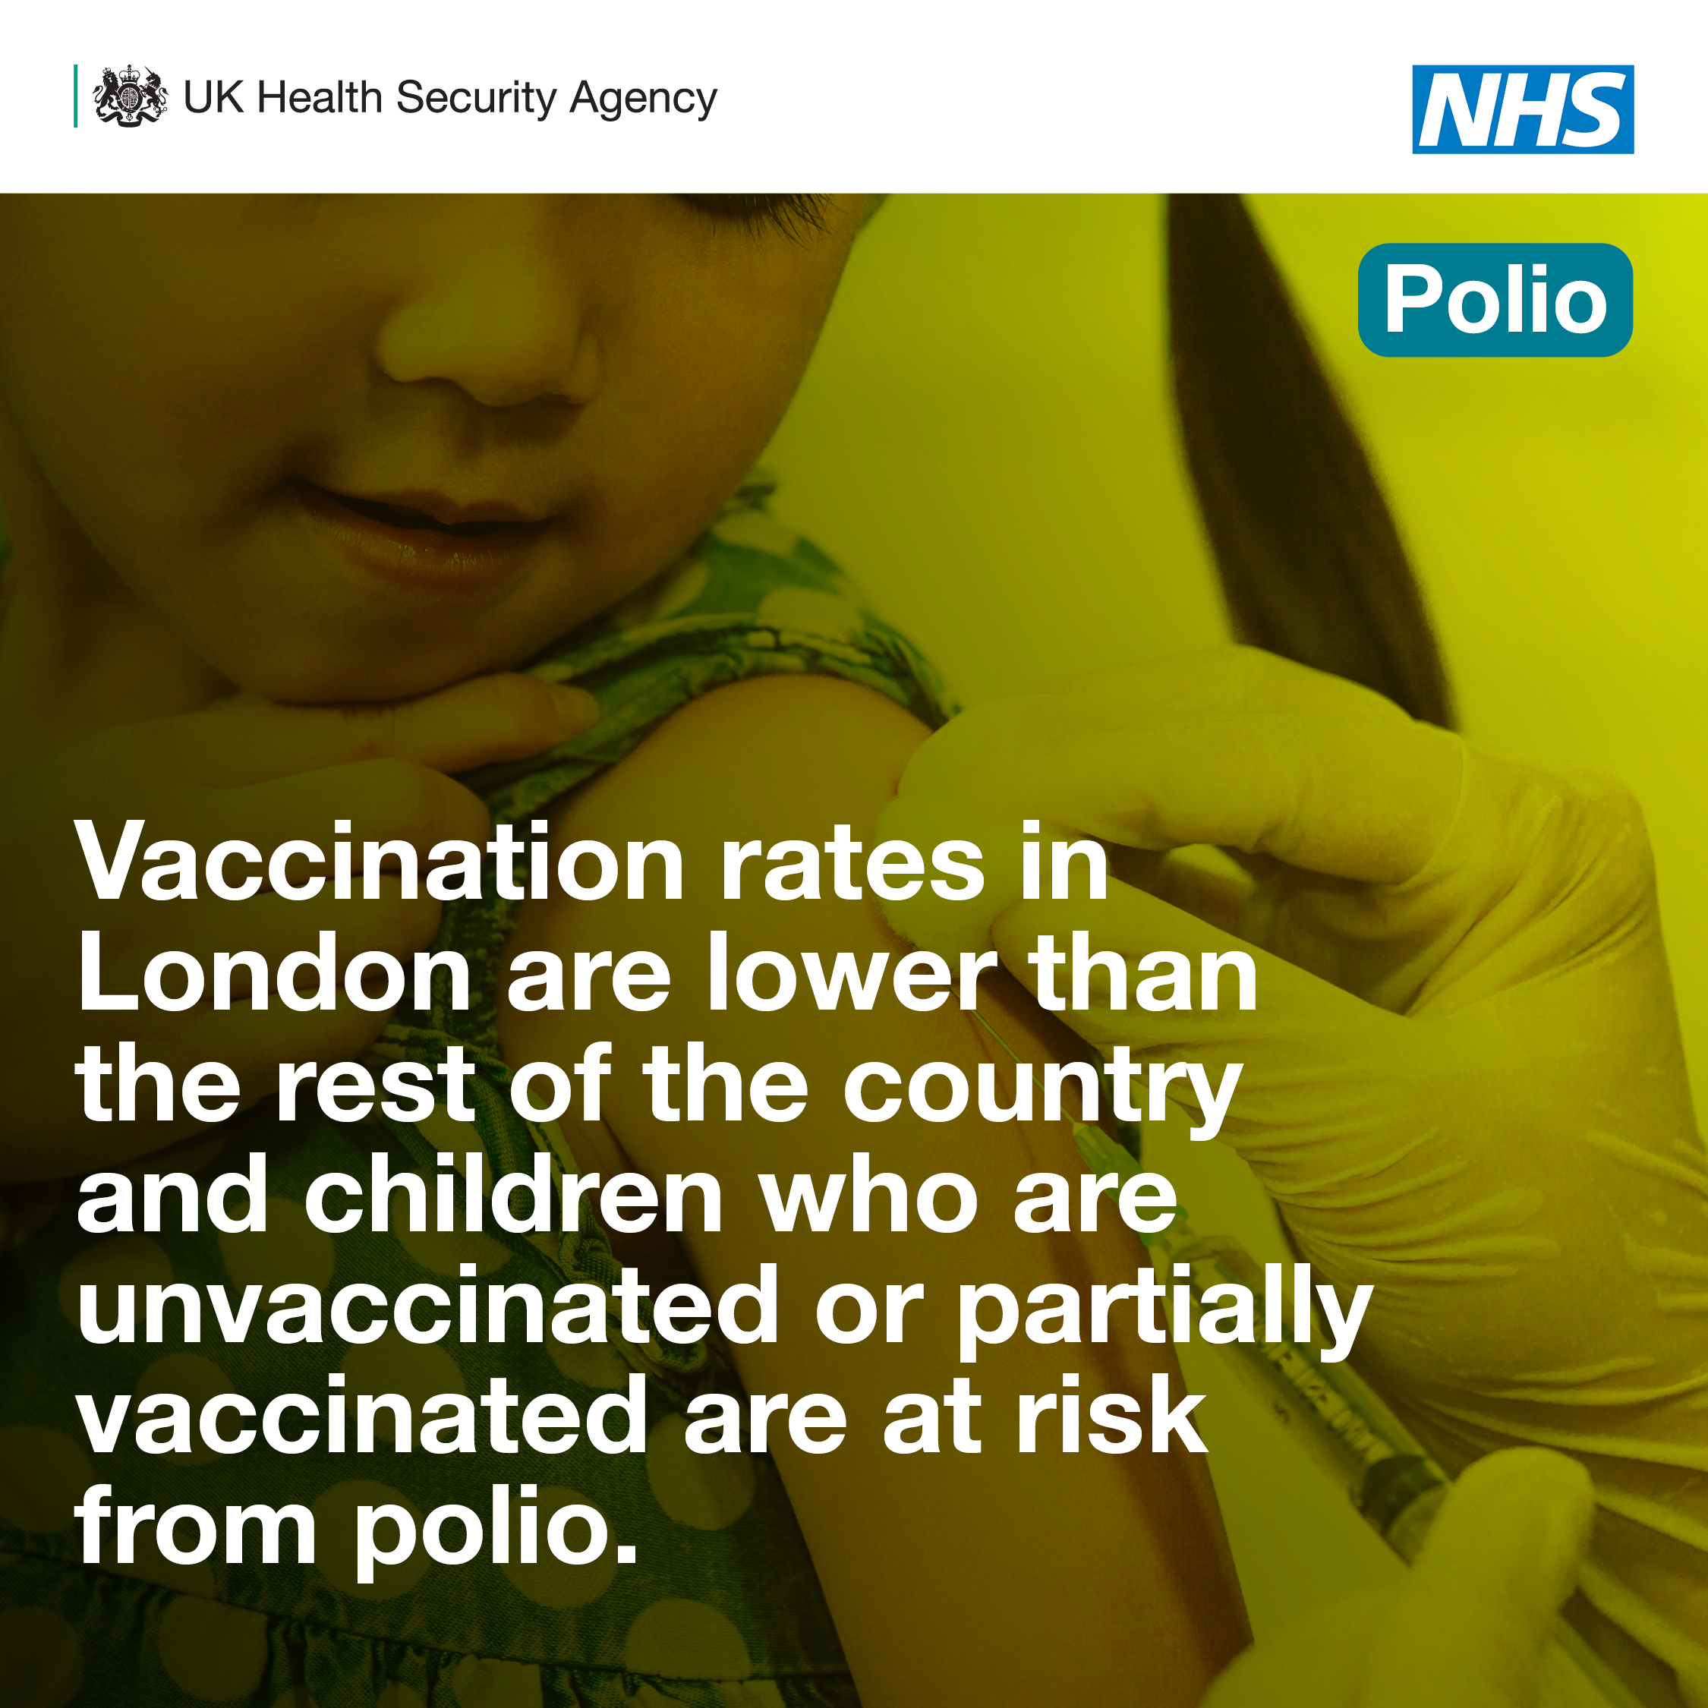
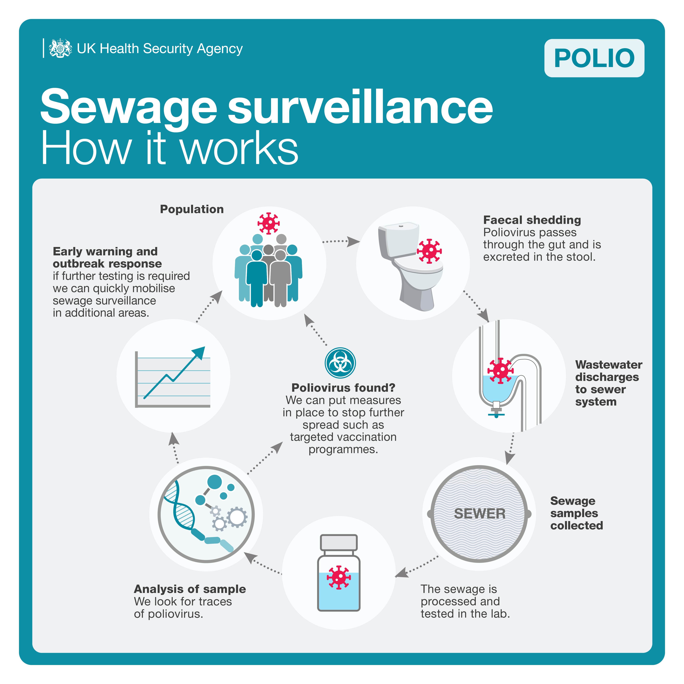
Communications assets:
UKHSA has produced assets which stakeholders can use for distribution on their own social media channels.
These can be found on our Google Drive and includes:
Latest polio findings, jpegs: statics and animations
Infographics on wastewater/sewage surveillance and how it works
Polio vaccine info for parents, jpegs

Slide 6
New findings
Fewer poliovirus detections in London suggests reduced community transmission but vaccine rates in some London boroughs still too low
Catch-up vaccination programme to gather pace through primary schools and community clinics during the summer term
The NHS in London to focus on under-vaccinated children most at risk
To date, no detections of vaccine-derived poliovirus type 2 in 18 sites outside of London
No paralytic polio cases reported in England

Slide 7
Key Points From announcement:
The NHS in London will soon be delivering a catch-up campaign, offering polio jabs and other routine childhood vaccines such as Measles, Mumps and Rubella (MMR) to unvaccinated or partially vaccinated children aged one to eleven years, during the summer term.
Children will receive vaccines through a combination of primary school and community clinics, with a particular focus on supporting communities with the lowest levels of vaccine uptake.
No paralytic polio cases have been reported in patients in England. However, there is still a risk that the VDPV2 could cause paralysis in an unvaccinated individual, as seen in the USA last year and more recently in Israel.
A total of 135 poliovirus type 2 isolates have been identified in 30 sewage samples collected in London between 8 February and 8 November last year. While the sewage surveillance was expanded to cover the whole of London, to date the virus has mainly been detected in samples from North and East London.

Slide 8
Outside of London - messages
The message for families is to check their children’s Personal Child Health Record (or “Red Book”) and if they are not up to date to catch their children up as soon as possible.
Local health economy partners should work together to ensure high uptake in the routine childhood immunisation programme, and robust catch-up of children who have missed out.
It is essential all areas have robust interventions in place to improve uptake in under-vaccinated communities and reduce inequalities in uptake.
GP practices should also check that newly registered children and adults are up to date with their routine immunisations with a particular emphasis on new migrants, asylum seekers and refugees.
The offer of polio, MMR and many other vaccinations is evergreen, and anyone who is not up to date with their immunisations should contact their GP surgery to catch-up.

Slide 9
Vaccination rates
Vaccination rates in London are lower than the rest of the country.
87.6% of children receiving all their polio vaccinations by the time they turn one year, compared to 92.1% in England as a whole.
Uptake for the pre-school booster for children aged 5 years is even lower at 69.9% in London, compared to 83.4% in England.
In response, the NHS in London will soon offer polio jabs and other routine childhood vaccines such as measles, mumps and rubella (MMR) to unvaccinated or partially vaccinated children aged 1 to 11 years, during the summer term.
Children will receive vaccines through a combination of primary school and community clinics, with a particular focus on supporting communities with the lowest levels of vaccine uptake.

Slide 10
Sewage findings: what do we know?
The London Beckton Sewage Works covers a population close to 4 million across north and east London.
A total of 135 poliovirus type 2 isolates have been identified in 30 sewage samples collected in London between 8 February and 8 November last year. While the sewage surveillance was expanded to cover the whole of London, to date the virus has mainly been detected in samples from North and East London.
All isolates are related to the Sabin 2 vaccine strain and show the same genetic structure, which suggests a common origin.
In September 2022 sewage surveillance was rolled out to 18 areas outside the capital. This was on a precautionary basis to determine whether the virus had spread further. To date, the poliovirus found in London has not been detected at any of these sites.

Slide 11
Why is vaccine-derived poliovirus in sewage?
In countries where polio still circulates, the oral polio vaccine (OPV) is used as it is more effective at controlling transmission and outbreaks.
OPV contains a weakened live virus which grows in the gut. It can be shed in faeces for a few weeks after vaccination.
People vaccinated with OPV can pass it on to close contacts, mainly through inadequate hand hygiene. OPV's tendency to spread is, in some circumstances, a desired characteristic to help spread immunity.
In communities with low vaccination uptake, the OPV virus spread can be prolonged. Over time the virus will eventually mutate and re-acquires some properties of the natural polio virus which allow it to cause harm (paralysis).

Slide 12
How often is virus detected in sewage?
Finding between one and three ‘vaccine-like’ polioviruses each year in routine UK sewage samples is normal.
These are one-offs from individuals vaccinated overseas with OPV, who have then travelled to the UK and briefly ‘shed’ traces of the vaccine-like poliovirus.
But this type 2 poliovirus has persisted in the sewage in London since February 2022 and has now evolved to a ‘vaccine-derived’ poliovirus type 2.
VDPV2 is of greater concern as it behaves more like naturally occurring ‘wild’ polio and may, on rare occasions, lead to cases of paralysis in unvaccinated individuals.

Slide 13
About Polio vaccines
The best way to prevent polio is to make sure you and your child are up to date with your vaccinations. The vaccine is given as part of a combined jab to babies, toddlers and teenagers as part of the NHS routine childhood vaccination schedule.
It's given when your child is:
• 8, 12 and 16 weeks old as part of the 6-in-1 vaccine
• 3 years and 4 months old as part of the 4-in-1 (DTaP/IPV) pre-school booster
• 14 years old as part of the 3-in-1 (Td/IPV) teenage booster
You need to have all of these vaccinations to be fully vaccinated against polio.
If you are not up to date, you can have a polio vaccination at any point for free on the NHS.
You should also get vaccinated even if you've had polio before as the vaccine protects against three different types of poliovirus.

Slide 14
Recent history of polio
‘Wild’ polio was last contracted in the UK in 1984. The UK was declared polio-free in 2003.
No paralytic polio cases have been reported in patients in England. However, there is still a risk that the VDPV2 could cause paralysis in an unvaccinated individual, as seen in the USA last year and more recently in Israel.
The Global Polio Laboratory Network confirmed that the VDPV2 isolated from the case is genetically linked to two Sabin-like type 2 isolates, collected from environmental samples in early June in both New York and greater Jerusalem, Israel, as well as to the recently detected VDPV2 from environmental samples in London.

Slide 15
Mild case symptoms
Most people with polio won't have symptoms.
A small number will experience a flu-like illness 5 to 21 days after infection.
The early symptoms are the same as a wide range of more common viral infections and include fever, sore throat, headache, abdominal pain, aching muscles, nausea and vomiting
Symptoms usually pass within a week without medical intervention.

Slide 16
More serious outcomes
In between 1/100 to 1/1,000 infections, the virus attacks the nerves in the spine and base of the brain. This can cause paralysis, usually in the legs, which develops over hours or days.
If the breathing muscles are affected, it can be life threatening.
There is no treatment specifically for polio; it can only be prevented by immunisation.
Before the introduction of the routine immunisation programme for polio about 8,000 cases of paralytic polio were diagnosed in the UK in epidemic years.

