Slide 1
Gambling in London: A Rapid Needs Assessment
OHID London
Lizzie Walsh
Health Equity Programme Manager
December 2022

Slide 2
Aims
Outputs from this exercise aim to:
Recognise that Gambling is a Public Health issue across London,
Estimate the scale of potential and actual risk and need against the backdrop of longstanding inequalities, COVID and Cost of living,
Inform a future, long-term assessment of need across the region,
Encourage further local profiling, and
Identify gaps in our knowledge.
By considering: compositional/demographic and contextual factors, comorbidities and health services.

Slide 3
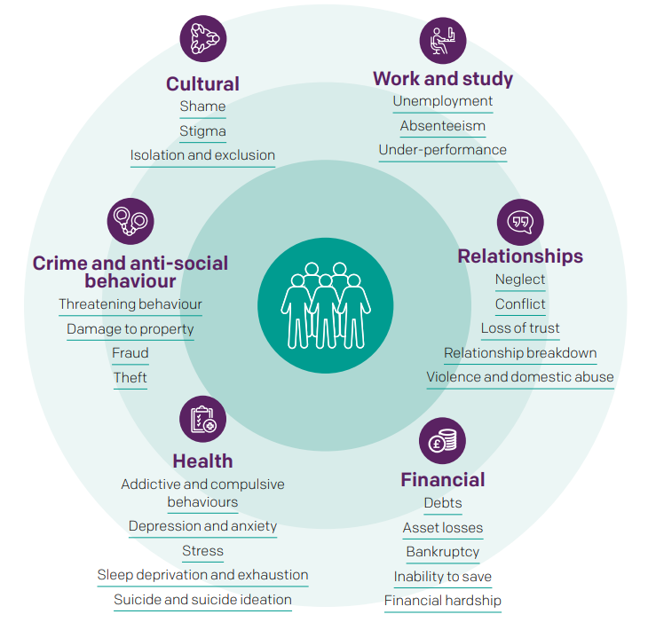
Gambling should be treated as a Public Health issue in London
In London, between 2012-18, Gambling participation prevalence in the last 12 months was approximately 50%, where 3.1-4.2% of the population were classified as at-risk gamblers, and 0.9-1.5% of the population were classified as problem gamblers, compared to 0.5% in England overall [1]. That means at least 6% of those participating in gambling in London are classified as ‘at-risk’.
Gambling, in its economic sense, can be briefly defined as behaviour involving the risk of money or valuables on the outcome of a game, contest or other event in the hope of winning additional money or material goods.3 It incorporates a wide range of activities in a variety of settings [2].
Harmful gambling has a different activity profile to general gambling and has serious consequences for individuals, families and communities. These harms are inherently complex and individualised. For many, gambling related harms leave a lasting legacy beyond initial recovery from gambling disorder and may be experienced for many years after the event.
Evidence shows that people with higher levels of gambling involvement and more severe gambling disorder experience the greatest degree of harms [1]. All harms are felt equally by the person who gambles and people affected by someone else’s gambling (which can include but is not exclusive to): friends, parents, partners, children and siblings [3,4].
Framework for the impact of gambling-related harms [3]
Against the backdrop the COVID-19 pandemic and the ongoing Cost of Living crisis, many of the known inequitable risk factors discussed throughout this document are likely to increase in prevalence, whilst simultaneously deepening in inequity. This is a moment in time where action must be taken to prevent and manage problem gambling as a public health issue.
Notes:
London stats from:
[1] Gambling-related harms evidence review: quantitative analysis of gambling involvement and gambling-related harms among the general population in England (publishing.service.gov.uk)
Gambling as public health content and image:
[2] A losing bet? Alcohol and gambling - investigating parallels and shared solutions | Alcohol Change UK
[3] https://www.greatermanchester-ca.gov.uk/media/6253/gambling-harms-in-gm-needs-assessment-may-2022.pdf
[4] A 'Whole Council' Approach to Gambling | London Councils

Slide 4
A note on language
Gambling-related harm encompasses the “adverse impacts from gambling on the health and wellbeing of individuals, families, communities and society”, whereas problem gambling is “gambling that disrupts or damages personal, family or recreational pursuits.”
The term “problem gambler” can imply that an individual is solely responsible for their gambling. This underplays the risky and harmful nature of gambling products.
However, “problem gambler” is widely used in diagnostic screening and prevalence studies. To maintain consistency with established tools and diagnostic criteria the terms “at risk” and “experiencing problem gambling” are replicated throughout this document.
In London we will promote the use of terms that encourage support for the whole person, and not just their ‘condition’, whilst also addressing the negative impact of stigma.
The term “affected other” is used to describe anyone who may be affected by someone who is experiencing gambling harms and may be applied to friends, parents, dependents, housemates, partners, colleagues or siblings.
Notes:
Note on language based on:
[1] https://www.greatermanchester-ca.gov.uk/media/6253/gambling-harms-in-gm-needs-assessment-may-2022.pdf
Image: 24,995 Stock Photos, Pictures & Royalty-Free Images - iStock (istockphoto.com)

Slide 5
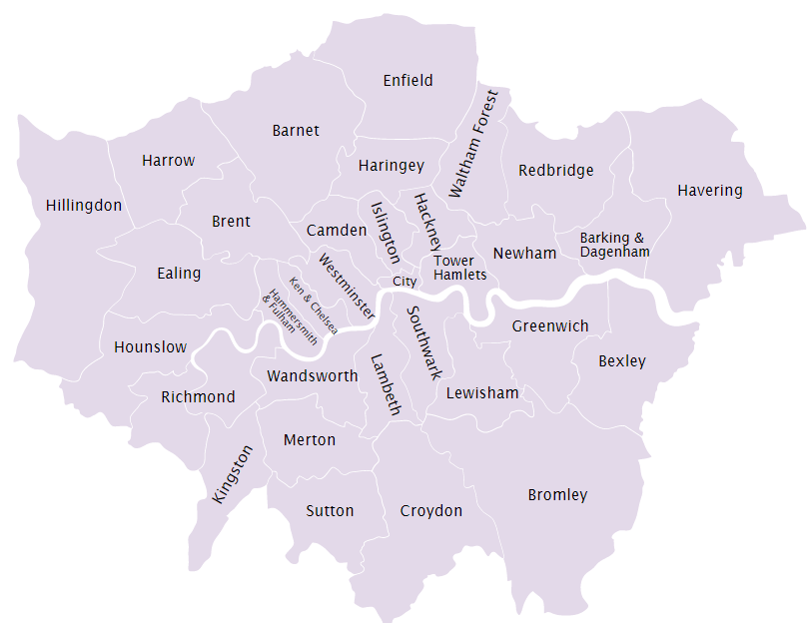
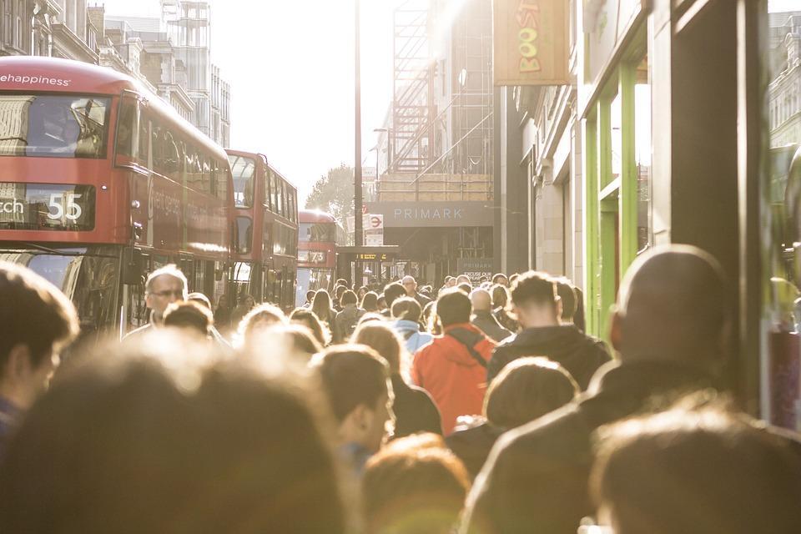
London is a large and diverse city, and so gambling risk profiles will differ across and within boroughs
London has an estimated population of 8.8million in 2021, making it the largest city in Western Europe[1].
The capital has seen an increase of 7.7% since 2011, with Tower Hamlets experiencing the largest increase 22.1% of any London borough and of any local authority in England and Wales. Other Local Authorities reporting the biggest percentage increases were Barking and Dagenham, the City of London, Newham and Greenwich, all of which recorded population growth of more than 10 per cent from 2011 to 2021.
There were three recorded falls in London: Camden (-4.6%, Westminster (-6.9%) and Kensington & Chelsea (9.6%) [1,2].
It is estimated that the London population will rise to around 9.7-10.4 million by 2041 [3].
Local Authorities in London
London is one of the most diverse cities in the world:
More than 300 languages are spoken every day in London [4],
In 2019, London had the largest non-white population in England and Wales, with a White British population of 43.3% compared to 78.4% across England and Wales overall [5],
2020 estimates suggest 62% of Londoners identify as religious compared to 53% across the rest of Britain excluding London [6],
In May 2021, 3.3% of working-age Londoners claimed ESA or another incapacity benefit [7],
And London has consistently been named the most unequal region in Britain, in terms of wealth inequality [8].
Notes:
[1] Population and household estimates, England and Wales: Census 2021 - Office for National Statistics (ons.gov.uk) [2] 2011 Census - Office for National Statistics (ons.gov.uk) [3] Trend-based population projections – London Datastore
[4] 20 facts about London’s culture | LGOV
[5] Population estimates by ethnic group and religion, England and Wales - Office for National Statistics (ons.gov.uk)
[6] Religious London - Theos Think Tank - Understanding faith. Enriching society.
[7] Disabled People | Trust for London, data sourced from: Benefit Combination via Stat-Xplore, DWP Mid-year population estimates via NOMIS, ONS
[8] Analysing regional economic and well-being trends - Office for National Statistics (ons.gov.uk)
Image: London City - Free photo on Pixabay
Map: London Government Directory (londoncouncils.gov.uk)

Slide 6
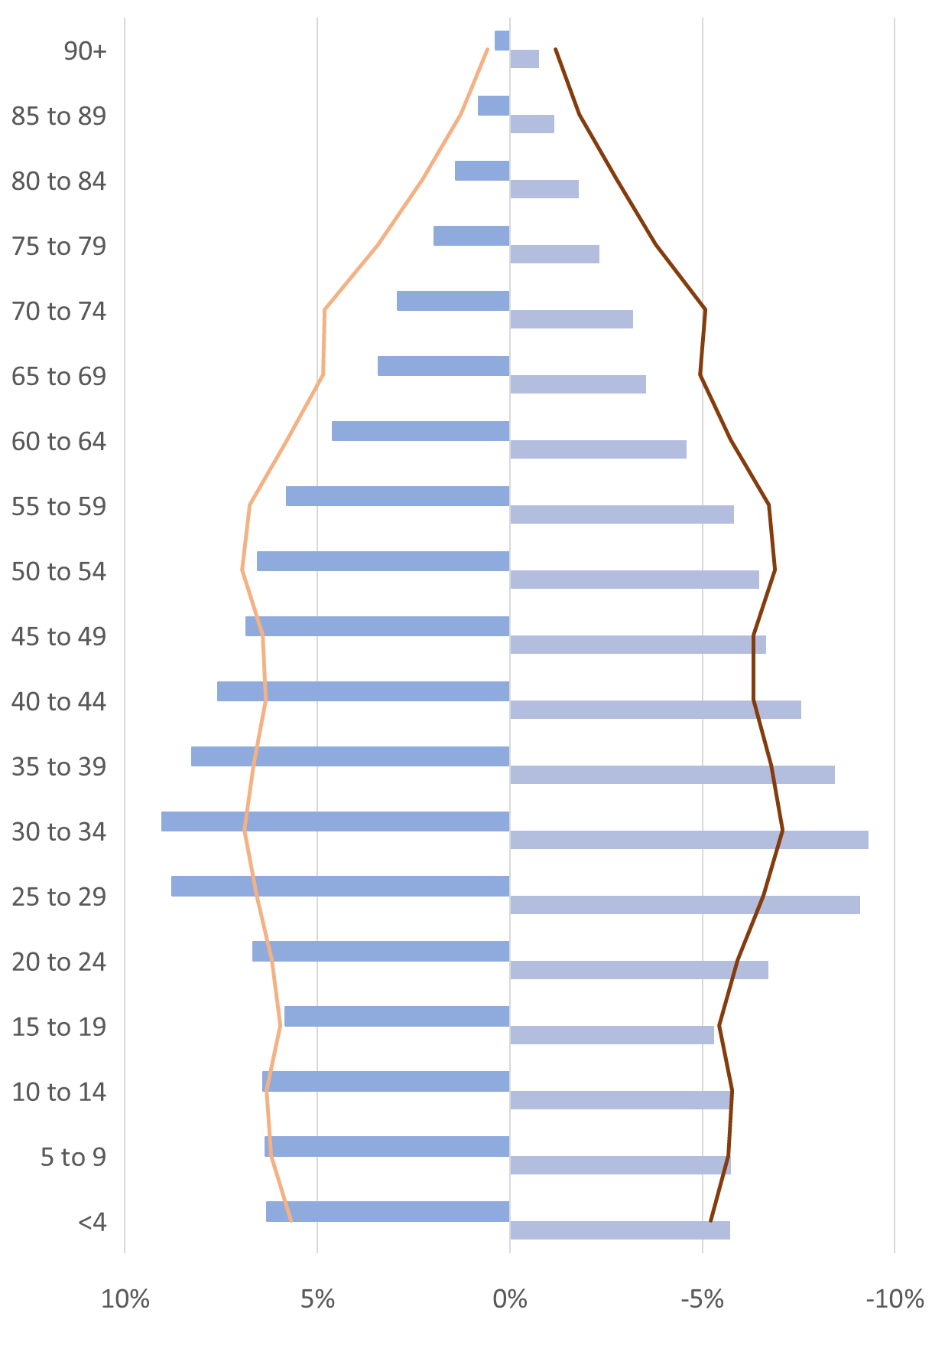
London’s younger population puts the region at particular risk of problematic gambling behaviours
Population age profile, Usual Resident population 2021 [1]
Impact of COVID-19
There is limited research to conclude the impacts of COVID-19 on gambling behaviours in the UK. However, a rapid review conducted by Public Health England suggests that younger males were the most likely to increase gambling activities during COVID-19 lockdowns [5].
London’s population profile differs to the rest of England:
The top 20 most densely populated local authorities in the country are in London,
Londoners are much younger than the rest of the country, generally due to economic migration both nationally and internationally, of people in their 20s and 30s,
The older population in London is relatively small, as people migrate away throughout the life course – particularly when starting a family and at retirement age, and
Population profiles vary between local authorities [2].
In 2018, the Health Survey for England indicated that men are more likely to participate in gambling than women, and those most likely to participate in gambling are between 25-34 year olds [3]. In particular, younger males are more likely to be classed as at-risk or problem gamblers [4], and being male is a more significant predictor of problematic gambling behaviours than economic factors including income, employment and relative deprivation.
This is of particular concern to the London gambling risk profile given the relatively large proportion of 25-34 year old males compared to other regions.
There are other population groups that warrant attention due to the harms that gambling can cause, in particular, women, children and young people [6] and the homeless population.
There were over 8,000 rough sleepers in London between April 2021 and March 2022 [7], and in 2021, there were 59,492 households in temporary accommodation [8]. The current cost-of-living crisis is likely to increase homelessness in London, and may therefore increase problematic gambling in the city.
10%
5%
0%
5%
10%
Perpetuates existing inequalities
Notes:
[1] Population and household estimates, England and Wales: Census 2021 - Office for National Statistics (ons.gov.uk)
[2] 2021 Census – London Datastore
[3] Gambling Commission publishes latest combined Health Survey - Gambling Commission
[4] Young Adults and Gambling | Safer Play | For the Public | Responsible Gambling Council
[5] The impact of COVID-19 on gambling behaviour and associated harms (publishing.service.gov.uk)
[6] Young People and Gambling 2022 - Gambling Commission
[7] Homelessness facts and statistics: The numbers you need to know in 2022 - The Big Issue
[8]Temporary accommodation types | London's Poverty Profile | Trust for London

Slide 7
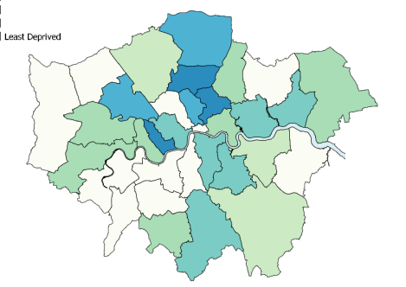
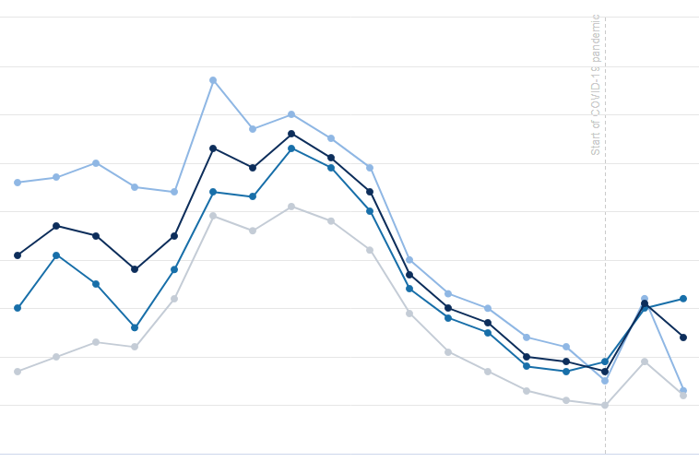
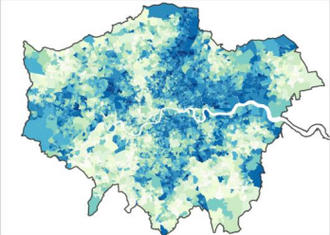
Socioeconomic factors increase the risk of problematic gambling for some Londoners
Distribution of the Index of Multiple Deprivation (IMD) 2019 by LSOA in London [1]
Unemployment rate over time (2004/05 Q1 – 2021/22 Q1) [2]
Problematic gambling is more prevalent in areas of greater deprivation [2].
According to the IMD2019, only three London Boroughs are ranked in the most deprived three deciles (Hackney, Haringey Kensington and Chelsea). However, pocket-deprivation exists; 107 LSOAs, or neighbourhoods, in London are in the most deprived decile nationally [1].
There are several areas with clusters of neighbourhoods that are highly deprived. These include parts of inner London, particularly around Tower Hamlets, Hackney and Islington, parts of East London and the western side of the Lea Valley up into Enfield.
The view of deprivation at different levels of geography can tell different stories. However, it is clear that there are pockets of deprivation throughout London, where communities and individuals may be at a higher risk of problematic gambling due to socioeconomic factors.
12
11
Start of COVID-19 pandemic
10
9
8
Unemployment rate for those aged 16 or over (%)
7
6
5
Least Deprived
Most Deprived
4
3
2004/5
2021/22
A paradox of harm exists in relation to unemployment, in that those who are unemployed are less likely to participate in gambling, but more likely to experience at-risk or problematic gambling compared to those in employment or training [3].
The unemployment rate in London has been consistently higher than the national average since 2004/5 [4], and so problematic gambling is a particular risk for this population.
Notes:
[1] The English Indices of Deprivation 2019 (publishing.service.gov.uk)
[2] Gambling-related harms evidence review: summary - GOV.UK (www.gov.uk)
[3] Risk Factors for Gambling Problems: An Analysis by Gender - PMC (nih.gov)
[4] Unemployment rate | Trust for London based on data from the Annual Population Survey, ONS via NOMIS

Slide 8
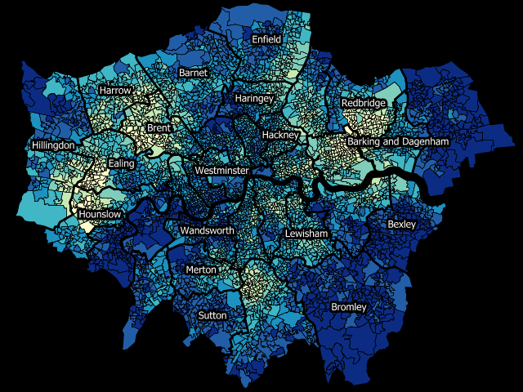
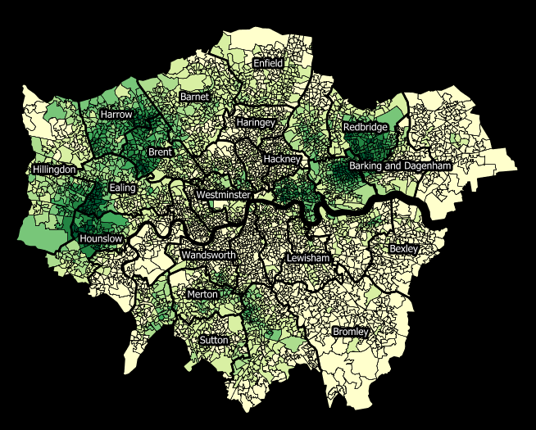
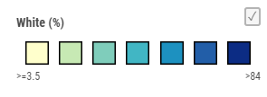
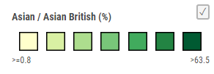
Some ethnic groups are at a higher risk of problematic gambling than others, which may be driven and compounded by socioeconomic disadvantage
White ethnic group (%) by LSOA in London [1]
Asian/Asian British ethnic group (%) by LSOA in London [1]
Participation in any gambling activity is most common in White and White British ethnic groups and least common in Asian and Asian British ethnic groups, however there is a paradox of harm regarding the Asian and Asian British group, as they are more likely to experience problematic gambling than the White and White British group [2].
In 2019, London had the largest non-white population in England and Wales, with an estimated White British population of 43.3% compared to 78.4% across England and Wales overall [3].
There are approximately 3.6m adults from ethnic minorities in the London, including 1.7m adults from the Asian and Asian British ethnic group [4]. In addition, there are higher proportions of ethnic minority populations in areas of higher deprivation, meaning multiple and/or intersecting disadvantage may put some individuals and communities at a higher risk of problematic gambling [5].
8
Notes:
[1] Ethnicity - Interactive Web Map (mangomap.com)
[2] Gambling in Asian Communities in Great Britain | SpringerLink
[3] Population estimates by ethnic group and religion, England and Wales - Office for National Statistics (ons.gov.uk)
[4] Ethnic Groups by Borough – London Datastore
[5] People living in deprived neighbourhoods - GOV.UK Ethnicity facts and figures (ethnicity-facts-figures.service.gov.uk)

Slide 9
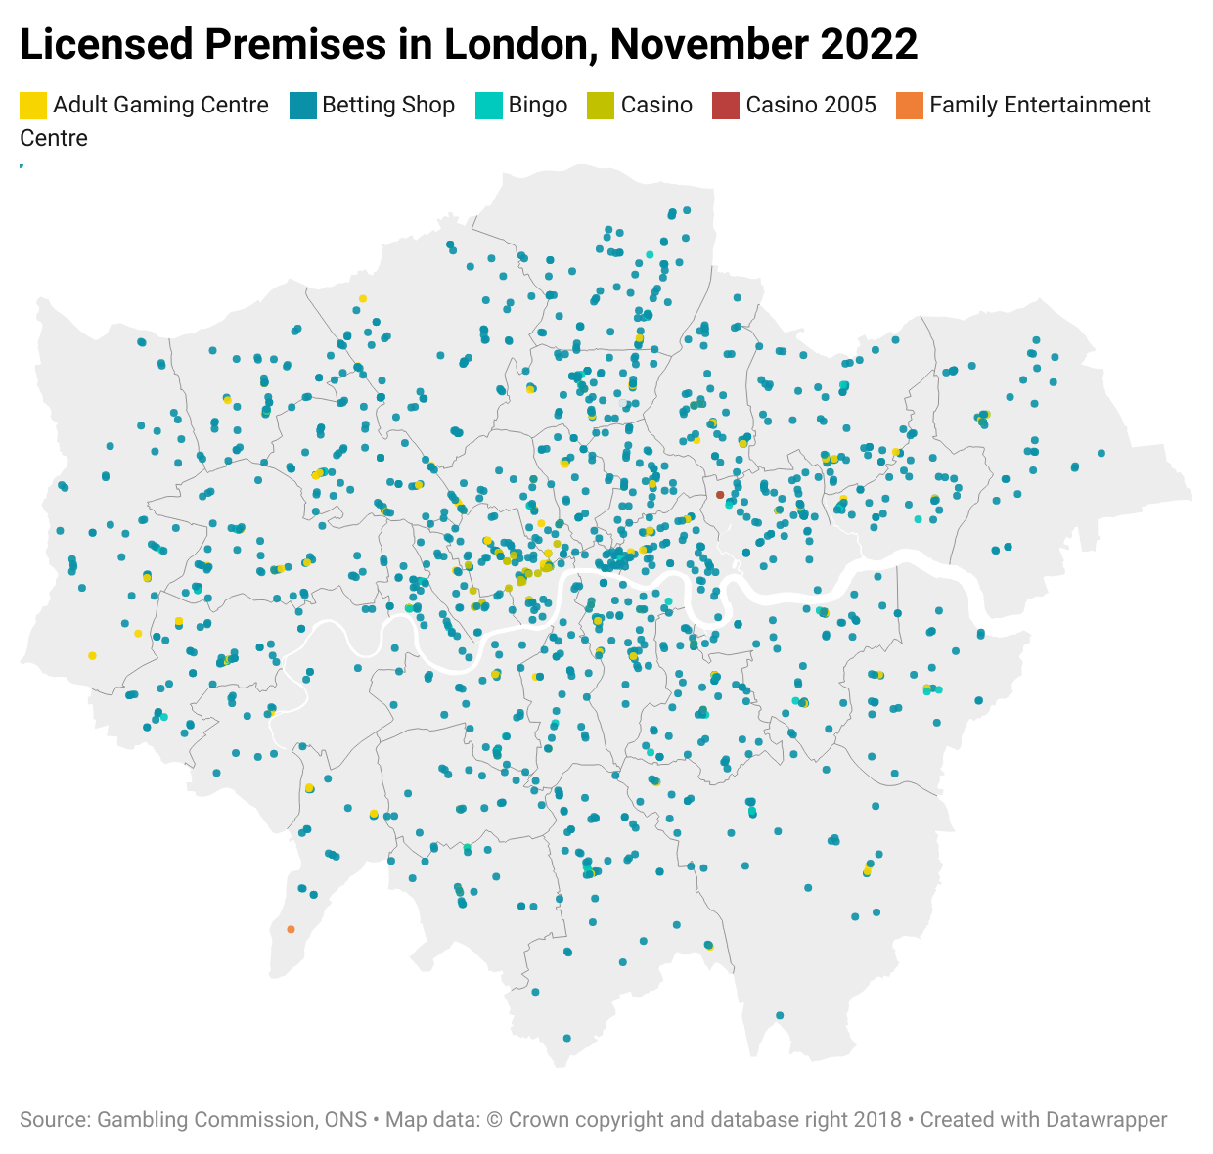
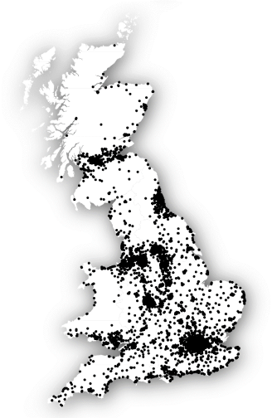
The high concentration of licensed premises in London presents a unique contextual challenge for the region
Licenced Premises in Britain, November 2020 [1]
Licenced Premises in London, November 2022 [2]
Licenced Premises per 1,000 population,
UTLAs in London, November 2022 [2]
The City of London has a particularly high concentration of licensed premises, at 2.8 per 1,000 residents [2], though it should be noted that not all customers of these premises will be London residents, particularly in the City of London where the weekday population can jump by over 50 times its resident population [5].
Whilst a relationship between higher prevalence of opportunities to gamble and deprivation has been found nationally [1], a linear relationship is not observed in the capital at a Local Authority level [2].
Between 2009 and 2021, the Gambling industry is reported to have shrunk by 18% in terms of licensed activities, and 36% in terms of the number of licensed operators [3]. Regional time series data is unavailable.
London has a high concentration of licensed premises for gambling compared to other regions [1], with 1,528 registered premises in November 2022, of which 1,321 are betting shops [2]. Not only does this put the general public at risk, but also those working in these establishments, as it has been found that employees of gambling premises are at higher risk of problem gambling [4].
Notes: based on licensing data submitted by local licensing authorities to the Gambling Commission. While licensing authorities should inform the GC of closures ‘as soon as is reasonably practicable’, it is likely that some closures take time to be reflected in the data.
Notes:
[1] Geography of gambling premises (bristol.ac.uk)
[2] OHID London analysis based on Licensing Authority Statistics 2021 to 2022 - Gambling Commission
[3] Industry Statistics – July 2022 Revision - Gambling Commission
[4] Supporting Gambling Industry Employees: Safer Gambling Policy - GamCare Safer Gambling Standard
[5] More than 350,000 people flock to the City every day (cityam.com)
Maps produced using Datawrapper: Datawrapper: Create charts, maps, and tables

Slide 10
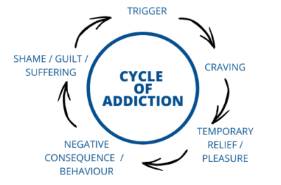
Public health priority areas such as mental health and substance misuse are central to gambling risk in London
The Cycle of addiction [1]
Gambling harm has been linked with substance misuse disorders and other behavioural addictions, which may be partially due to common underlying issues and risk factors such as mental ill-health [5].
The most consistent association is with alcohol addiction; a PHE review of the harms of gambling concluded there is a clear association between gambling at all levels of harm and increased alcohol consumption. The association is greater for at-risk and problem gambling [2].
Whilst alcohol related mortality is lower in London than England overall [6], these remain areas of public health concern for the region. The highest rates tend to be in inner boroughs such as Islington and Hackney, and the lowest rates were in outer boroughs like Redbridge and Richmond upon Thames [7].
Whilst those will poorer mental health are less likely to gamble in general, poor mental health is a stronger predictor of at-risk gambling than both poor physical health and negative health behaviours, with the notable exception of alcohol [2].
In 2017, jus under 20% of Londoners aged 16 and over were estimated to be living with a common mental health disorder [3]. It is likely this will have been impacted by the COVID-19 pandemic, and will continue to be impacted by the current cost-of-living crisis, but to what extent is unclear.
It is the reinforcing cycle of problem gambling and mental ill-health that pose further risk to individuals; those experiencing gambling-related harms are at least four times more likely to have suicidal thoughts than those not experiencing gambling-related harms [4].
Alcohol dependence prevalence in 2018 to 2019 by local authority [7]
Notes:
[1] Alcohol Addiction - Thomas McGowan Therapy - Addiction Specialist (thomas-mcgowan.co.uk)
[2] Gambling-related harms evidence review: summary - GOV.UK (www.gov.uk)
[3] Public Mental Health Dashboard, OHID: https://app.powerbi.com/view?r=eyJrIjoiN2Y2NjFiOWUtOWZiOS00OGY5LTk5ZDEtMzQ3YWM0OGRjMGJhIiwidCI6ImVlNGUxNDk5LTRhMzUtNGIyZS1hZDQ3LTVmM2NmOWRlODY2NiIsImMiOjh9
[4] Samaritans_Gambling_Harms_Guidance.pdf
[5] Gambling Disorder and Other Behavioral Addictions: Recognition and Treatment - PMC (nih.gov)
[6] Public health profiles - OHID (phe.org.uk)
[7] Adult substance misuse treatment statistics 2020 to 2021: report - GOV.UK (www.gov.uk)

Slide 11
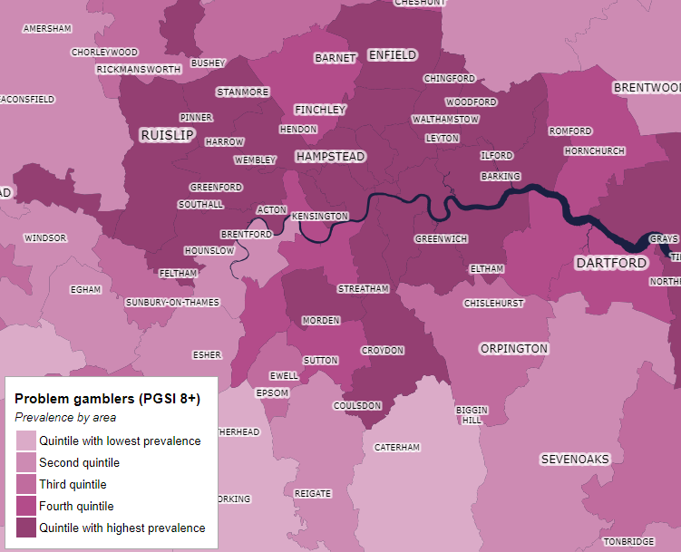
Gambling prevalence is estimated as being relatively high in London, compared to other areas in Great Britain
The screening tools that are most commonly used for gambling are the Diagnostic and Statistical Manual of Mental Disorders, 4th version (DSM-IV) and the Problem Gambling Severity Index (PGSI). The questions asked in these tools can be found in the appendix. The PGSI defines levels of gambling as:
Non-problem gambler: Gamblers who gamble with no negative consequences.
Low-risk gambler: Gamblers who experience a low level of problems with few or no identified negative consequences.
Moderate risk: Gamblers who experience a moderate level of problems leading to some negative consequences.
Problem gambler: Gambling with negative consequences and a possible loss of control.
GambleAware and University College London have worked together to model gambling prevalence at each level of severity, providing a picture of how prevalence is spread across Great Britain in relative terms [1].
The map shown here provide some indication that there are relatively high levels of problem gambler prevalence in local authorities in London, compared to local authorities around Great Britain.
In fact, all but one London local authority are in the lowest quintile for non-problem gambler prevalence, which supports evidence presented in these slides, in that across London, all local authorities should be considering gambling as a risk to population health.
It is important to also consider gambling related harm, which impacts more than just those partaking in problem gambling behaviours, including the families and friends of problem gamblers. It is likely therefore, that prevalence of gambling related harm will be even greater.
It is recommended (1) that each local authority use local data to estimate absolute prevalence, (2) national data collections to routinely include gambling prevalence, (3) that analysis be undertaken to understand contributions of different risk factors to problem gambling in London.
Problem gamblers (PGSI 8+), Prevalence by area [1]
Notes: Unfortunately, absolute prevalence data for local authorities is not routinely collected, and due to small sample sizes used in the modelling presented here, it is not possible to specify the prevalence of problem gamblers in each local authority.
Notes:
[1] GambleAware GB Maps | BeGambleAware

Slide 12
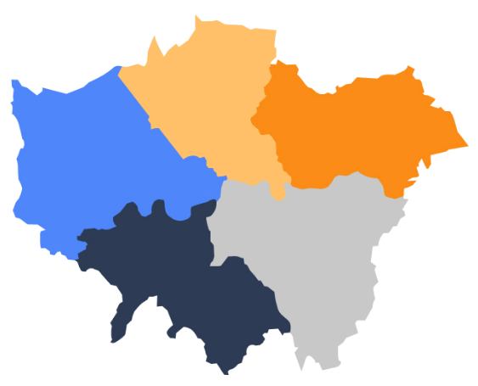
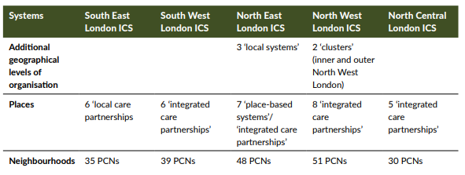
London’s complex health system presents challenges for local service delivery partnerships
Footprint and approximate populations of Integrated Care Systems [1] in London
Integrated care systems (ICSs) are partnerships of organisations that come together to plan and deliver joined up health and care services, and to improve the lives of people who live and work in their area. Following several years of locally led development, recommendations of NHS England and passage of the Health and Care Act (2022), 42 ICSs were established across England on a statutory basis on 1 July 2022 [1].
The demographics and institutional systems of London make it unique in the challenges it faces, both health related and otherwise. A large number of organisations play a role in our health and social care system, including:
33 Local Authorities,
5 Integrated Care Systems,
NHS commissioners,
NHS providers,
Voluntary sector organisations, and
The Mayor of London and the Greater London Authority (GLA) [2].
In 2017, London Partners secured a devolution deal with national government to improve health and care across the city, giving local leaders more control over key decisions [2,3].
Within each ICS, there are further local partnerships [2]:
North Central London
12 NHS Trusts &
5 councils:
Barnet,
Camden,
Enfield,
Haringey,
Islington
North East London
5 NHS Trusts &
8 councils:
Barking & Dagenham,
City of London,
Hackney,
Havering,
Newham,
Redbridge,
Tower Hamlets,
Waltham Forest
North West London
8 NHS Trusts &
8 councils:
Brent,
Ealing,
Hammersmith and Fulham,
Harrow,
Hillingdon,
Hounslow,
Kensington and Chelsea,
Westminster
1.5m
2m
2.1m
South West London
10 NHS Trusts &
6 councils:
Croydon,
Kingston upon Thames,
Merton,
Richmond upon Thames,
Sutton,
Wandsworth
South East London
7 NHS Trusts &
6 councils:
Bexley,
Bromley,
Greenwich,
Lambeth,
Lewisham,
Southwark
1.5m
1.8m
Notes:
[1] NHS England » What are integrated care systems?
[2] Integrated care systems in London: Challenges and opportunities ahead (kingsfund.org.uk)
[3] https://www.london.gov.uk/programmes-strategies/health-and-wellbeing/london-health-and-care-devolution/what-health-and-care-devolution-means-london#:~:text=The%20London%20Health%20and%20Care,improvements%20to%20health%20and%20care.
Map: Stotles

Slide 13
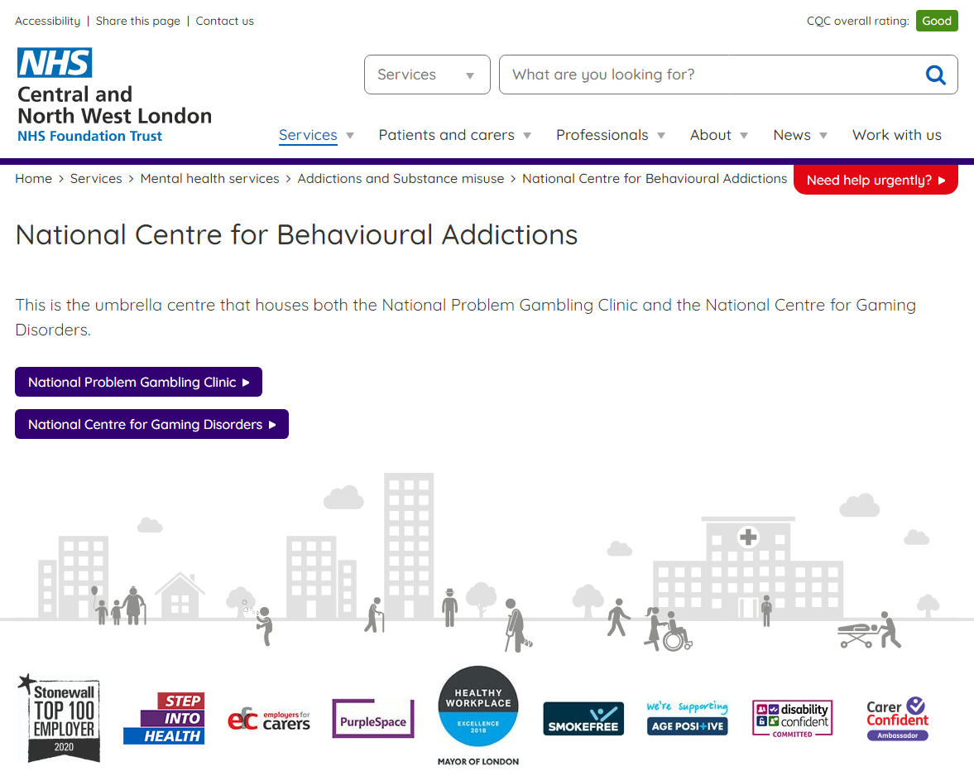
Gambling Treatment and care services in London are provided through a variety of organisations and schemes, reflecting the complexities of the wider health and care system
Gambling Treatment Services in London
One of seven National Problem Gambling Clinics is funded by the Central and North West London NHS Foundation Trust, based in Earl’s Court (SW5), and treats people living in England aged 13 and over who are experiencing gambling harms [1].
National Gambling Treatment Service service providers differ across London, and are not necessarily consistent across each ICS. Service providers include: BKM Goals, Breakeven, Derman and GamCare [2].
The Primary Care Gambling service supports GP surgeries to ensure adults with problems related to gambling are supported by multidisciplinary teams of mental health nurses, GPs, treatment practitioners and therapists [3].
Self-exclusion schemes are available for individuals to self-exclude from both land-based and online gambling [4].
There are also Voluntary and Charity sector organisations who offer help and advice to those requiring support [5].
Notes:
[1] National Problem Gambling Clinic :: Central and North West London NHS Foundation Trust (cnwl.nhs.uk)
[2] GambleAware GB Maps | BeGambleAware
[3] New Primary Care Gambling Service Launched in London - GamCare
[4] Free multi operator and national self-exclusion schemes - Gambling Commission
[5] Organisations that can help - Gambling Commission

Slide 14
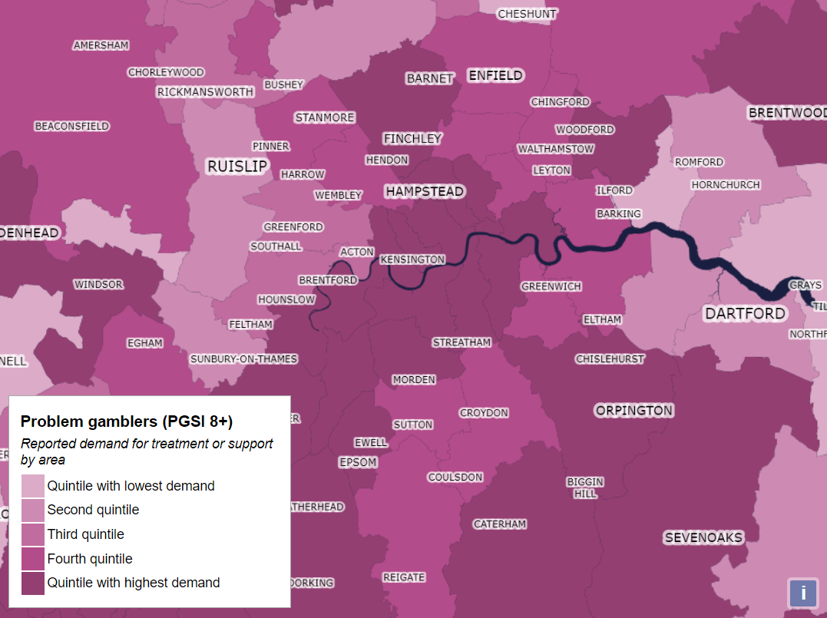
Patterns of reported service demand across London do not reflect estimated prevalence
Problem gamblers (PGSI 8+), Prevalence by area [1,2]
Problem gamblers (PGSI 8+), Reported demand for treatment or support by area [1,2]
Estimates presented by GambleAware and University College London for the reported demand for treatment or support by local area do not reflect the pattern of estimated problem gambler prevalence. Demand includes individual desire for any form of treatment, advice or support, where data has been collected by YouGov through an online survey [2].
Further analysis is required to understand why this may be, including whether the following may have an impact:
Distribution of services
Health seeking behaviours among problem gamblers
Notes:
[1] GambleAware GB Maps | BeGambleAware
[2] gambling-treatment-and-support.pdf (begambleaware.org)

Slide 15
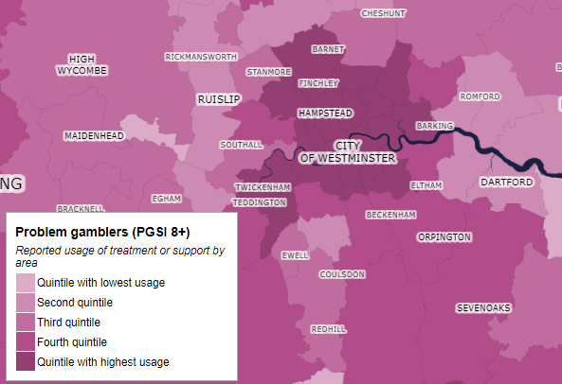
Patterns of reported service usage across London do not reflect estimated prevalence or demand
Problem gamblers (PGSI 8+), Prevalence by area [1,2]
Problem gamblers (PGSI 8+), Reported usage of treatment or support by area [1,2]
Estimates presented by GambleAware and University College London for the reported demand for treatment or support by local area do not reflect the pattern of estimated problem gambler prevalence. Usage includes usage of treatment services and less formal support and advice, where data has been collected by YouGov through an online survey [2].
Further analysis is required to understand why this may be, including whether the following may have an impact:
Distribution of services
Health seeking behaviours among problem gamblers
Notes:
[1] GambleAware GB Maps | BeGambleAware
[2] gambling-treatment-and-support.pdf (begambleaware.org)

Slide 16
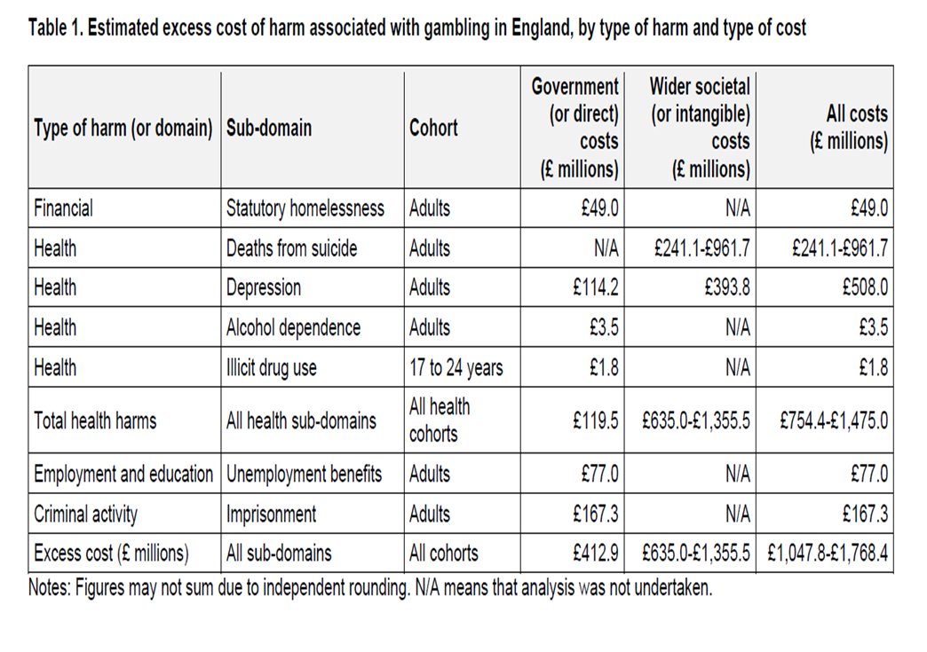
Estimated excess costs of harm associated with gambling in England
]
The areas of harm costed are:
•
Notes:
The areas of harm costed are:
• deaths by suicide (impacts on health) and depression (impacts on health and healthcare costs);
• the report also sets out the cost of homelessness (applications);
• alcohol dependence and illicit drug use;
• unemployment and imprisonment
Our 2023 economic analysis estimated that the annual excess direct financial cost to government associated with harmful gambling is equivalent to £412.9 million. It also shows that our estimate for the annual societal value of health impacts is equivalent to between £635.0 and £1,355.5 million (in 2021 to 2022 prices). This provides a combined estimate of approximately £1.05 to £1.77 billion.
This is likely to be underestimated due to a lack of available evidence, which means that some identified harms have been only costed partially (financial, health, employment and education, crime), while others have not been costed at all (cultural harms and impact on relationships). Table 1 shows an overview of costs.

Slide 17
Summary
It is difficult to summarise the needs of London; each borough has a unique population profile, health profile, and services available.
However, the data and evidence presented in this pack demonstrate that most, if not all, local authorities in London will have individuals and communities at higher risk of at-risk and problem gambling than others, and strategies to tackle gambling as a public health issue require thorough data and evidence and targeted action. What this information does not identify is specific areas with high levels of need, or specific risks where action must be taken.
An important element of preparing a local area profile is proactive engagement with responsible authorities as well as other organisations in the area that can input; the information presented here only scratches the surface of what London partners understand of gambling as a public health issue across London, and should be further developed through conversation with partners.
It is intended that this information and the existing local area profiles of London local authorities (see annex) are used to increase awareness of regional and local risks, and improve information sharing across the region. These area profiles can facilitate constructive engagement with partners and a regional view sets the stage for a more coordinated response to risks across the city. However, there is no mandate for local areas to produce local area profiles.
Gaps in our knowledge
Online vs offline gambling activity in London
Why do people in London gamble?
How is gambling changing over time in London?
What are the perceptions held of gambling in London?
Impacts on affected others in London
A regional view of Young people and gambling
Recommendations:
For Local Authorities and ICSs to produce a local area profile, as recommended by the Gambling Commission
To continue this conversation in the coming months, to identify how best to move forward at a local and regional level.
To review the latest HSE data available in 2023
For improvement of gambling data and intelligence to be considered by pan-London partners, feeding into potential regional work.
For further insights to be gathered through conversation with communities and those affected by gambling, to understand pathways to problematic gambling and barriers to treatment, care and recovery in London specifically.

Slide 18
Acknowledgements:
The information presented here is largely guided by work undertaken by the OHID Midlands regional team, and the Greater Manchester Combined Authority.
Key resources:
Gambling Commission website - Gambling Commission
GambleAware GB Maps | BeGambleAware
A 'Whole Council' Approach to Gambling | London Councils
Understanding gambling related harms - Greater Manchester Combined Authority (greatermanchester-ca.gov.uk)

